Slide 1

IUCN WCPA Transboundary Conservation Specialist Group: activities and plans
Maja Vasilijević
Co-Chair
WCPA Transboundary Conservation Specialist Group
TransParcNet, Bad Schandau, 7-10 June 2016
Transboundary Conservation Specialist Group

Slide 2
IUCN’s Assets
Members
Commissions
Secretariat
Over 1,200 members from 160 countries
States, Government agencies, NGOs
Over 60 regional and national committees
Nearly 12,000 voluntary experts in 6 thematic groups
Global pool of science, research and action
Founded in 1948
Nearly 1,000 full-time staff in the HQ and 45 offices wordlwide
Observer at the UN General Assembly
Transboundary Conservation Specialist Group

Slide 3






IUCN Commissions
WCPA World Commission on Protected Areas
SSC Species Survival Commission
CEC Commission on Education and Communication
CEM Commission on Ecosystem Management
CEL Commission on Environmental Law
CEESP Commission on Environmental, Economic and Social Policy
World Commission on
Environmental Law
Transboundary Conservation Specialist Group

Slide 4
Transboundary Conservation
Specialist Group: members
Established in 1997
The only and the largest global network of transboundary conservation specialists
260+ members
Voluntary network of experts
Representing protected area administrations, government agencies, NGOs, international organisations, universities, private foundations

Slide 5

Benefits of membership
Networking - access to the peers from diverse affiliations
Enabled exchange of knowledge, information, experience and advice seeking
Provide opinion on relevant policy documents
Easy communication via e-listserv
Presentation of your work at www.tbpa.net
Contribution to the TB eNEWS
Represent the TBC SG at various events
Provide support for TBC SG’s activities
Cooperate on potential joint projects and publications
Transboundary Conservation Specialist Group

Slide 6
TBC SG Executive Committee
Co-Chairs
Maja VASILIJEVIĆ Kevan ZUNCKEL maja.vasilijevic1@gmail.com kevanzunckel@gmail.com
Vice Chairs
Jamie McCALLUM Tatjana ROSEN Michael SCHOON jmccallum@transfrontier.org trosen@panthera.org michael.schoon@asu.edu
Senior Advisors
Trevor SANDWITH Peter SHADIE trevor.sandwith@iucn.org peter.shadie@iucn.org
Regional Coordinators
East & South Africa Piet THERON piettheron01@gmail.com
West & Central Africa Andrew DUNN adunn@wcs.org
North Africa & West Asia Saleh DADJOUY dadjouy@gmail.com
Asia Rahimatsah AMAT rahimatsah@gmail.com
Central America Olivier CHASSOT ochassot@cct.or.cr
North America & the Caribbean Dorothy ZBICZ dorothy.zbicz@zbicz.net
South America German ANDRADE giandradep@yahoo.com
Europe Boris ERG boris.erg@iucn.org

Slide 7
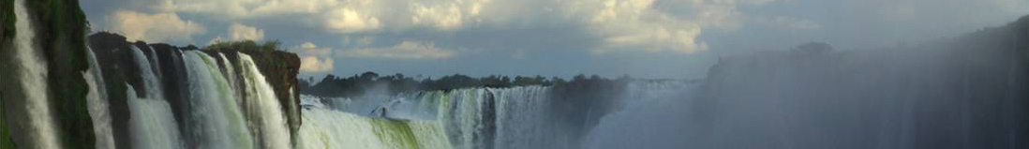
Objectives
Support CBD Parties in delivering the goals and targets of the CBD Programme of Work on Protected Areas
Support transboundary conservation initiatives through improved knowledge management, networking and capacity building
Transboundary Conservation Specialist Group

Slide 8
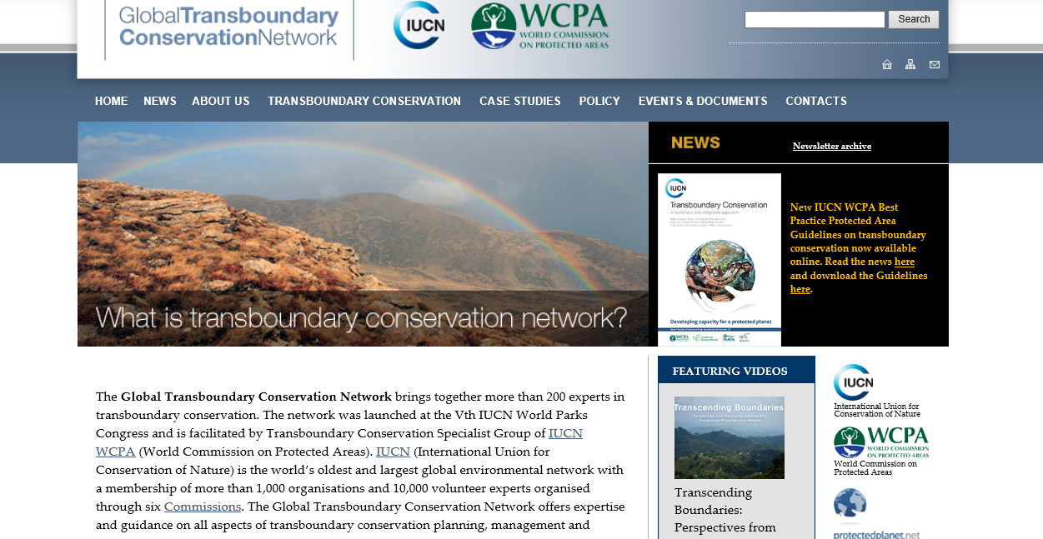
Global Transboundary Conservation
Learning Network www.tbpa.net
Transboundary Conservation Specialist Group

Slide 9
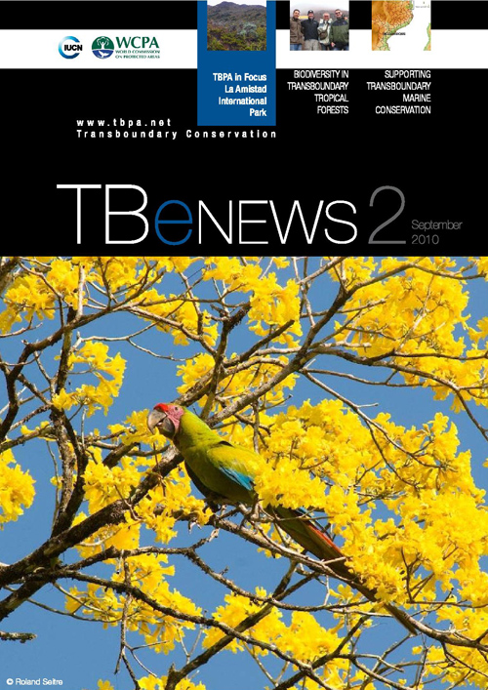
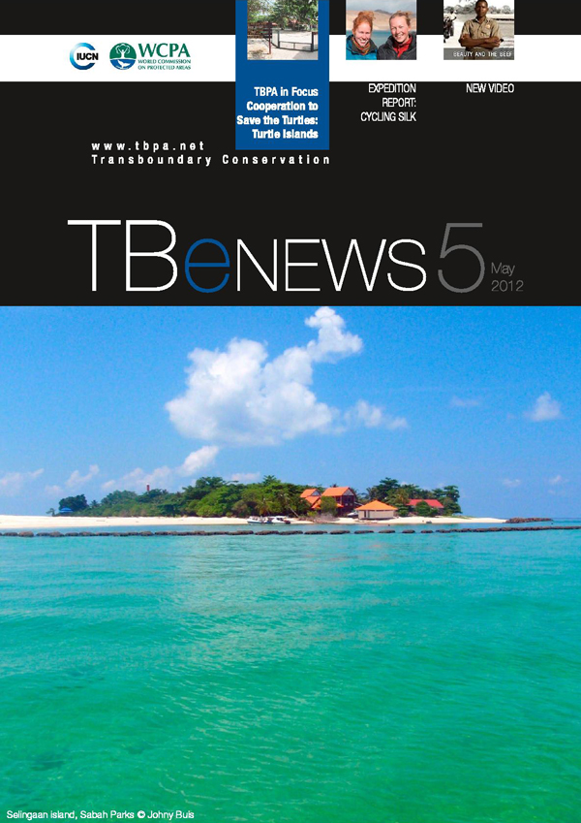
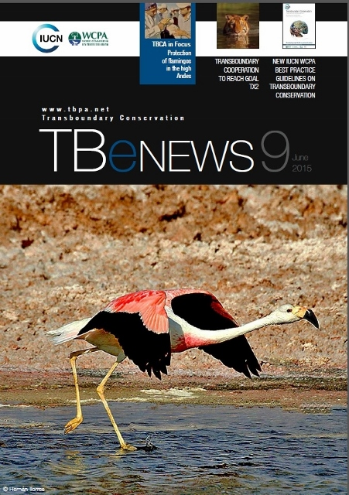
TB eNEWS newsletter
Transboundary Conservation Specialist Group

Slide 10
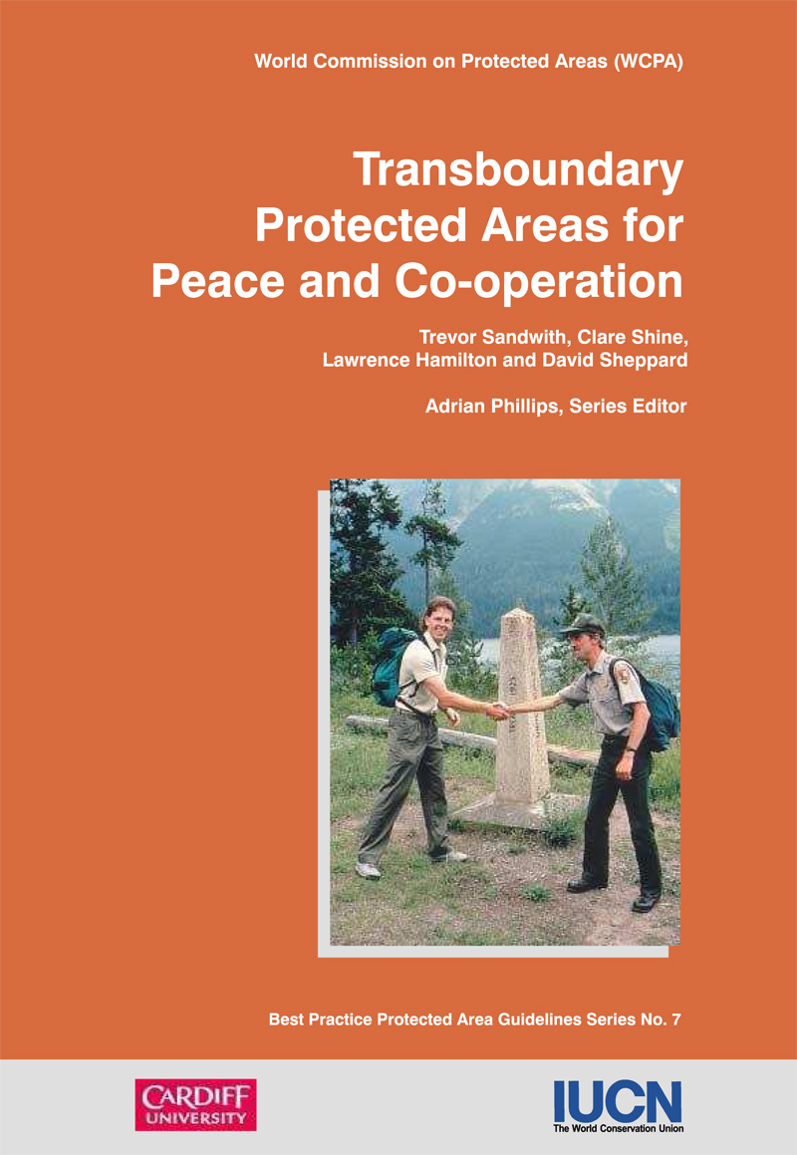
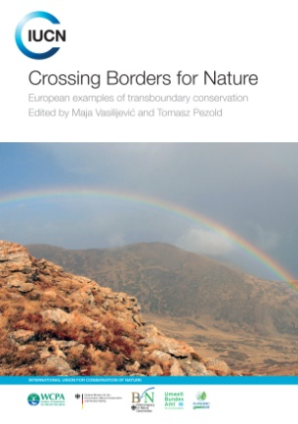
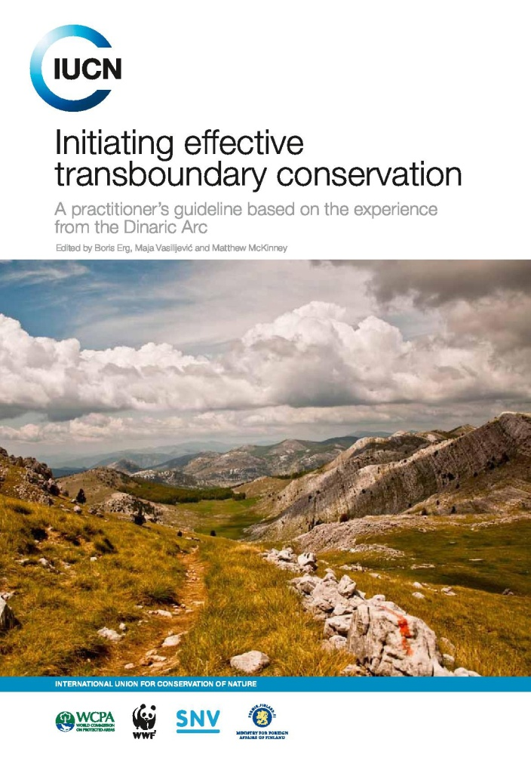
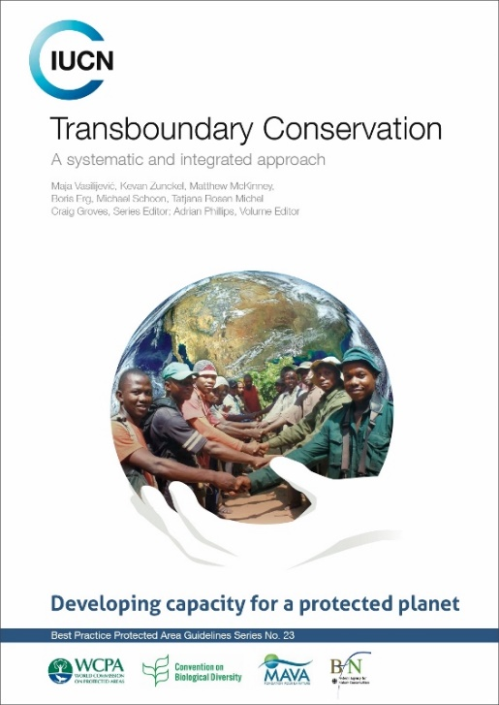
IUCN Guidelines and publications
Transboundary Conservation Specialist Group

Slide 11
Development of new tools:
diagnostic tool for transboundary conservation planners
Assesses:
the need for TBC
readiness of stakeholders to initiate TBC
opportunities that could speed up the process and/or be generated by TBC
risks that could slow the process
‘S’ QUESTIONS: Stakeholders
OPPORTUNITY (‘S3’)
Instructions and results
List the ‘S3’ questions evaluated with 5 points: _______
‘Opportunity’ statements
There are a number of opportunities, namely: _______ (list the ‘S3’ question areas evaluated with 5 points)
RISK (‘S4’)
Instructions and results
List the ‘S4’ questions evaluated with 1 point: _______
‘Risk’ statements
There are a number of risks, namely: _______ (list the ‘S4’ question areas evaluated with 1 point)
Transboundary Conservation Specialist Group

Slide 12
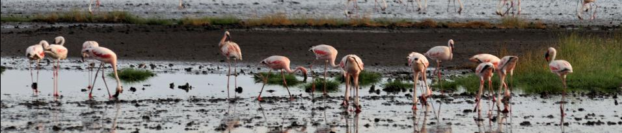
Self-assessment component
(1) Compelling reason for transboundary conservation
(2) Stakeholders
(3) Geographic reach, regional stability and complexity
(4) Capacity
Final product: a narrative report that presents the answers in a summarized way and helps in planning the initiative more efficiently
Transboundary Conservation Specialist Group

Slide 13
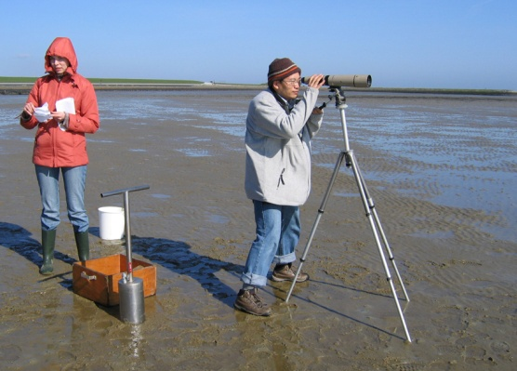
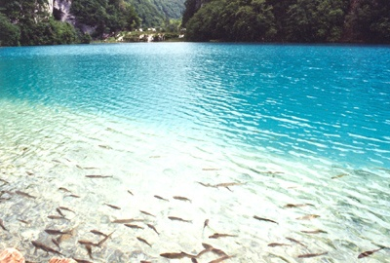
Further steps for the diagnostic tool
Translate to other global languages
Test in different regions and a variety of ecosystems
Develop new multilingual edition
Develop a web portal
Evaluate global potential for transboundary conservation
Transboundary Conservation Specialist Group

Slide 14
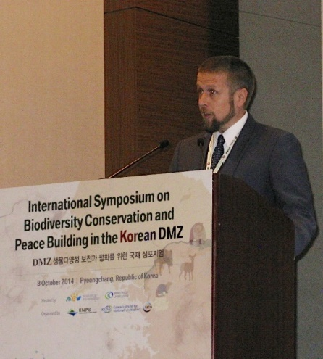
Advisory role
Provide advice on TBC establishment, management and process to planners and managers
Develop statements and policy recommendations of global and regional importance
(e.g. A Statement on Transboundary Conservation for Biodiversity
and Peace, CBD COP12; Promise of Sydney – Governance Stream,
WPC, Sydney, 2014, Razor wire and nature in Europe, 2015)
Transboundary Conservation Specialist Group [...] raises serious concern about erection of the razor wire fence which has already proven to harm the wildlife by exposing it to suffering, and believes that such a fence creates unfavorable conditions for ecological connectivity and the migration of wildlife, including threatened species.
Transboundary Conservation Specialist Group

Slide 15
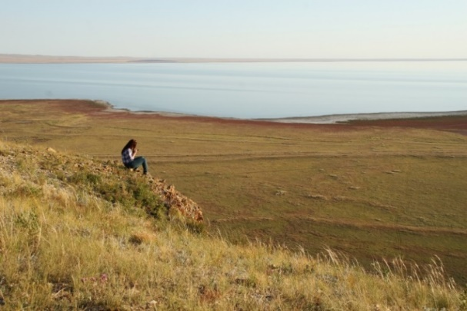
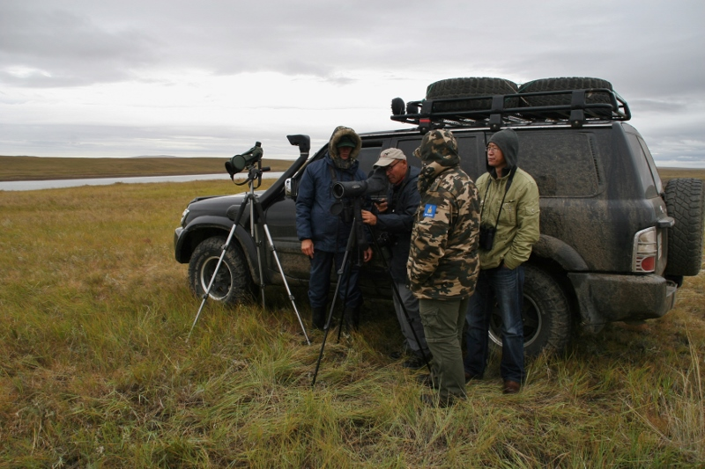
Advisory role
Evaluate transboundary UNESCO World Heritage nominations
(e.g. Dauria Landscapes, Russia/Mongolia, 2014)
World Heritage Conservation Outlook Assessment
Transboundary Conservation Specialist Group

Slide 16
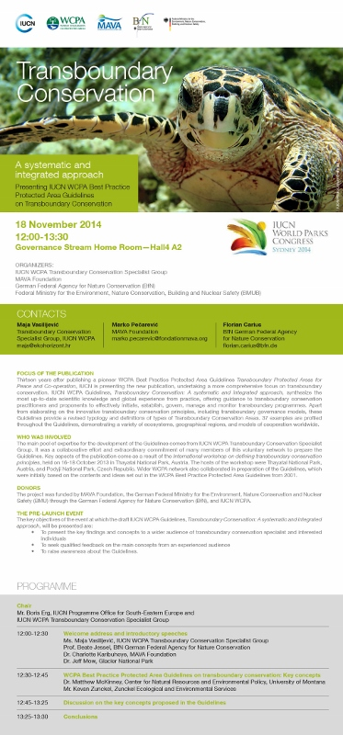
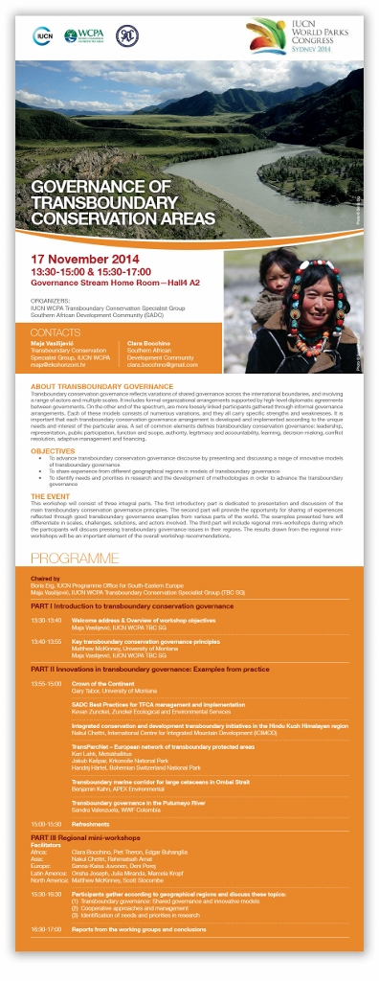
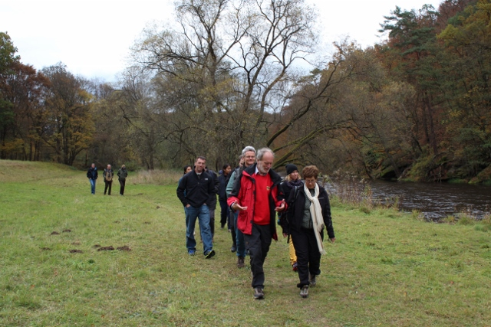
Organization of events
Convene international workshops and events
(e.g. International workshop, Thayatal NP, 2013;
Best Practice Guidelines’ pre-launch, WPC, Sydney, 2014;
Governance of TBCAs, WPC, Sydney, 2014)
Transboundary Conservation Specialist Group

Slide 17






Partnerships
Establish cooperation and partnerships with various institutions
(e.g. Thayatal National Park, Southern African Development Community (SADC),
International Centre for Integrated Mountain Development (ICIMOD), MAVA Foundation,
The University of Montana, Federal Agency for Nature Conservation (BfN), IUCN ECARO)
Transboundary Conservation Specialist Group

Slide 18
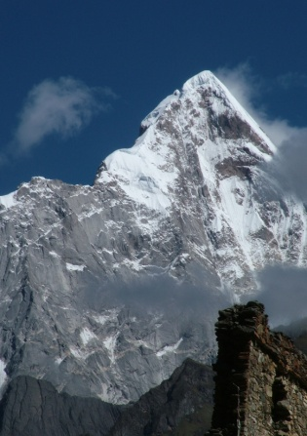
Training development and implementation:
Hands across Borders
13-18 Sept 2016, Glacier NP, Montana, USA
Key purpose of the workshop:
To bring together practitioners from TBC initiatives to build and share knowledge and information, foster relationships and build capacity to enable and sustain TBC efforts
To unpack the IUCN WCPA’s Best Practice Protected Area Guidelines Transboundary Conservation a systematic and integrated approach
To gather feedback from the participants and replicate this pilot project in other regions of the world
Transboundary Conservation Specialist Group

Slide 19








Hands across Borders event
A 3-day workshop for transboundary conservation practitioners
Field trips in Waterton-Glacier International Peace Park (WGIPP)
+
84th WGIPP Assembly + Hands across Borders ceremony

Slide 20
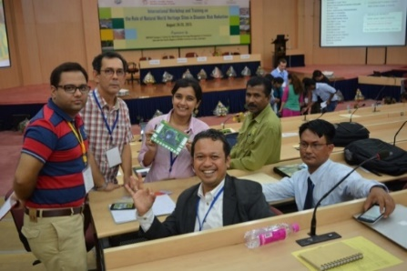
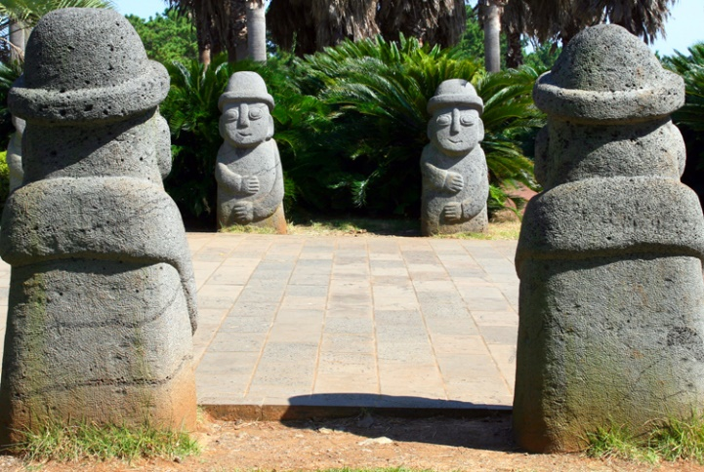
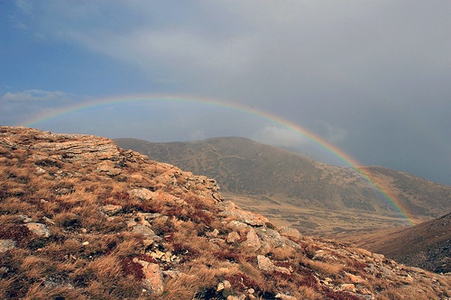
Participation at events
Attend various global, regional and local events where TBC expertise is required
(e.g. World Leaders Conservation Forum, R.Korea, 2015; Capacity Building Workshop for E&SE Asia on Achieving Aichi Target #11, China, 2015; Biodiversity Conservation Challenges in the Asia-Pacific, Thailand, 2015; Little Sydney, Austria, 2015; WPC, Australia, 2014; Strengthening Transboundary Conservation Collaboration Between Nigeria and Cameroon, Nigeria, 2012; Jordan River SIWI, Jordan, 2012; GBIF Science Symposium, R.Korea, 2010; International Conference on Transboundary Cooperation in the Dinaric Arc, BiH, 2010; DMZ Conference, Goseong, 2010)
Transboundary Conservation Specialist Group

Slide 21

IUCN WCPA’s Best Practice Guidelines on
transboundary conservation
Revised, updated, extended
2001
2015
Transboundary Conservation Specialist Group

Slide 22
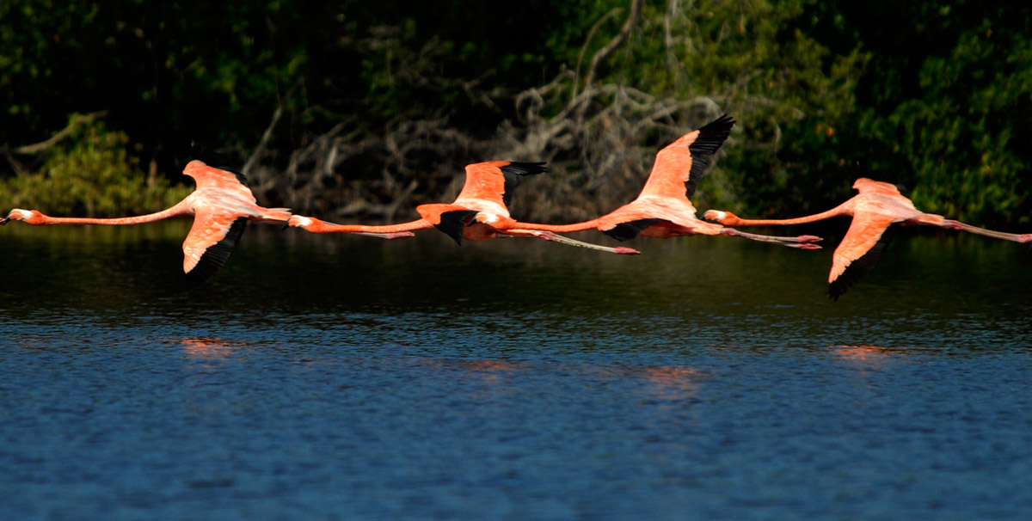
What are IUCN WCPA Best Practice
Protected Area Guidelines? www.iucn.org/pa_guidelines
No ordinary publication
The world’s authoritative resource for protected area managers
One of the key WCPA products
Global standards setting guide
Supports better implementation of conservation action in the field
Builds institutional and individual capacity to manage protected areas effectively
Transboundary Conservation Specialist Group

Slide 23
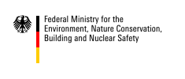

Transboundary conservation BPG: Donors
German Federal Ministry for the Environment, Nature
Conservation, Building and Nuclear Safety (BMUB)
through
the Federal Agency for Nature Conservation (BfN)
MAVA Foundation
WCPA
Transboundary Conservation Specialist Group

Slide 24


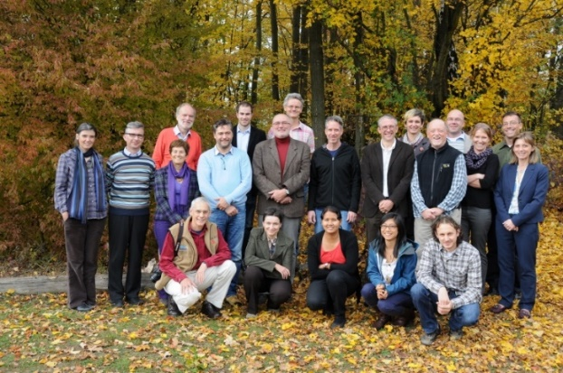
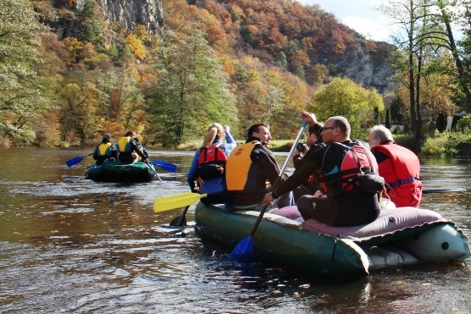
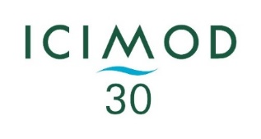
Development of key concepts
An International workshop on defining transboundary conservation principles
16-18 October 2013, Thayatal NP, Austria
Gathered 24 experts from 16 countries, including protected area staff, government officials, NGO representatives, academia and donors
Partnership with the International Centre for Integrated Mountain Development
Transboundary Conservation Specialist Group

Slide 25
Wide participatory approach
Prinipal co-editors and co-authors:
Maja Vasilijević, Kevan Zunckel, Matthew McKinney, Boris Erg, Michael Schoon, Tatjana Rosen Michel
Brahim Abou el Abbes, Rahimatsah Amat, Giorgio Andrian, Kenneth Angu Angu, Taïbou Ba, Tim Badman, Jitendra Bajracharya, Martin Barriteau, Diana Bedoya, Charles Besançon, Paul Bewsher, Florian Carius, Juan E. Bezaury Creel, Duan Biggs, Clara Bocchino, Grazia Borrini-Feyerabend, Alain Brandeis, Robert Brunner, Edgar Buhanga, Tony Bynum, Andy Bystrom, Zhao Chao, Olivier Chassot, Sunita Chaudhary, Nakul Chettri, Rusudan Chochua, Nguyen The Cuong, Jan De Winter, Askar Devletbakov, Emma Doyle, Nigel Dudley, Andrew Dunn, Dominique Endamana, Cristina Eghenter, Wayne Freimund, Wolfgang Fremuth, Ewald Galle, Jean-Marc Garreau, Sonali Ghosh, Nick de Goede, Catarina Grilo, David Grossmann, Craig Groves, Christine Guiness, Ely ould Mohamed el Hadj, John Hanks, Anne Katrin Heinrichs, Elaine Hsiao, Syed Ainul Hussain, Paul Insua-Cao, Boedhihartono Intou, Tilman Jaeger, Shawn Johnson, Harry Jonas, Orisha Joseph, Sanna-Kaisa Juvonen, Benjammin Kahn, Cheikh Tidiane Kane, Vadim Kiriliuk, Elizabeth Koch Ya’ari, Sabine Koenig, Rajan Kotru, Anna Kuhmonen, Kari Lahti, Annette Lanjouw, Michelle Lim, John Lambing, Alois Lang, Yan Lu, Kathy MacKinnon, Salifou Mahamadou, Neeraj Mahar, Marek Majerczak, Paul Martin, Daniela Marzo, Vinod Bihari Mathur, Volker Mauerhofer, Jamie McCallum, Edwin Meru, Stefan Michel, Li Migura, Peter Myles, Servi Nabuurs, Federico Niccolini, Aaron Nicholas, Krishna Prasad Oli, Marco Onida, Gisela Paredes-Leguizamón, Midori Paxton, Marko Pečarević, Fan Pengfei, Tomasz Pezold, Adrian Phillips, Irma Popović Dujmović, Nawraj Pradhan, Michael S. Quinn, Gopal S. Rawat, Johannes Refisch, Lenka Reiterova, Cristian Remus-Papp, Kent Redford, David Reynolds, Tamar Ron, Pedro Rosabal, Patrizia Rossi, Tómaš Rothröckl, Tobias Salathe, Trevor Sandwith, Petra Schultheiss, Harald Schütz, Gabriel Schwaderer, Peter Shadie, Eklabya Sharma, Lhakpa Norbu Sherpa, Andrej Sovinc, Anna Spenceley, Robert Stejskal, David Tiku Okon, Amir Tolouei, Hernán Torres, Yongyut Trisurat, Martin Valašek, Alan Valverde, Antonio Vasilijević, Maxim Vergeichik, Sally Walkerman, Arthur H. Westing, Graeme Worboys, Dorothy Zbicz
Transboundary Conservation Specialist Group

Slide 26


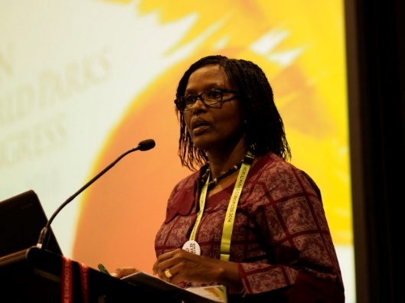
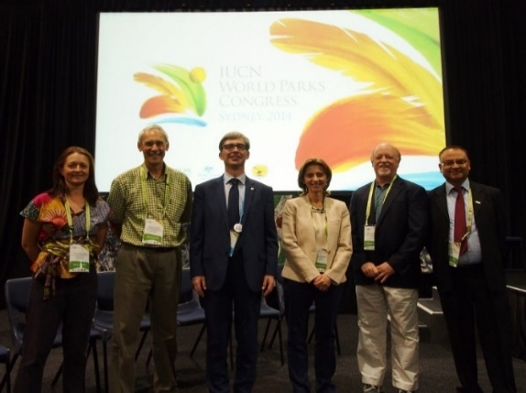
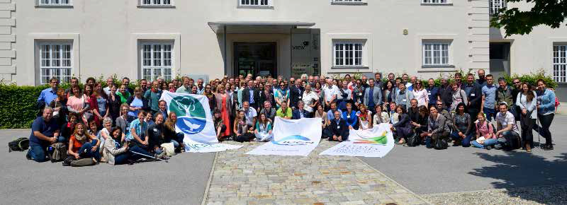
Launch of the IUCN WCPA’s Guidelines
Pre-launch at IUCN World Parks Congress, Sydney, 2014 – concept endorsed
Published in May 2015
Launched at ‘Little Sydney - Protecting Nature in Europe’, Hainburg, 2015
https://portals.iucn.org/library/sites/library/files/documents/PAG-023.pdf
Transboundary Conservation Specialist Group

Slide 27
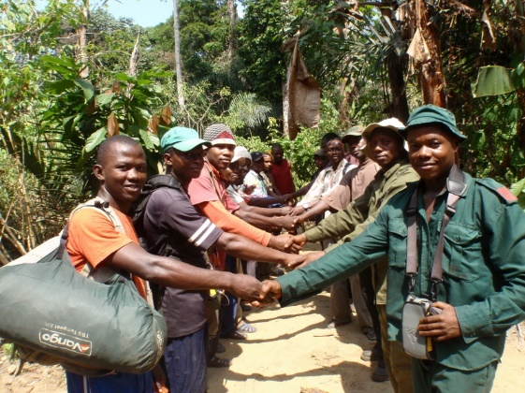
Transboundary Conservation:
a systematic and integrated approach
PART 1.
Understanding transboundary conservation: history and key concepts
Global trends
Definitions and typology
Benefits of transboundary conservation
Transboundary conservation governance
Transboundary Conservation Specialist Group

Slide 28
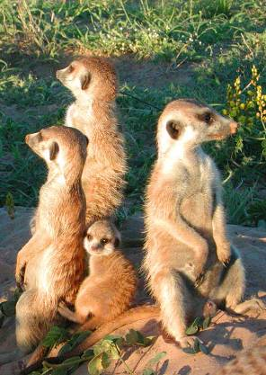
WCPA’s typology of Transboundary
Conservation Areas
Type 1:
Transboundary Protected Area
Type 2:
Transboundary Conservation Landscape and/or Seascape
Type 3:
Transboundary Migration Conservation Area
Special designation:
Park for Peace
Transboundary Conservation Specialist Group

Slide 29
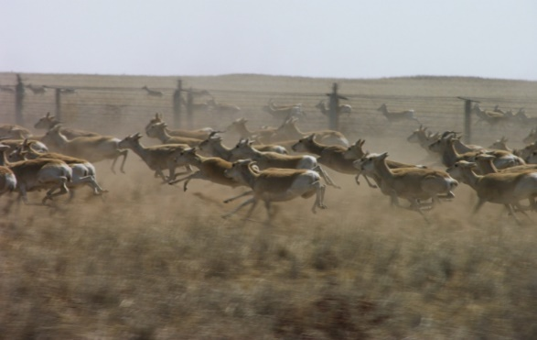
Transboundary Conservation:
a systematic and integrated approach
PART 2.
From principles to action
Context and planning the TBC process
The establishment and management of transboundary conservation initiatives
Measuring results: the monitoring and evaluation of transboundary management effectiveness
Transboundary Conservation Specialist Group

Slide 30
Common stages of a transboundary
conservation process
WCPA’s Framework | CONTEXT AND PLANNING |  | INPUTS AND PROCESSES | OUTPUTS AND OUTCOMES
Stages | DIAGNOSE | DESIGN | TAKE ACTION | EVALUATE
Goals | Determine the need for transboundary conservation | Match the process to the situation | Secure resources and implement actions | Learn and adapt
Step 1 | Identify if there is a compelling reason to act | Determine who should lead the effort | Assess the capacity to implement plans | Assess progress and outcomes
Step 2 | Determine if there is a constituency for change | Mobilize and engage the right people | Develop an action plan | Determine if there is a need to continue
Step 3 | Estimate the scope of the issue | Define the geographic extent | Secure financial sustainability | Adapt the management and action plans
Step 4 | Estimate the capacity to work across boundaries | Negotiate a joint vision and develop management objectives | Implement the plans | Communicate progress

Slide 31
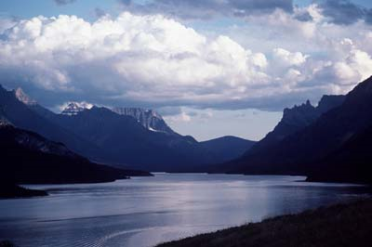
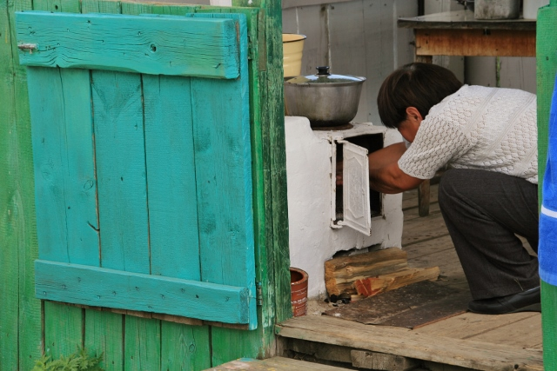
Best practice examples
33 best practice examples drawn from different geographical regions and ecosystems around the world, and
involving different protected area management categories, models of cooperation and transboundary arrangements
Transboundary Conservation Specialist Group

Slide 32
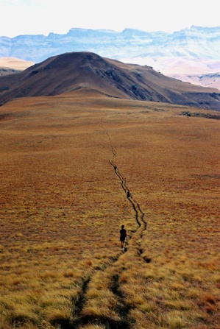
Training courses for capacity building
Use the WCPA’s Guidelines as a basis from which to develop training modules and facilitate capacity building
Encourage tertiary institutions to take up this challenge
Encourage transboundary conservation practitioners and decision-makers to support, attend and participate in training
Transboundary Conservation Specialist Group

Slide 33
A call to action
Develop a comprehensive global database of TBCAs, based on new WCPA’s definitions
Geographical distribution
Historical background
Partners involved
Models of cooperation and their effectiveness
Existence of agreements
TBC governance (formal and/or informal arrangements)
Overlays with other conservation strategies
Overlays with regions of past and current conflict
BEST PRACTICE GUIDELINES ON TBC
+
GLOBAL POLICY RECOMMENDATIONS
To enhance
knowledge about transboundary conservation
networking & experience sharing between interested parties
To help connect TBCAs with other forms of large scale conservation areas
To facilitate scientific research and comparative analyses
To assist in tracking global trends in transboundary cooperation for conservation

Slide 34
A call to action
Develop a comprehensive global database of TBCAs, based on new WCPA’s definitions
Support implementation of a variety of formal and informal models of TBC governance
BEST PRACTICE GUIDELINES ON TBC
+
GLOBAL POLICY RECOMMENDATIONS
Develop guidance on monitoring and evaluation of the effectiveness of TBC programmes
Support TBC as a practical way to encourage cooperation across international boundaries
Test and improve the TBC SG’s diagnostic tool to assess the feasibility for TBC
Translate to other languages
Transboundary Conservation Specialist Group

Slide 35
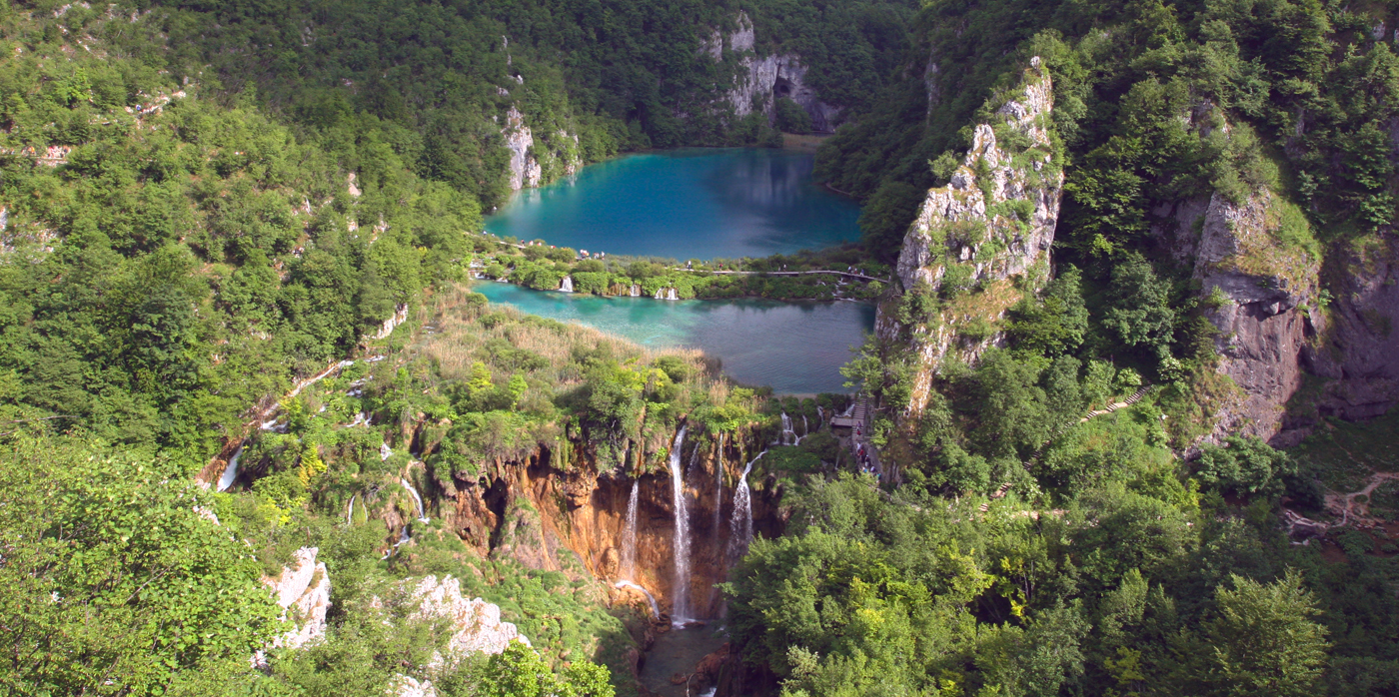
Thank you
www.tbpa.net
maja@ekohorizont.hr
Transboundary Conservation Specialist Group

