Slide 1

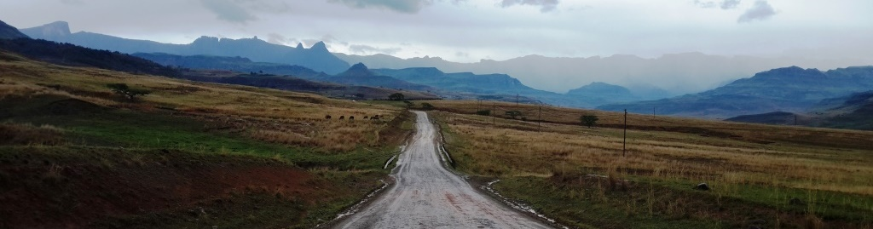
Global trends in transboundary conservation and peace building
...
Transboundary Conservation Specialist Group

Slide 2
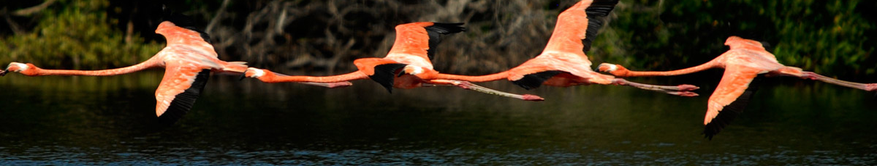
Presentation outline
The benefits of Transboundary Conservation;
Global trends;
Future vision;
Call to action; within the context of the
2015 IUCN Transboundary Conservation Guidelines
Transboundary Conservation Specialist Group

Slide 3
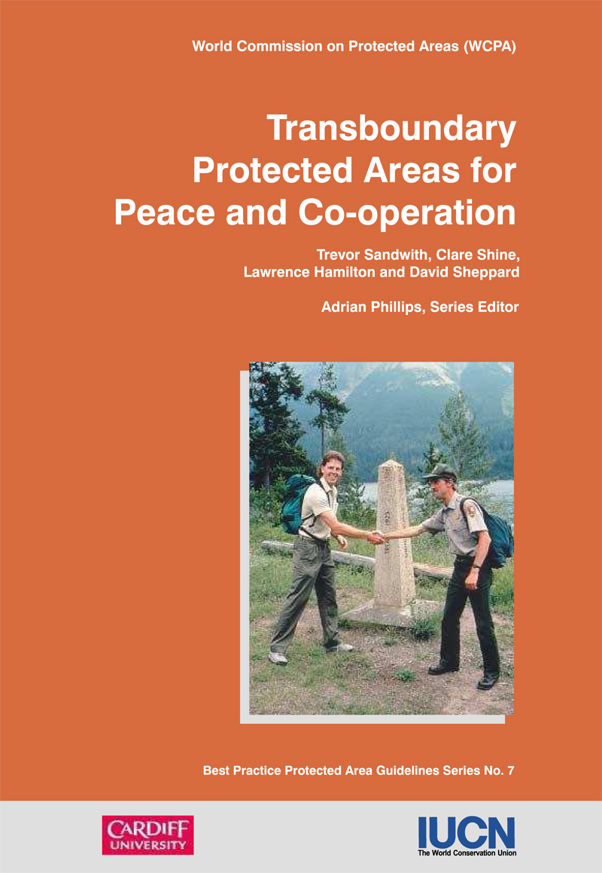
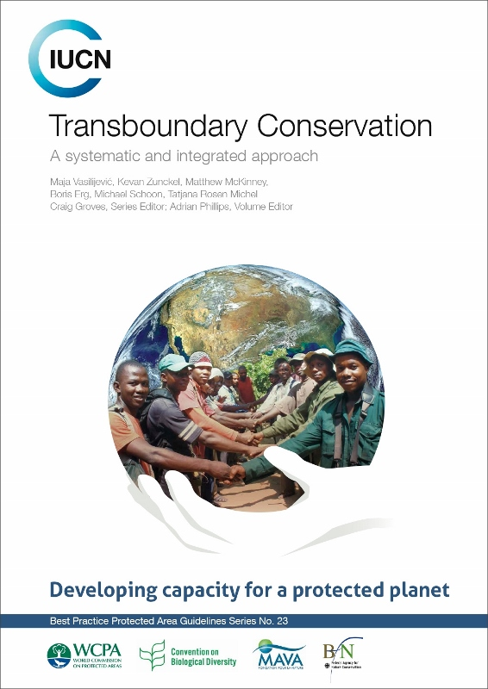
IUCN Transboundary Conservation
Guidelines
REVISED
&
UPDATED
2001
2015
Transboundary Conservation Specialist Group

Slide 4
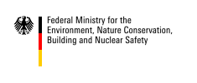



IUCN Transboundary Conservation
Guidelines - Donors
German Federal Ministry for the Environment, Nature
Conservation, Building and Nuclear Safety (BMUB)
through the Federal Agency for Nature Conservation (BfN)
MAVA Foundation
WCPA
Transboundary Conservation Specialist Group

Slide 5


Development of key concepts
An International workshop on defining transboundary conservation principles 16-18 October 2013, Austria
Transboundary Conservation Specialist Group

Slide 6
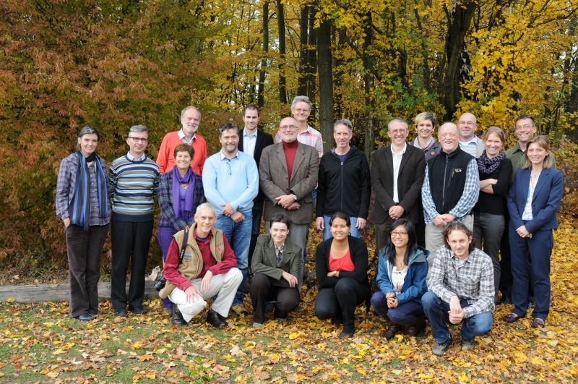
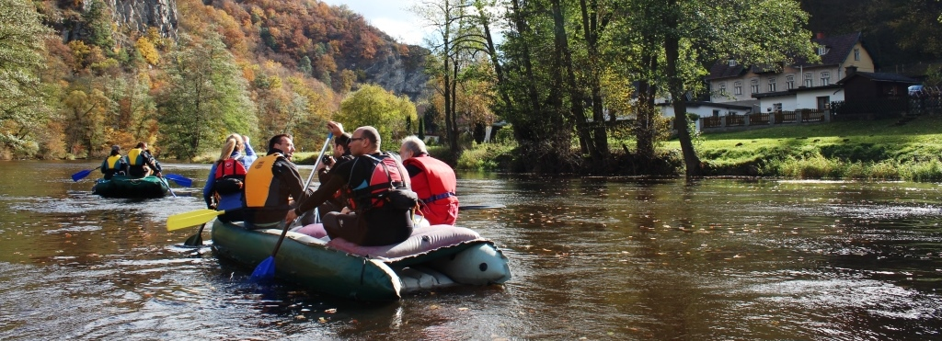
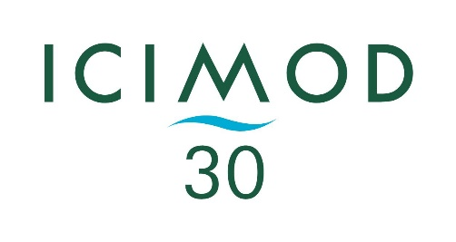
Gathered 24 experts from 16 countries, including protected area staff, government officials, NGO representatives, academia and donors
Partnership with the International Centre for Integrated Mountain Development established
Transboundary Conservation Specialist Group

Slide 7
Wide participatory approach
Prinipal co-editors and co-authors:
Maja Vasilijević, Kevan Zunckel, Matthew McKinney, Boris Erg, Michael Schoon, Tatjana Rosen Michel
Brahim Abou el Abbes, Rahimatsah Amat, Giorgio Andrian, Kenneth Angu Angu, Taïbou Ba, Tim Badman, Jitendra Bajracharya, Martin Barriteau, Diana Bedoya, Charles Besançon, Paul Bewsher, Florian Carius, Juan E. Bezaury Creel, Duan Biggs, Clara Bocchino, Grazia Borrini-Feyerabend, Alain Brandeis, Robert Brunner, Edgar Buhanga, Tony Bynum, Andy Bystrom, Zhao Chao, Olivier Chassot, Sunita Chaudhary, Nakul Chettri, Rusudan Chochua, Nguyen The Cuong, Jan De Winter, Askar Devletbakov, Emma Doyle, Nigel Dudley, Andrew Dunn, Dominique Endamana, Cristina Eghenter, Wayne Freimund, Wolfgang Fremuth, Ewald Galle, Jean-Marc Garreau, Sonali Ghosh, Nick de Goede, Catarina Grilo, David Grossmann, Craig Groves, Christine Guiness, Ely ould Mohamed el Hadj, John Hanks, Anne Katrin Heinrichs, Elaine Hsiao, Syed Ainul Hussain, Paul Insua-Cao, Boedhihartono Intou, Tilman Jaeger, Shawn Johnson, Harry Jonas, Orisha Joseph, Sanna-Kaisa Juvonen, Benjammin Kahn, Cheikh Tidiane Kane, Vadim Kiriliuk, Elizabeth Koch Ya’ari, Sabine Koenig, Rajan Kotru, Anna Kuhmonen, Kari Lahti, Annette Lanjouw, Michelle Lim, John Lambing, Alois Lang, Yan Lu, Kathy MacKinnon, Salifou Mahamadou, Neeraj Mahar, Marek Majerczak, Paul Martin, Daniela Marzo, Vinod Bihari Mathur, Volker Mauerhofer, Jamie McCallum, Edwin Meru, Stefan Michel, Li Migura, Peter Myles, Servi Nabuurs, Federico Niccolini, Aaron Nicholas, Krishna Prasad Oli, Marco Onida, Gisela Paredes-Leguizamón, Midori Paxton, Marko Pečarević, Fan Pengfei, Tomasz Pezold, Adrian Phillips, Irma Popović Dujmović, Nawraj Pradhan, Michael S. Quinn, Gopal S. Rawat, Johannes Refisch, Lenka Reiterova, Cristian Remus-Papp, Kent Redford, David Reynolds, Tamar Ron, Pedro Rosabal, Patrizia Rossi, Tómaš Rothröckl, Tobias Salathe, Trevor Sandwith, Petra Schultheiss, Harald Schütz, Gabriel Schwaderer, Peter Shadie, Eklabya Sharma, Lhakpa Norbu Sherpa, Andrej Sovinc, Anna Spenceley, Robert Stejskal, David Tiku Okon, Amir Tolouei, Hernán Torres, Yongyut Trisurat, Martin Valašek, Alan Valverde, Antonio Vasilijević, Maxim Vergeichik, Sally Walkerman, Arthur H. Westing, Graeme Worboys, Dorothy Zbicz
Transboundary Conservation Specialist Group

Slide 8
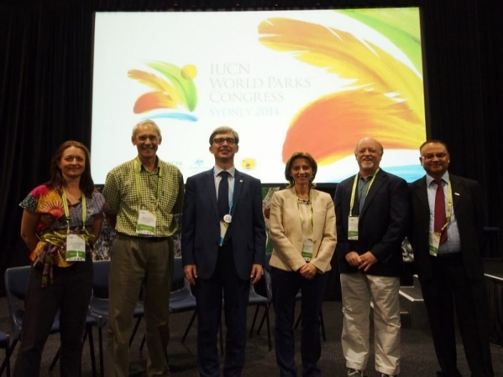
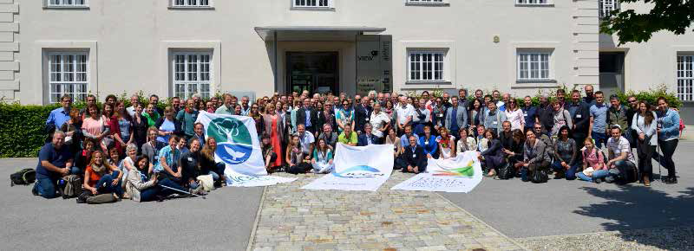
IUCN Transboundary Conservation
Guidelines
Pre-launch event at WPC 2014 – concept endorsed
Published by IUCN in May 2015
Launched at ‘Little Sydney - Protecting Nature in Europe conference, held from 28-31 May 2015 in Austria
Transboundary Conservation Specialist Group

Slide 9
IUCN Transboundary Conservation
Guidelines – a systematic and integrated approach
PART 1: Understanding transboundary conservation: history and key concepts
Global trends
Definitions
Benefits
Governance
Transboundary Conservation Specialist Group

Slide 10
Global Trends of TBC
Author | Scope | Results
Thorsell and Harrison (1990) | Border parks | 70
Zbicz and Green (1997) | Transfrontier protected area complexes | 136 (comprising 488 protected areas)
Zbicz (2001) | Internationally adjoining protected areas | 169 (comprising 666 protected areas)
Besançon and Savy (2005) | Internationally adjoining protected areas and other transboundary conservation initiatives | 188 (comprising 818 protected areas)
Lysenko et al. (2007) | Transboundary protected areas | 227 (comprising 3,043 protected areas)
Transboundary Conservation Specialist Group

Slide 11
Global Trends of TBC
Transboundary Conservation Specialist Group

Slide 12
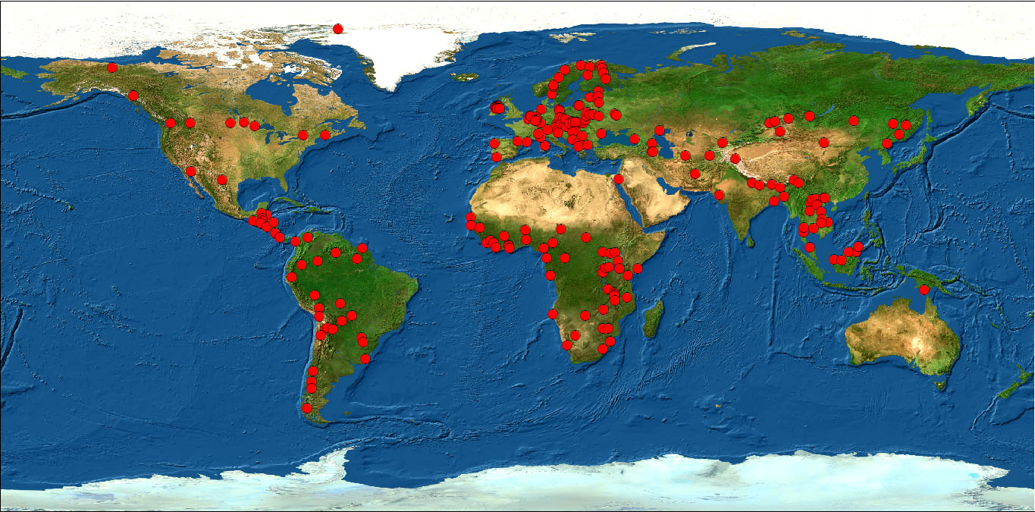
Global Trends of TBC
Distribution (2007)
Transboundary Conservation Specialist Group

Slide 13
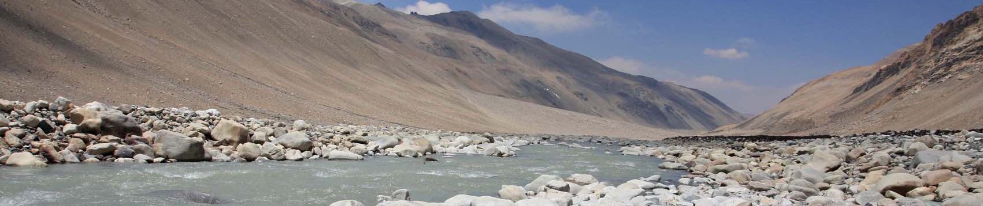
Definitions
Transboundary conservation is a process of cooperation to achieve conservation goals across one or more international boundaries
Transboundary Conservation Specialist Group

Slide 14
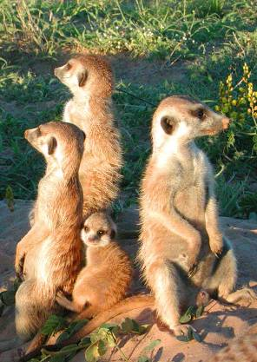
WCPA typology of Transboundary Conservation Areas
Type 1:
Transboundary Protected Area
Type 2:
Transboundary Conservation Landscape
and/or Seascape
Type 3:
Transboundary Migration Conservation Area
Special designation:
Park for Peace
Transboundary Conservation Specialist Group

Slide 15
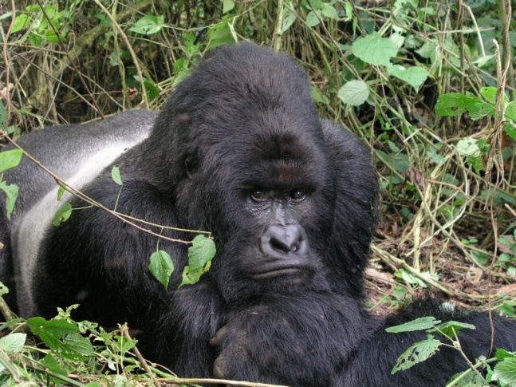
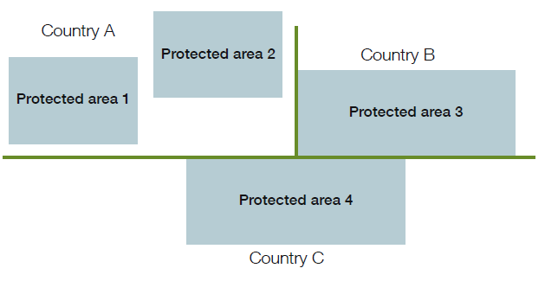
Definitions of TBCA types
A Transboundary Protected Area is a clearly defined geographical space that is comprised of protected areas* that are ecologically connected across one or more international boundaries and is under some form of cooperation.
*Dudley, 2008
Transboundary Conservation Specialist Group

Slide 16
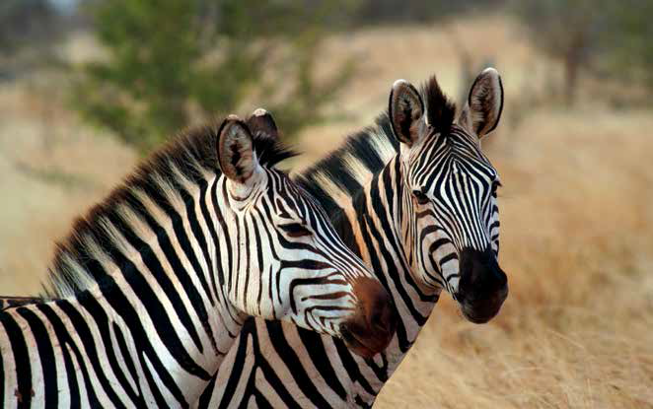
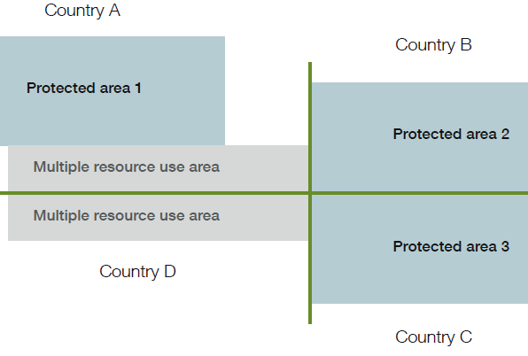
Definitions of TBCA types
A Transboundary Conservation Landscape and/or Seascape is an ecologically connected area that sustains ecological processes and crosses one or more international boundaries, and which includes protected areas as well as multiple resource use areas, and is under some form of cooperation.
Transboundary Conservation Specialist Group

Slide 17
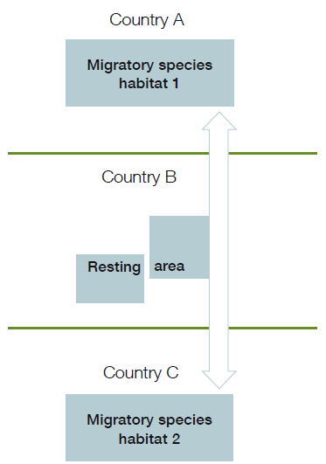
Definitions of TBCA types
Transboundary Migration Conservation Areas are wildlife habitats that are necessary to sustain populations of migratory species and are under some form of cooperation.
Transboundary Conservation Specialist Group

Slide 18
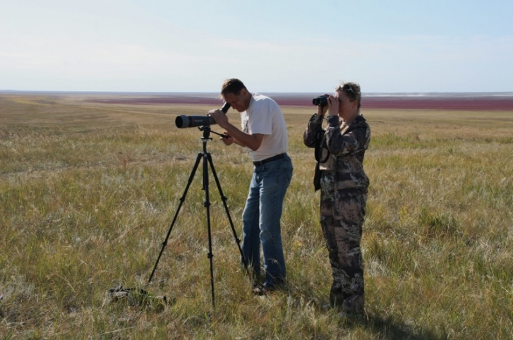
Definitions of TBCA types
A Park for Peace is a special designation that may be applied to any of the three types of Transboundary Conservation Areas and is dedicated to the promotion, celebration, and/or commemoration of peace and cooperation.
Transboundary Conservation Specialist Group

Slide 19
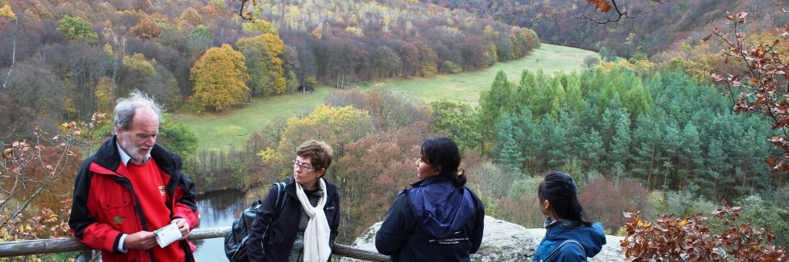
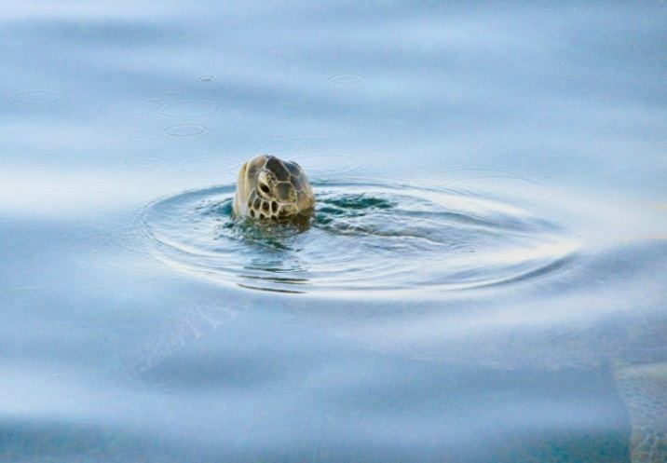
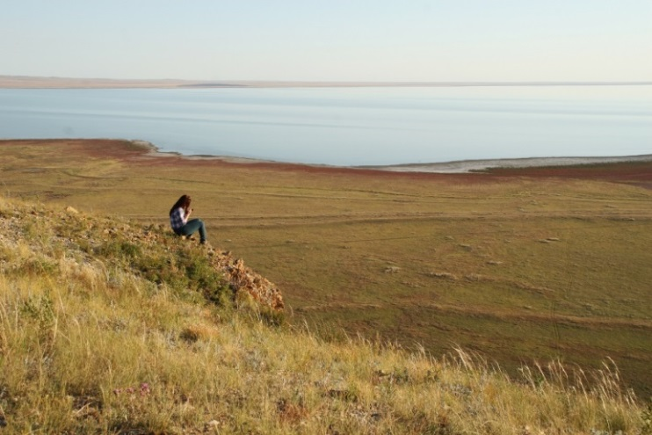
The benefits of Transboundary Conservation (TBC)
Humanity has and continues to make serious mistakes in the way we relate to our natural world.
Transboundary conservation is a mechanism and an approach that can help us correct many of these mistakes,
and in doing so, begin to address our increasing vulnerability and introduce resilience to the way we live.
Transboundary Conservation Specialist Group

Slide 20
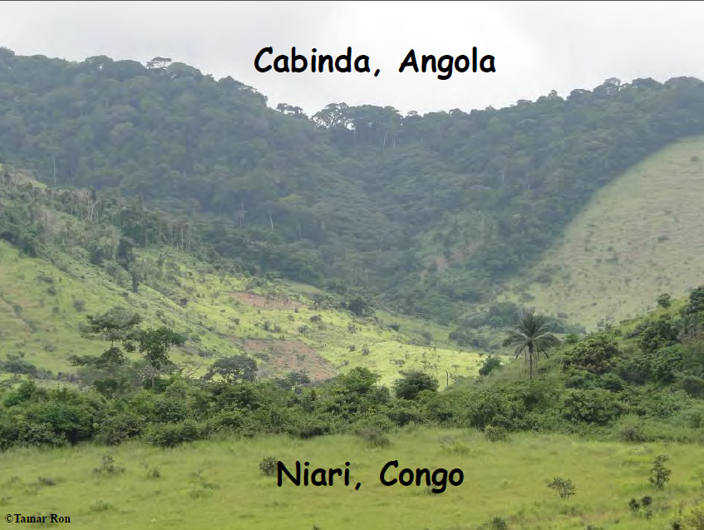
Notes:
It is not so much the mess we have made with political boundaries, but rather the incompatible way in which we manage the ecosystems that are crossed by these boundaries.

Slide 21
The benefits of Transboundary Conservation
TBC enhances ecological functionality and therefore species survival – including human
TBC initiatives enhance the potential of shared ecosystems to deliver a broad range of ecosystem goods and services that underpin societies and their economies – way beyond the traditional nature-based tourism paradigm
TBC enhances the cultural significance of nature by bringing divided cultures back together again and restoring their links with nature
Transboundary Conservation Specialist Group

Slide 22
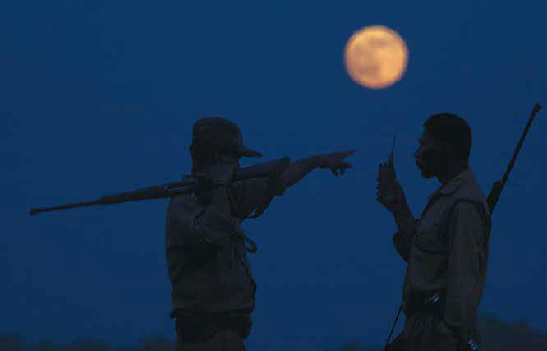
The benefits of Transboundary Conservation
TBC provides a framework within which the on-the-ground management of shared issues can be more effectively implemented on a day-to-day basis
TBC can create the momen-
tum for the harmonisation of
legal and policy frameworks
TBC can provide a foundat-
ion from which peace and
political stability is secured
Transboundary Conservation Specialist Group

Slide 23
Governance:
Models of cooperation in TBC
Model of cooperation | Example
Communication or Information sharing | Occasional or regular communication on actions, problems, opportunities or other relevant issues Sharing of information
Consultation | Seeking opinion, feedback or advice from each other Cooperative process with the aim to harmonize management
Coordinated action | Jointly coordinated management actions implemented within the sovereign areas of each party, that contribute to the conservation goals of the entire transboundary ecosystem, e.g. monitoring of species and ecological processes occurs as regular activity on the territory of each party, but the results contribute to conservation of species or ecosystems in the whole shared ecosystem This is a form of cooperative management
Joint implementation of decisions | Jointly coordinated and implemented management actions across the sovereignty boundaries, e.g. joint law enforcement patrols, joint fundraising and project implementation, the production of marketing material that profiles the TBCA as a single entity, etc. This is a form of cooperative management
Transboundary Conservation Specialist Group

Slide 24
IUCN Transboundary Conservation
Guidelines – a systematic and integrated approach
PART 2: From principles to action
Context and planning the transboundary conservation process – pre-feasibility and feasibility
The establishment and management of transboundary conservation initiatives – getting it done
Measuring results: the monitoring and evaluation of transboundary management effectiveness
Transboundary Conservation Specialist Group

Slide 25
Part 2: From principles to action
WCPA FRAMEWORK | CONTEXT & PLANNING |  | INPUTS & PROCESS | OUTPUTS & OUTCOMES
Stages | DIAGNOSE | DESIGN | TAKE ACTION | EVALUATE
Goals | Determine the need for TBC | Match the process to the situation | Secure resources and implement actions | Learn and adapt
Step 1 | Identify if there is a compelling reason to act | Determine who should lead the effort | Assess the capacity to implement plans | Assess progress and outcomes
Step 2 | Determine if there is a constituency for change | Mobilize and engage the right people | Develop an action plan | Determine if there is a need to continue
Step 3 | Estimate the scope of the issue | Define the geographic extent | Secure financial sustainability | Adapt the management and action plans
Step 4 | Estimate the capacity to work across boundaries | Negotiate a joint vision and develop management objectives | Implement the plans | Communicate progress
Transboundary Conservation Specialist Group

Slide 26
Future Vision for TBC
WPC 2014, Recommendation 7, Conclusions of the Governance Stream:
‘All countries... support the maintenance and implementation of a variety of shared governance models for protected and conserved areas, in particular for the conservation of transboundary ecosystems and migratory species as means to ensure their equity, effectiveness and efficiency, including for sustainable use. This should be achieved through recognition of... models of transboundary conservation governance designed to suit their contexts.’;
and …
Transboundary Conservation Specialist Group

Slide 27
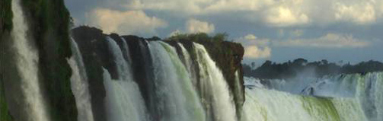
Future Vision for TBC
WPC 2014, Recommendation 12, Conclusions of the Governance Stream:
‘All countries... engage in putting transnational wildlife crime out of business by well-coordinated support to... efficient transboundary cooperation...’
Transboundary Conservation Specialist Group

Slide 28
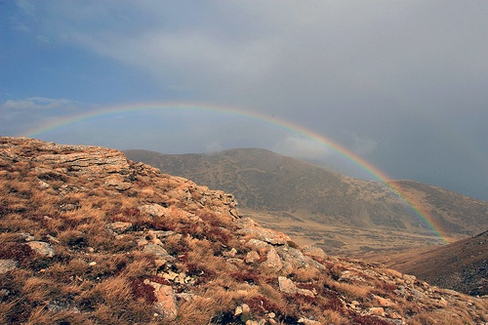
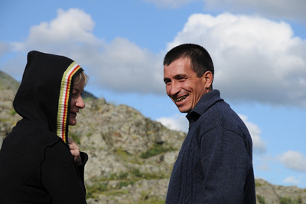
A call to action
WPC 2014, Conclusion 2, WCPA Transboundary Conservation Specialist Group’s Side-event ‘Transboundary Conservation: A systematic and integrated approach’:
‘IUCN, WCPA Transboundary Conservation Specialist Group and relevant conservation agencies and organisations should develop guidance on monitoring and evaluation of the effectiveness of transboundary conservation programmes.’
Transboundary Conservation Specialist Group

Slide 29
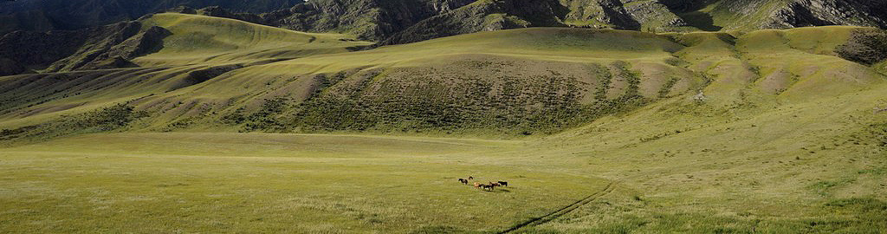
A call to action
In theory the case is strong, but the mechanisms to measure the benefits and to track their distribution, need to be developed.
Recommendation of the International symposium on Biodiversity and Peace, CBD COP 12:
‘Support the development of a comprehensive global inventory of Transboundary Conservation Areas, in cooperation with IUCN WCPA, UNEP WCMC, UNESCO and CBD Secretariat.’

Slide 30
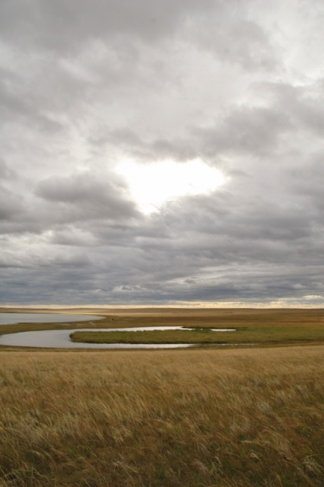
Need for a comprehensive database,
and a framework for keeping it current
Geographical distribution
Historical background
Partners involved
Models of cooperation and their effectiveness
Existence of agreements
Transboundary conservation governance
(formal or informal arrangements)
Overlays with other conservation strategies
Overlays with regions of past and current conflict
Transboundary Conservation Specialist Group
Notes:
Last database of Transboundary Conservation Areas wa done in 2007 and there is urgent need to revise that databse and develop a comprehensive and sound new data sets.

Slide 31
What such database would enable
Enhanced knowledge about transboundary conservation
Improved networking between interested parties
Enhanced sharing of experience
Help connect TBCAs with other forms of large scale conservation
Facilitate scientific research and comparative analyses
Assist in tracking global trends in transboundary cooperation for conservation
Transboundary Conservation Specialist Group

Slide 32
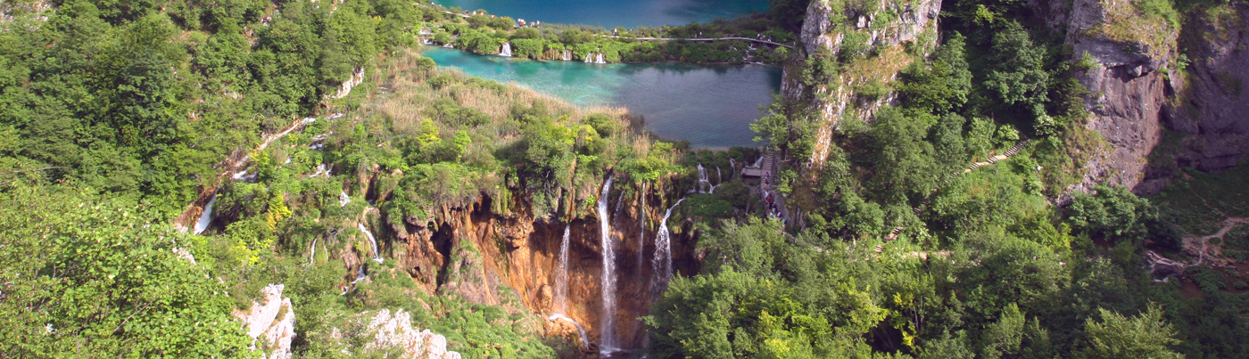
Training modules &
capacity building
Use the TBC Guidelines as a basis from which to develop training modules and facilitate capacity building
Encourage tertiary institutions to take up this challenge
Encourage TBC practitioners and decision-makers to support, attend and participate in training
Transboundary Conservation Specialist Group

Slide 33
A call to action
Develop TBC M&E to better measure and track benefit flows, as well as gauge effectiveness/performance;
Develop a framework for a TBC database and mechanisms to keep it up to date; and
Use the 2015 TBC Guidelines to develop training courses for capacity development at all levels
THANK YOU
https://portals.iucn.org/library/sites/library/files/documents/PAG-023.pdf
Transboundary Conservation Specialist Group
Transboundary Conservation Specialist Group

