Slide 1
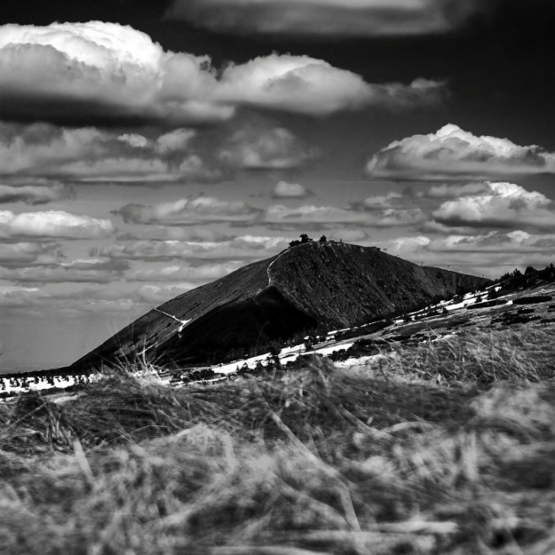

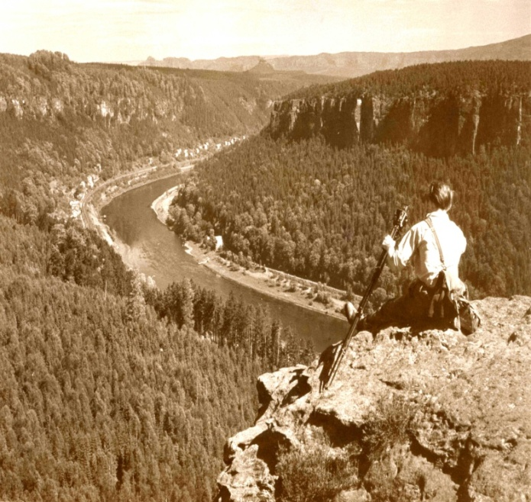




TransParcNet
European network
of transboundary areas
Case studies:
Saxon-Bohemian Switzerland
Krkonoše/Karkonosze
National Parks
Kari Lahti, Handrij Härtel, Jakub Kašpar

Slide 2
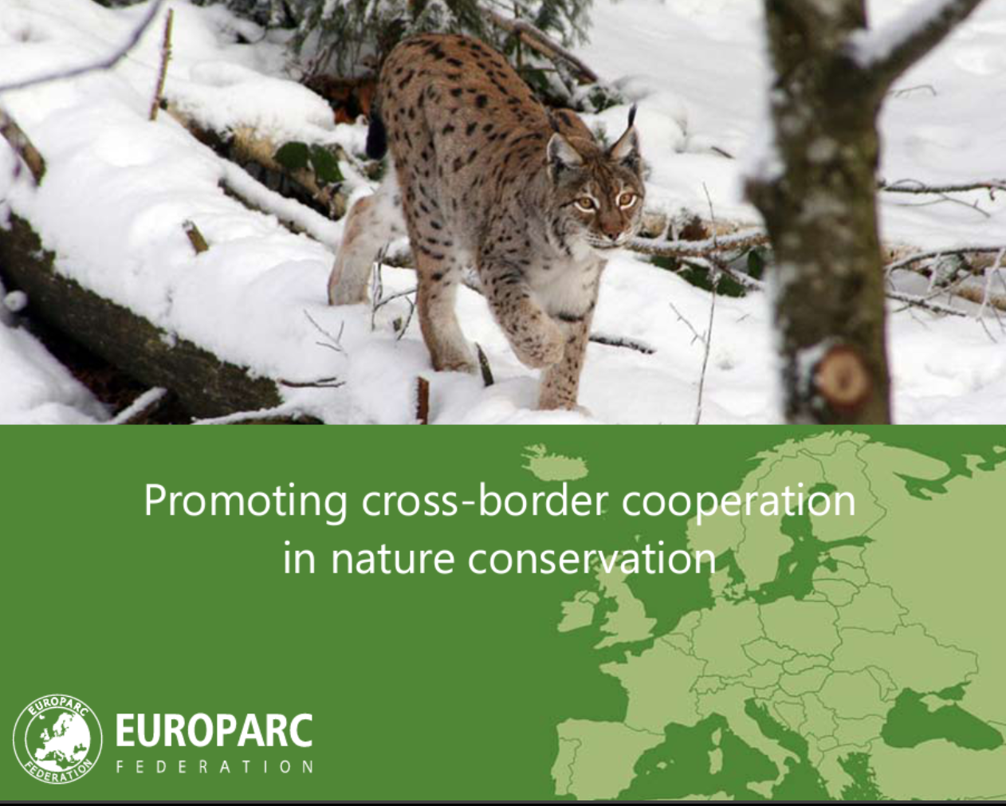
http://www.europarc.org/what-we-do/transboundary-parks

Slide 3
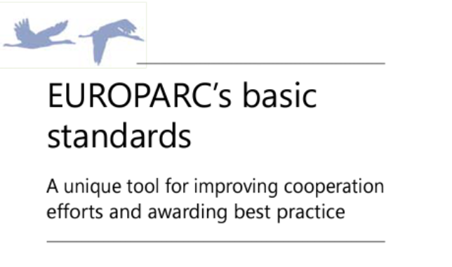
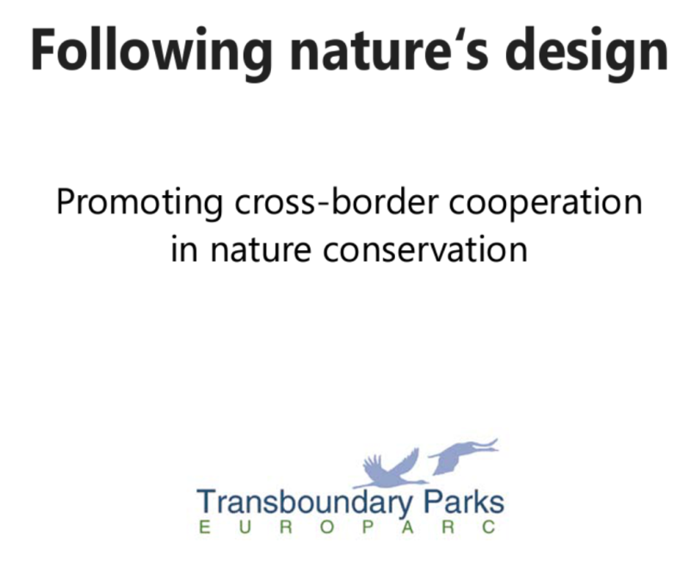
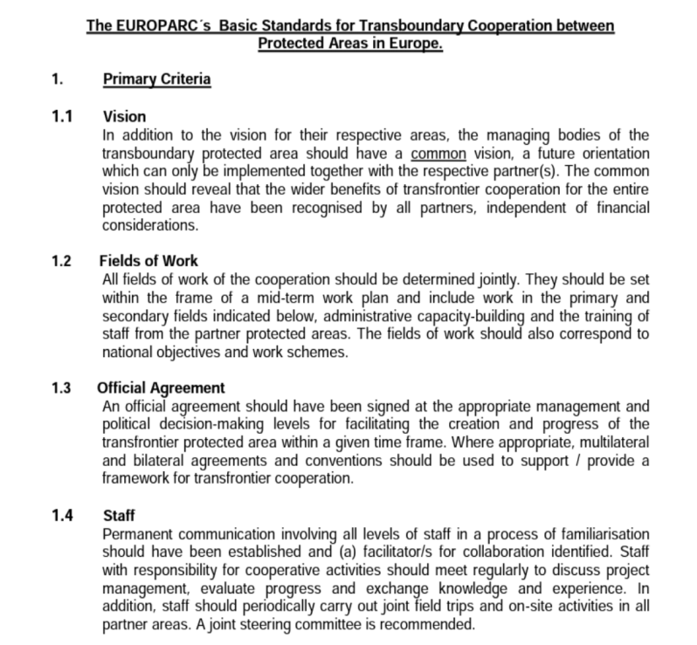
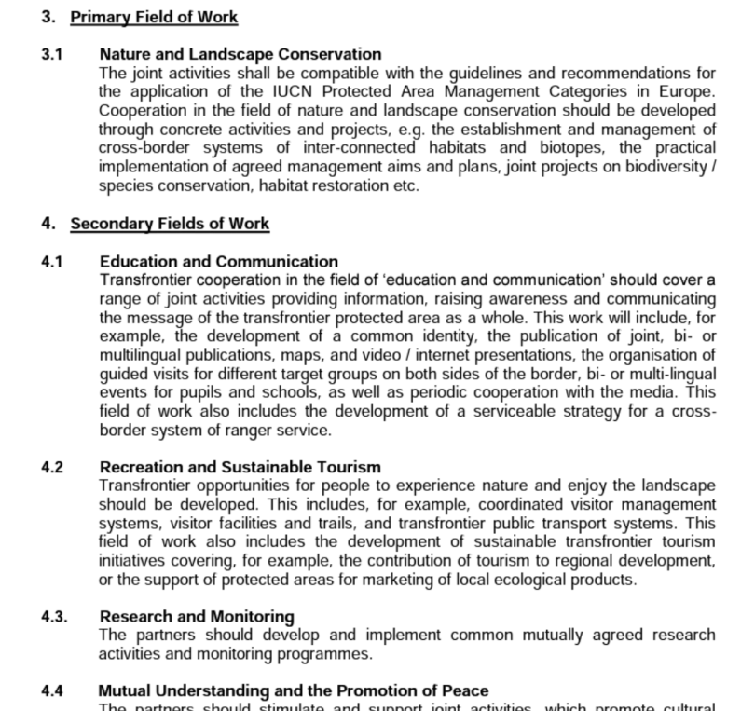
From DURBAN to SYDNEY

Slide 4
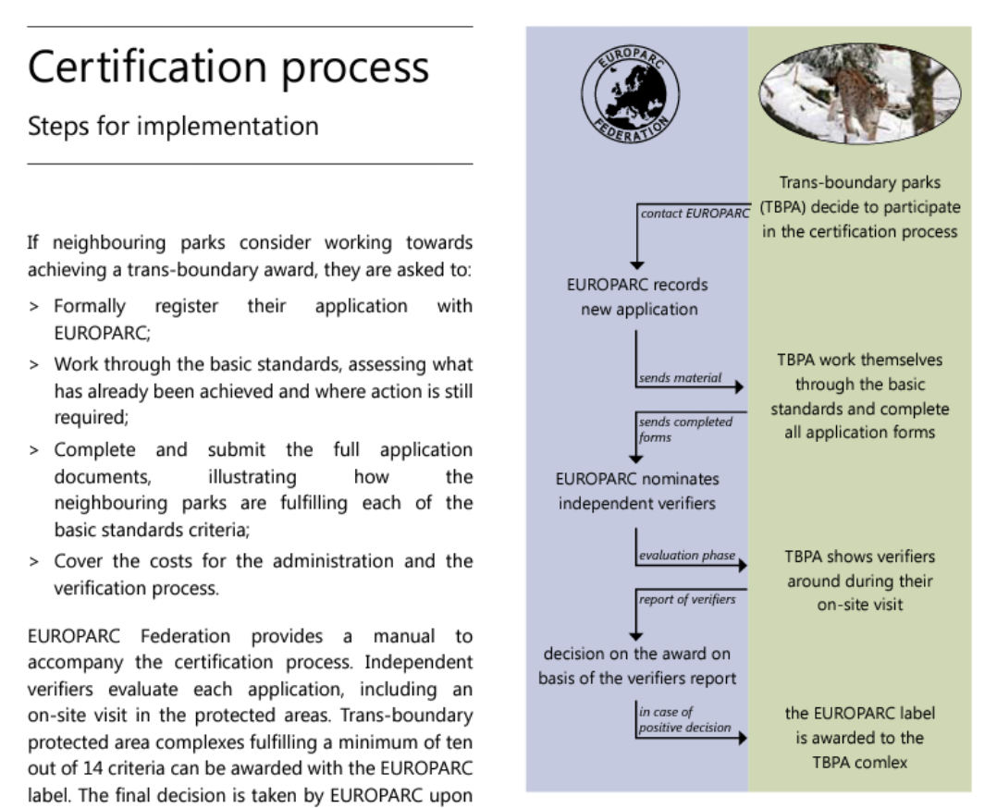
From DURBAN to SYDNEY

Slide 5
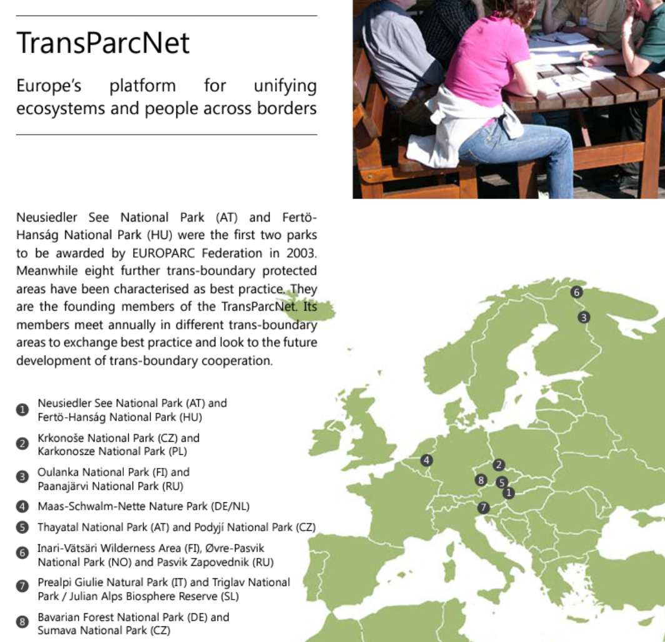
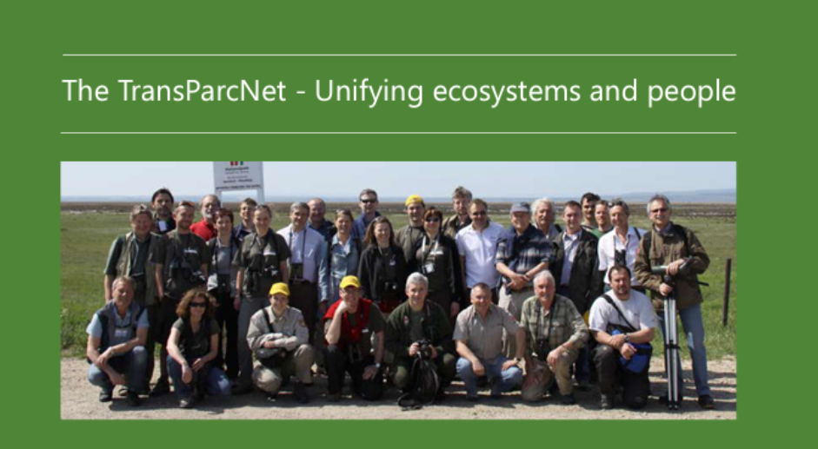
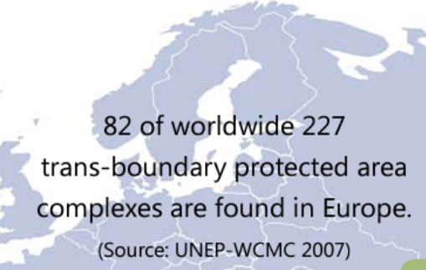
From DURBAN to SYDNEY
http://www.europarc.org/what-we-do/transboundary-parks

Slide 6
TransParcNet
TransParcNet: Certified parks
Neusiedler See National Park (Austria) and Fertö-Hansag National Park (Hungary)
Krkonoše National Park (Czech Republic) and Karkonosze National Park (Poland)
Oulanka National Park (Finland) and Paanajärvi National Park (Russia)
Maas-Schwalm-Nette Nature Park (Germany/Netherlands)
Thayatal National Park (Austria) and Podyjí National Park (Czech Republic)
Vätsäri Wilderness Area (Finland), Øvre-Pasvik National Park (Norway), Øvre-Pasvik Landscape Protection Area (Norway), Pasvik Nature Reserve (Norway) and Pasvik Zapovednik (Russia)
Prealpi Giulie Nature Park (Italy) and Triglav National Park/ Julian Alps Biosphere Reserve (Slovenia)
Bavarian Forest National Park (Germany) and Sumava National Park (Czech Republic)
Saxon Switzerland National Park (Germany), Bohemian Switzerland National Park (Czech Republic) and Elbe Sandstones Protected Landscape Area (Czech Republic)
Escaut Plaines Nature Park (Belgium) and Scarpe-Escaut Regional Nature Park (France)

Slide 7
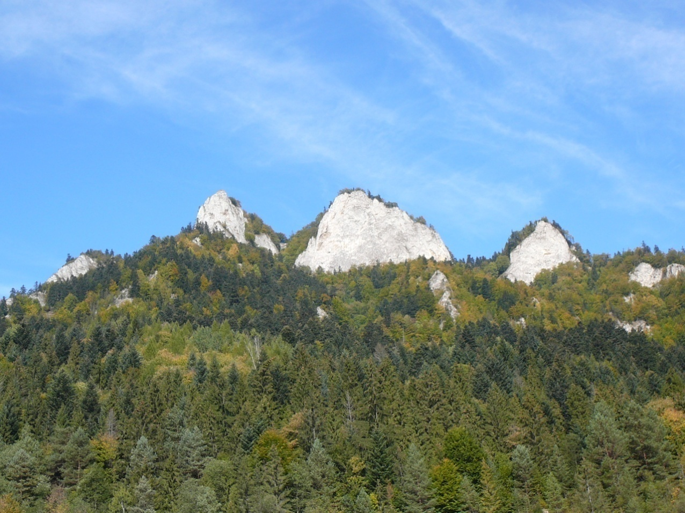
TB PAs Europe: historical background
First TB area:
1932 Pieniny Nature Reserve (today National Park) between Czechoslovakia (today Slovakia) and Poland

Slide 8
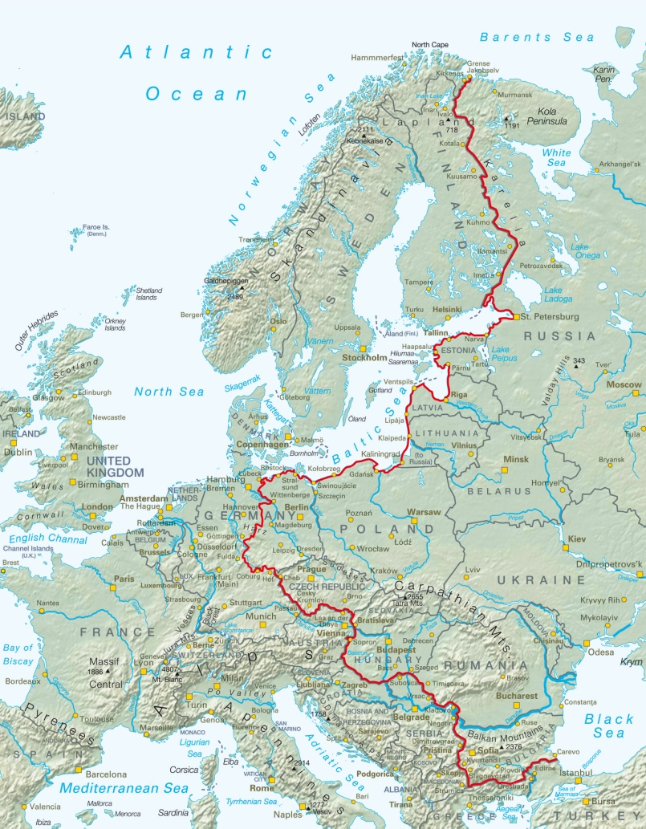
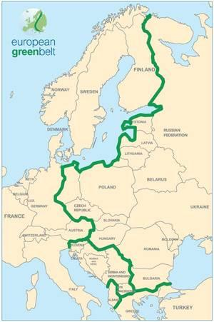
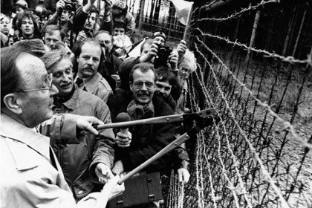
TB PAs Europe: historical background
Challenging time: 90th of the 20th century
Political changes: End of the iron-curtain
Splitting to smaller countries (Czechoslovakia, Yugoslavia)

Slide 9
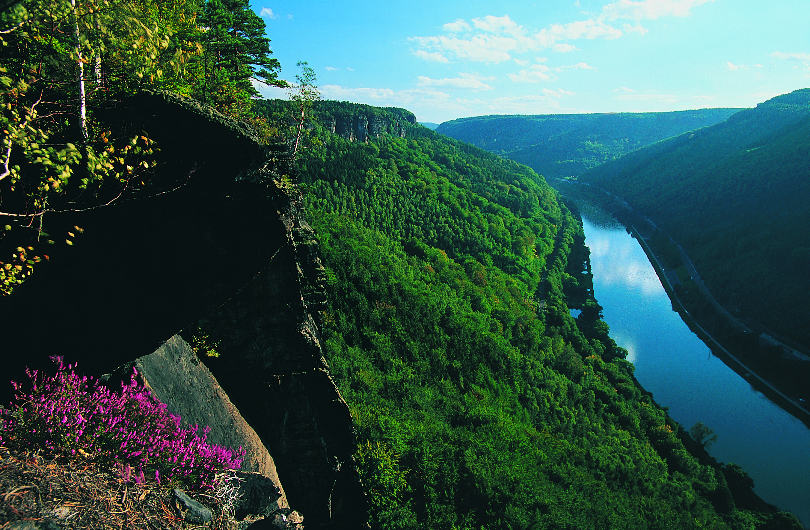
Saxon-Bohemian Switzerland
synonym: Elbe Sandstones
The largest sandstone rock landscape in Europe

Slide 10
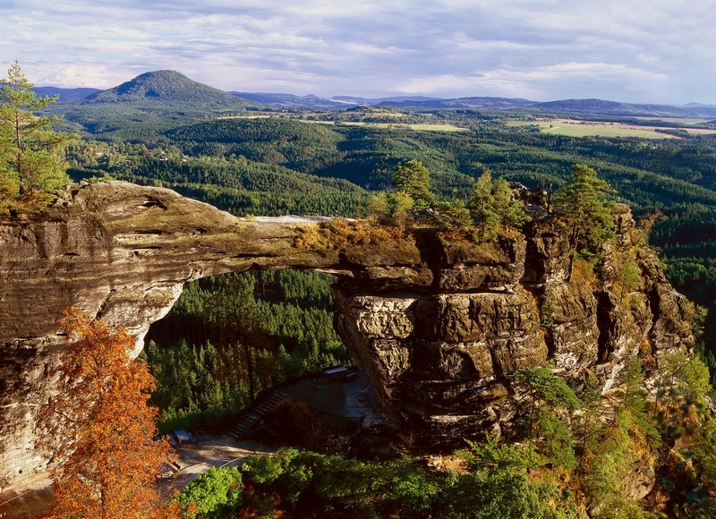
3 pillars of cooperation
(i) Nature and Landscape, (ii) Formal basis of cooperation,
(iii) Personal basis

Slide 11
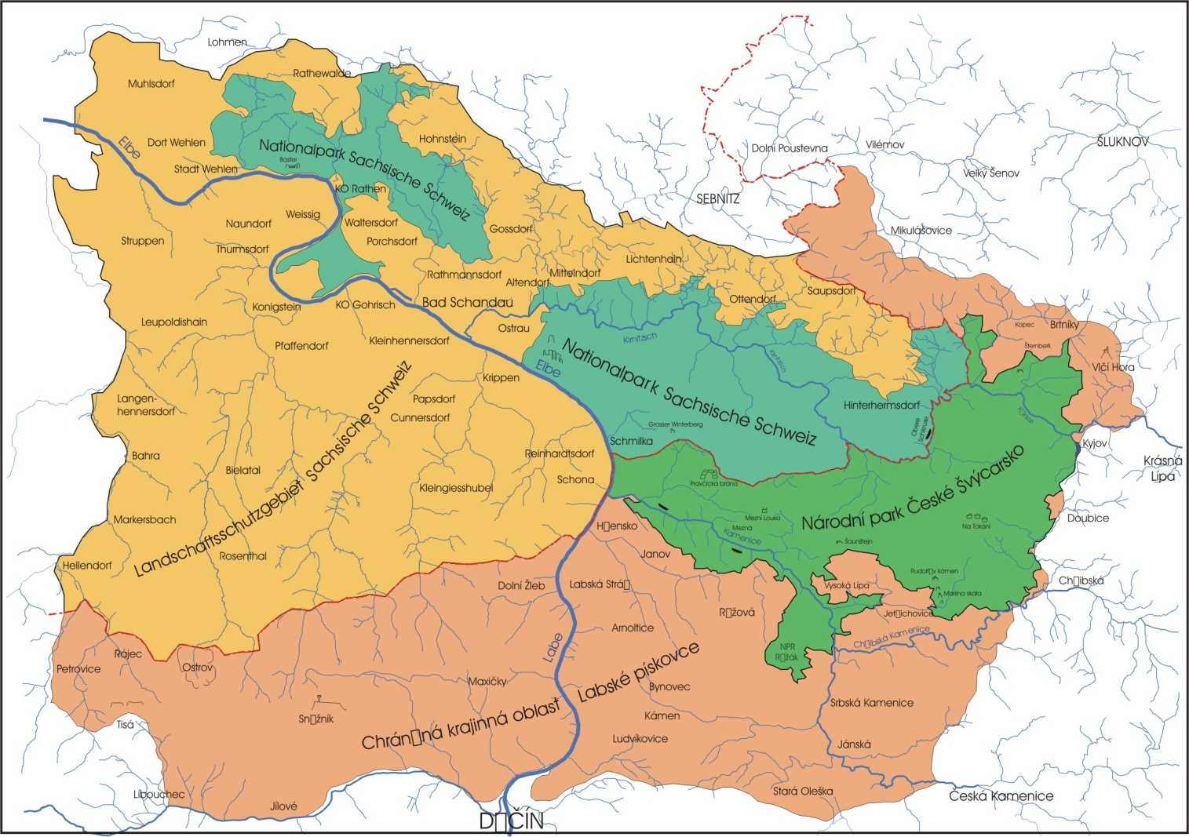
1. Shared nature heritage
Národní Park
České Švýcarsko

Slide 12
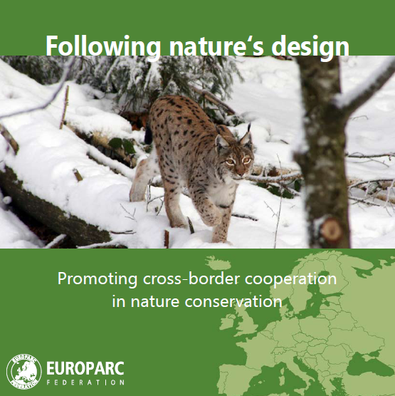
2. Formal basis
  1991: Agreement between the MoE of the Czech Repulic and the MoE of Saxony about the cooperation in nature conservation
  1994: Joint Strategy
  2010: Joint Vision
  2012: Transboundary Certificate

Slide 13
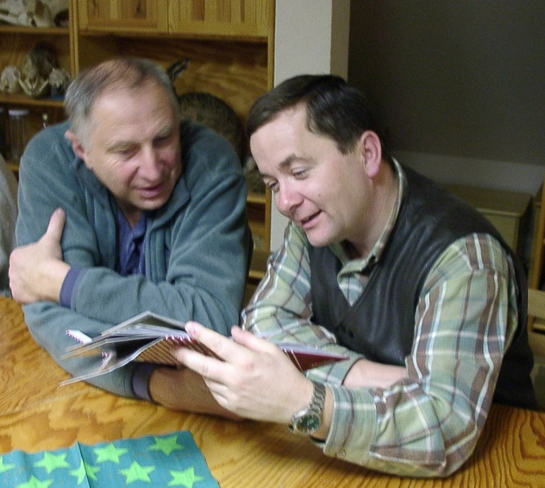
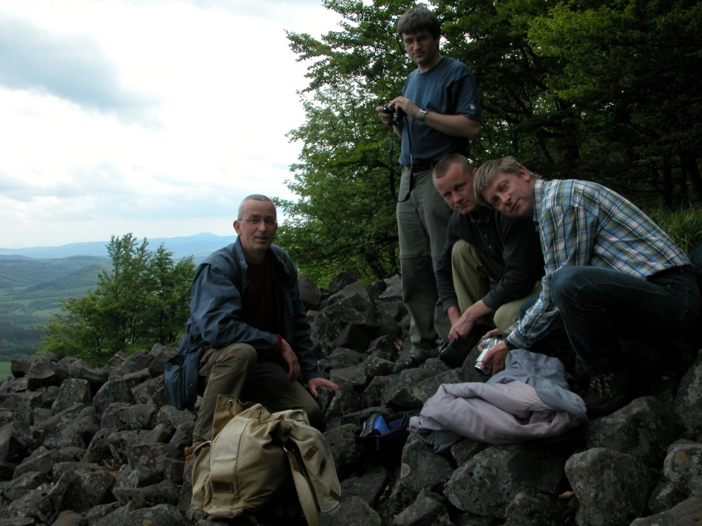
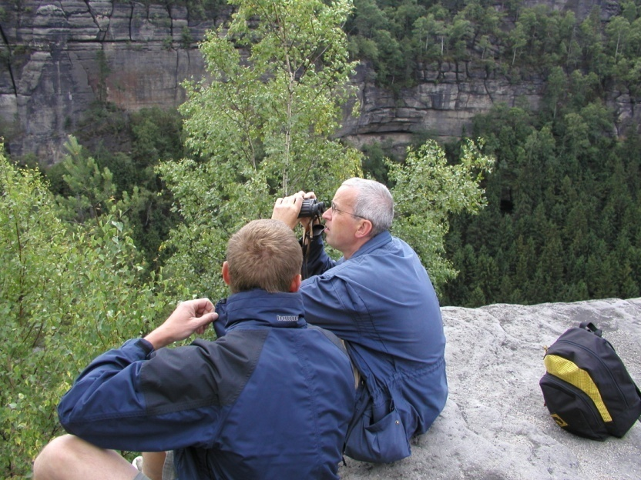
3. Personal level
Working Groups
  1. Research and monitoring
  2. Forest management
  3. Sustainable tourism and environmental education
  4. Rangers

Slide 14
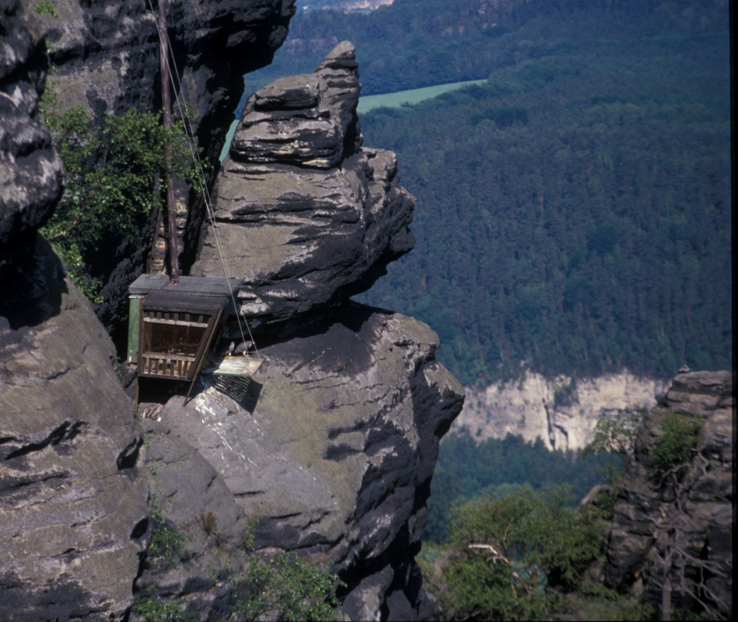
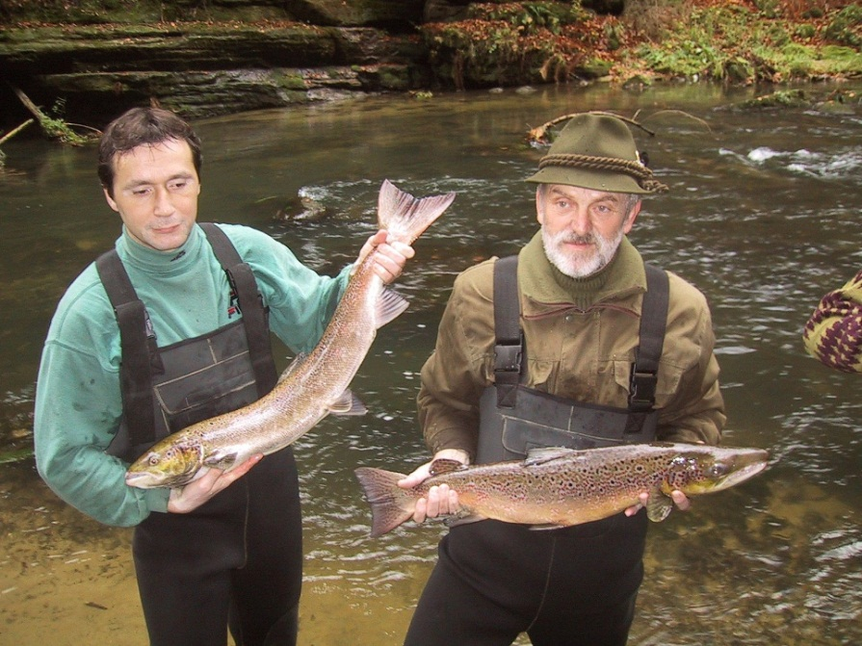
Joint reintroduction projects:
Elbe-Salmon Peregrine Falcon
1994 the Sächsische Landesanstalt für Landwirtschaft started with the implementation of the Elbe-Salmon 2000 Program (Elblachs 2000)
The new salmon population is supported by the release of 200.000 to 250.000 salmon fry every year. In 1998 the first salmon was caught in the Saxon Switzerland
Within seven years 77 young falcons were released in the Saxon Switzerland
Today the falcon population in Saxon-Bohemian Switzerland is stabilized and there are regularly about 30 pairs in the whole area

Slide 15
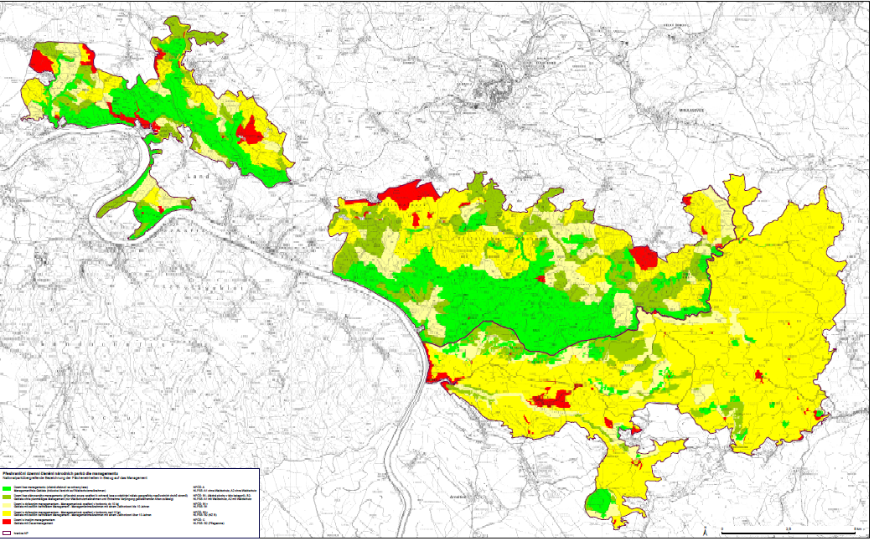
Joint management concept

Slide 16
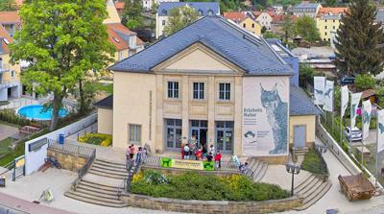
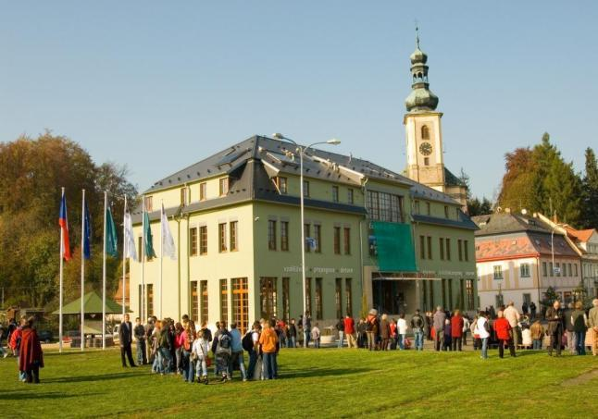
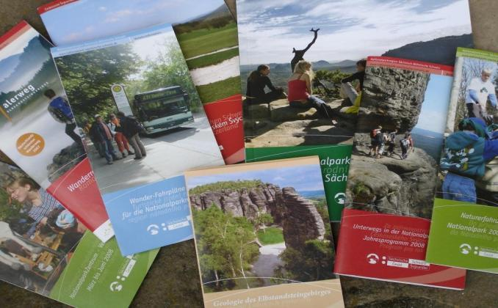

Joint PR concept
Two bilingual national park centres
Krásná Lípa (CZ) and Bad Schandau (DE)
Joint corporate design

Slide 17
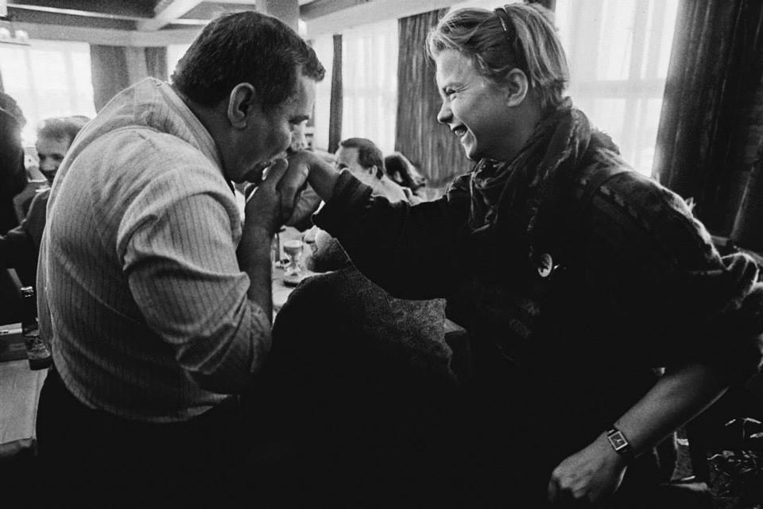
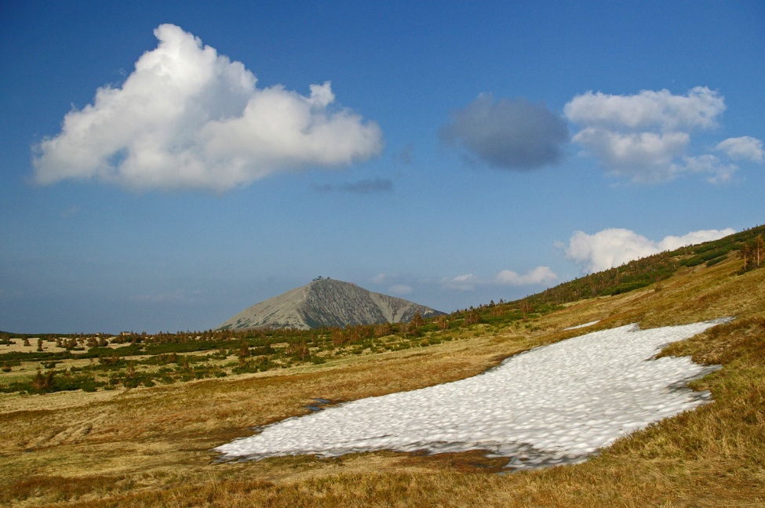
Krkonoše/Karkonosze Mts. NPs
Cooperation since 1960’s – problematic politically. After 1989 real cooperation has started, systematically based since 2000. Certified by EUROPARC Federation in 2006.

Slide 18
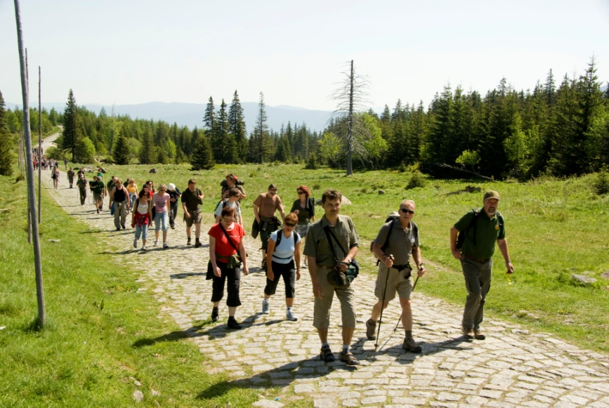
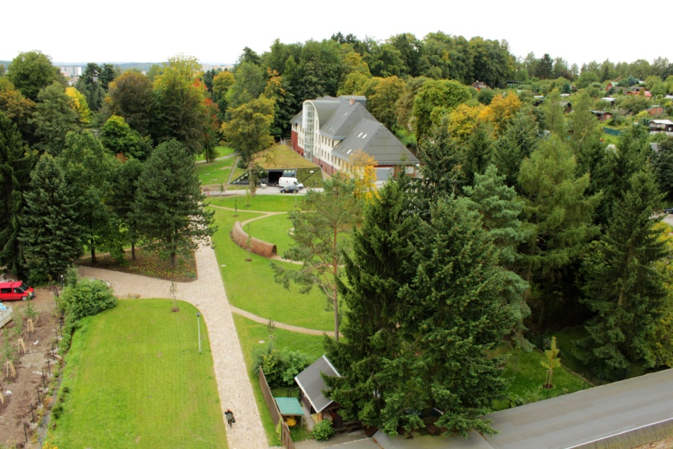
Main means of cooperation
Harmonization of management plans and management practice
Everyday work – working “twins”
Joint projects (financed mainly by EU Funds)

Slide 19
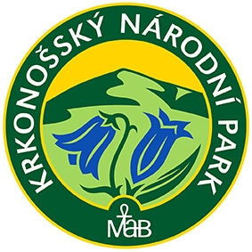

Main outcomes
Joint identity (common logo signalizing that we are in fact one National Park)
Coordinated field work, monitoring and research
Coordinated educational and promotional work as well as work with visitors
Better approach to project money

Slide 20
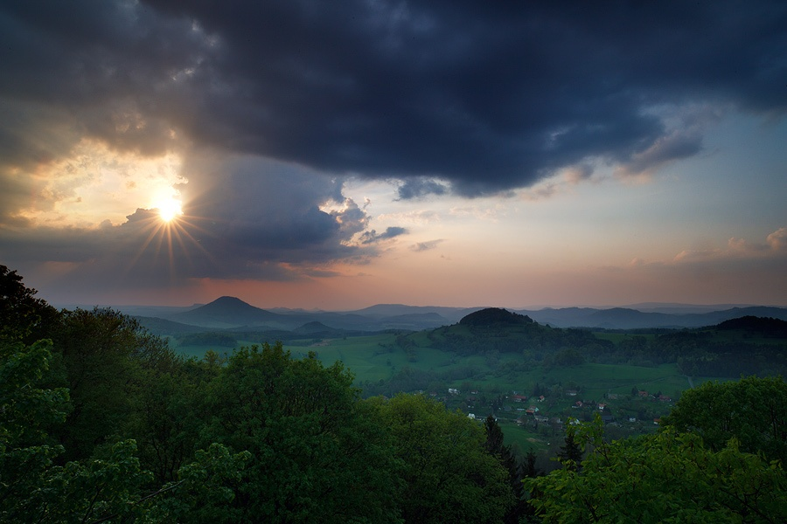
For profitable collaboration a formal agreement is necessary, but it alone is not sufficient. Enthusiastic, friendly relationships between the respective park directors, and at all levels, must exist or transboundary cooperation will founder.
L.S.Hamilton, 1996

