Slide 1
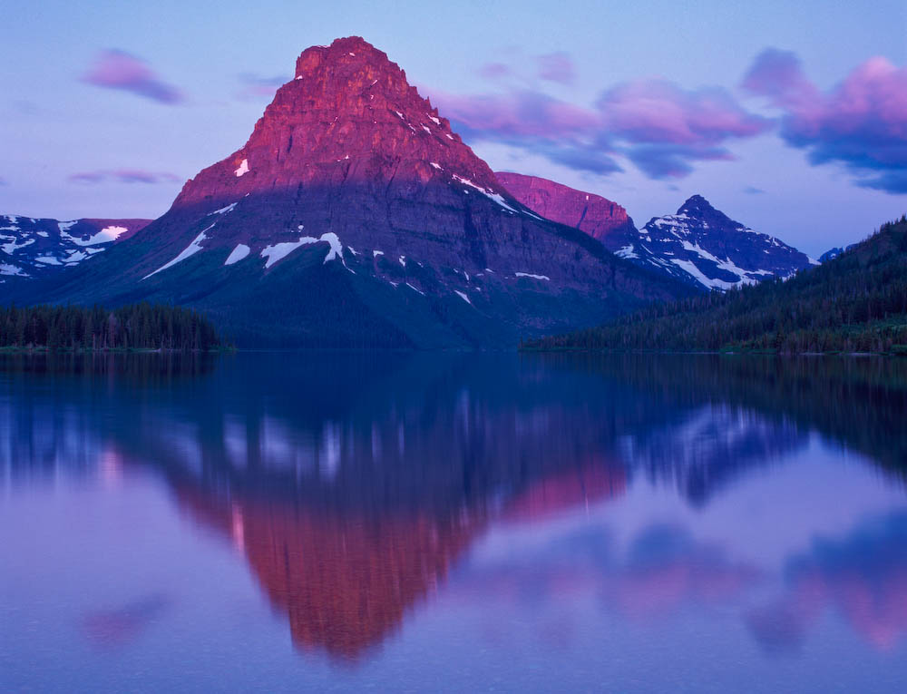
Roundtable on the
Crown of the Continent
Connecting People to Sustain and Enhance
Culture, Community, and Conservation
Gary Tabor and Melly Reuling, Center for Large Landscape Conservation
Matt McKinney and Shawn Johnson, University of Montana
Patrick Bixler, University of Oregon

Slide 2
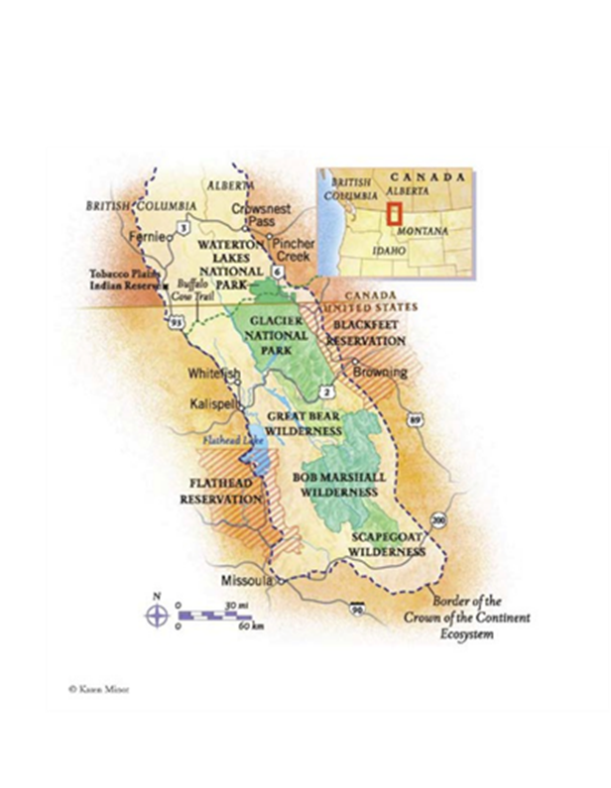
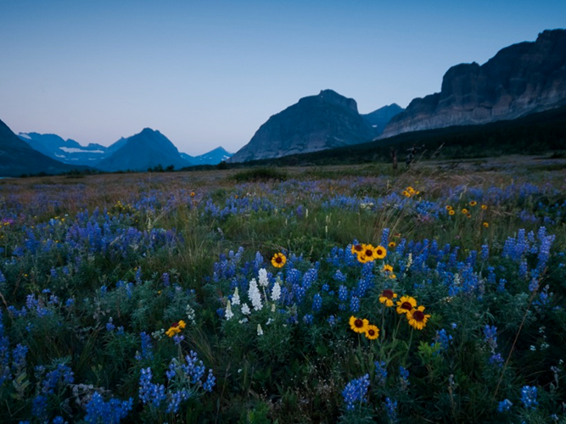

Slide 3
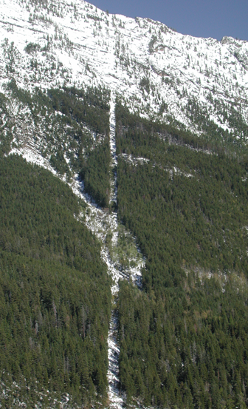
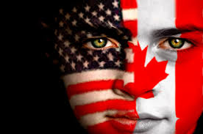

Slide 4
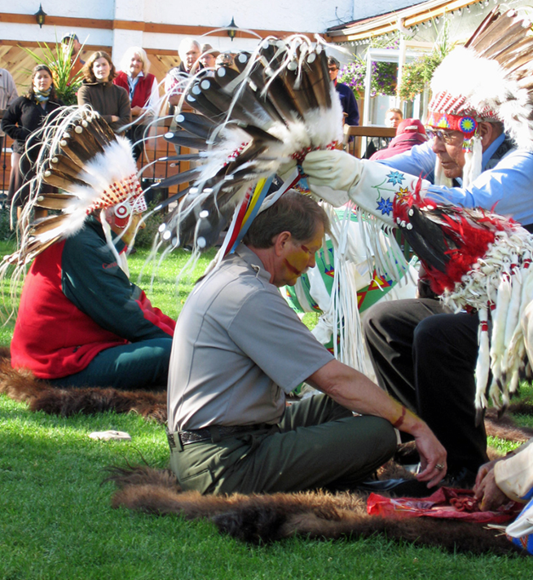

Slide 5
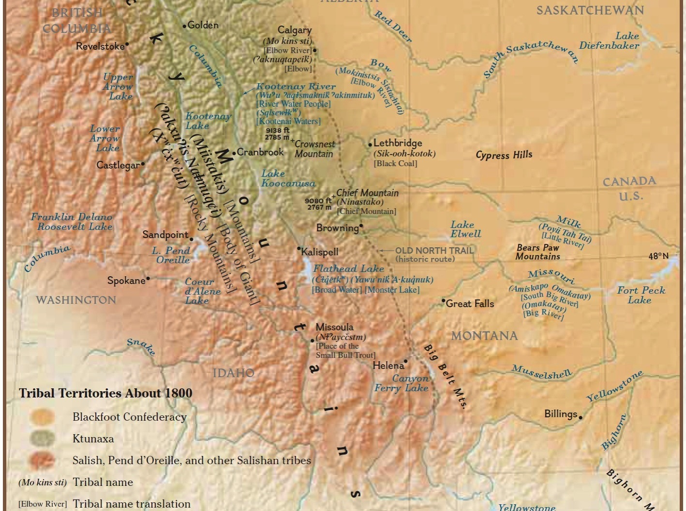
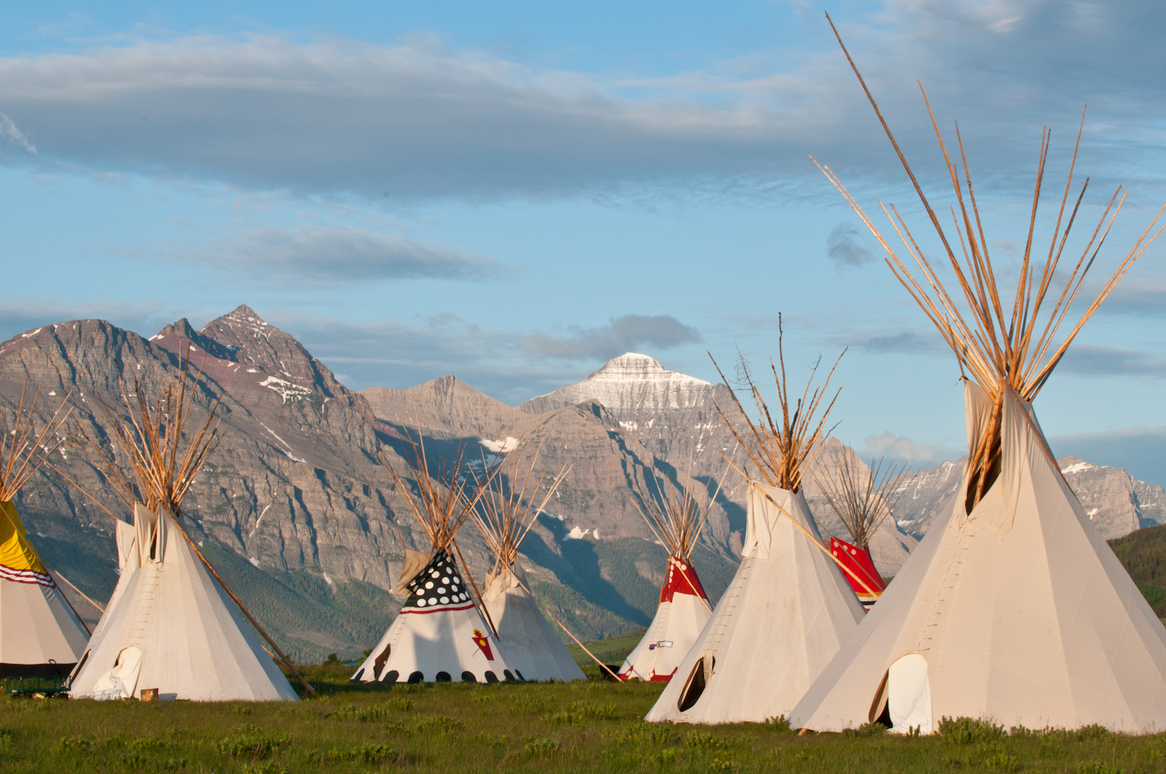

Slide 6
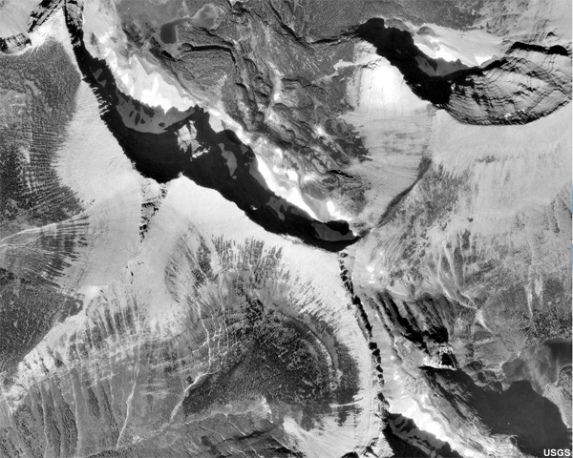
Hudson Bay
Atlantic
Pacific
Notes:
CrossSheds

Slide 7
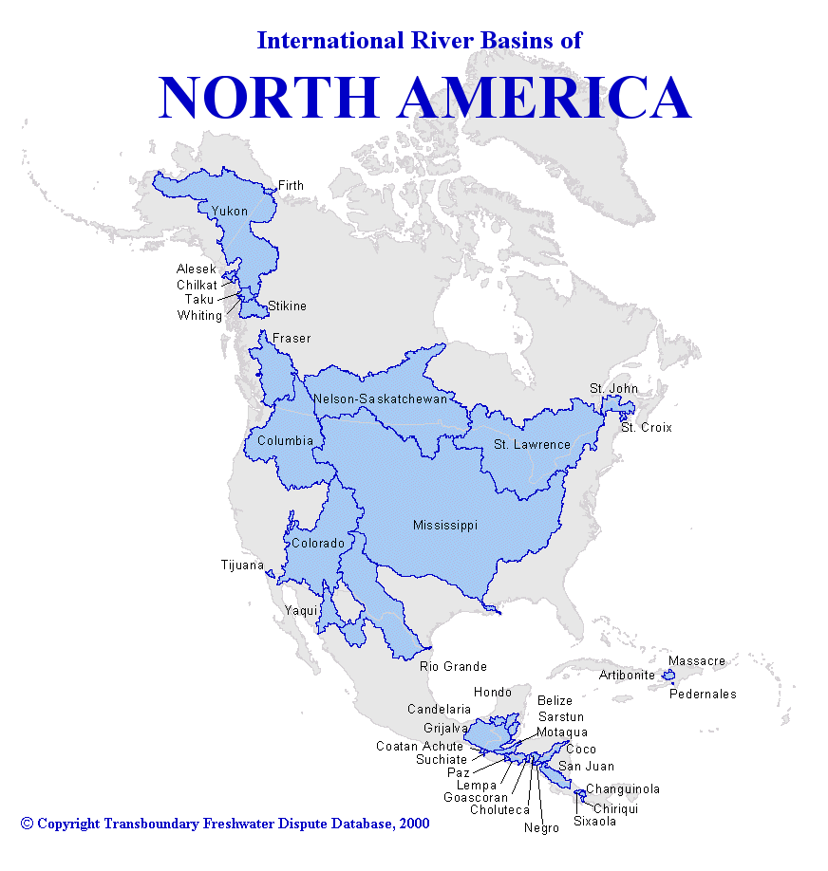

Slide 8
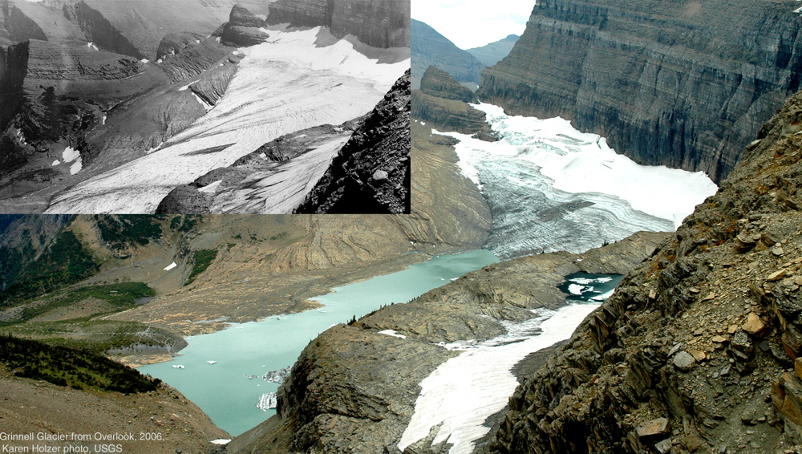
Grinnell Glacier: Glacier National Park
1940
2006
Courtesy USGS NOROCK

Slide 9
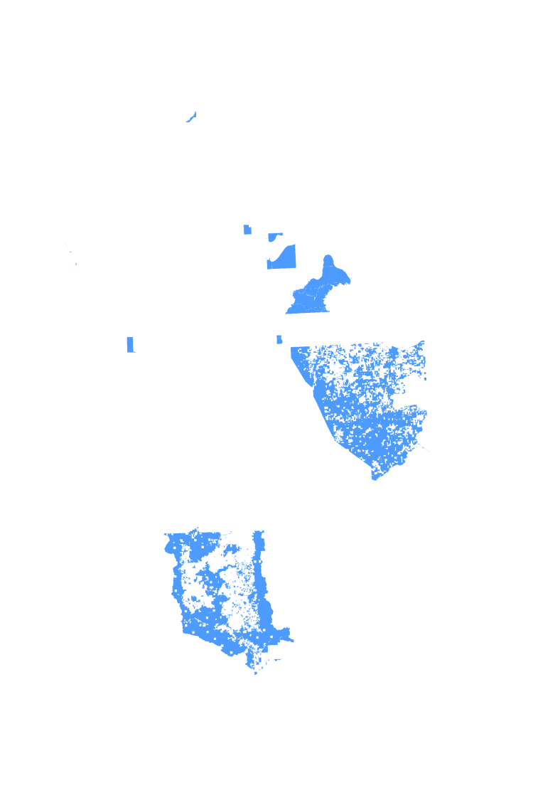
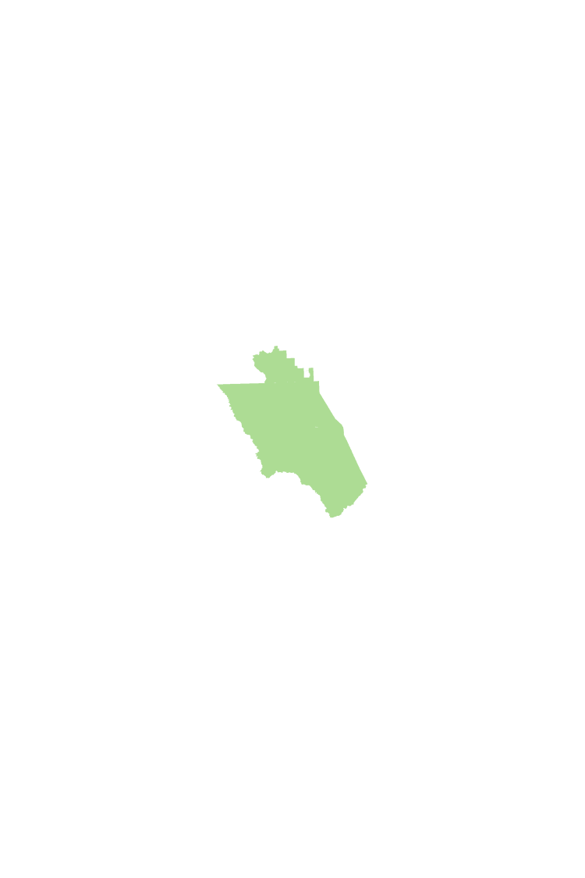


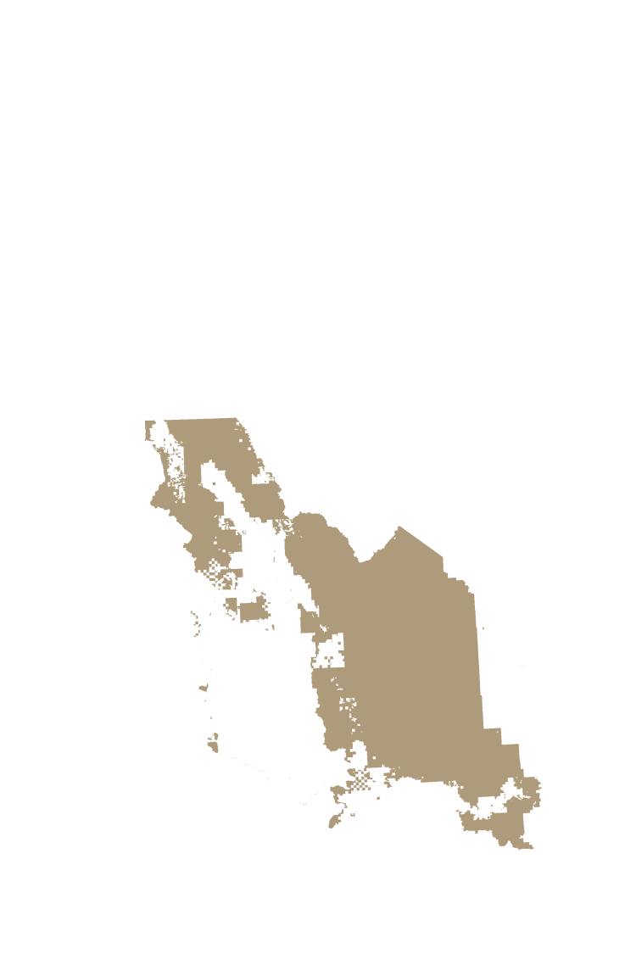




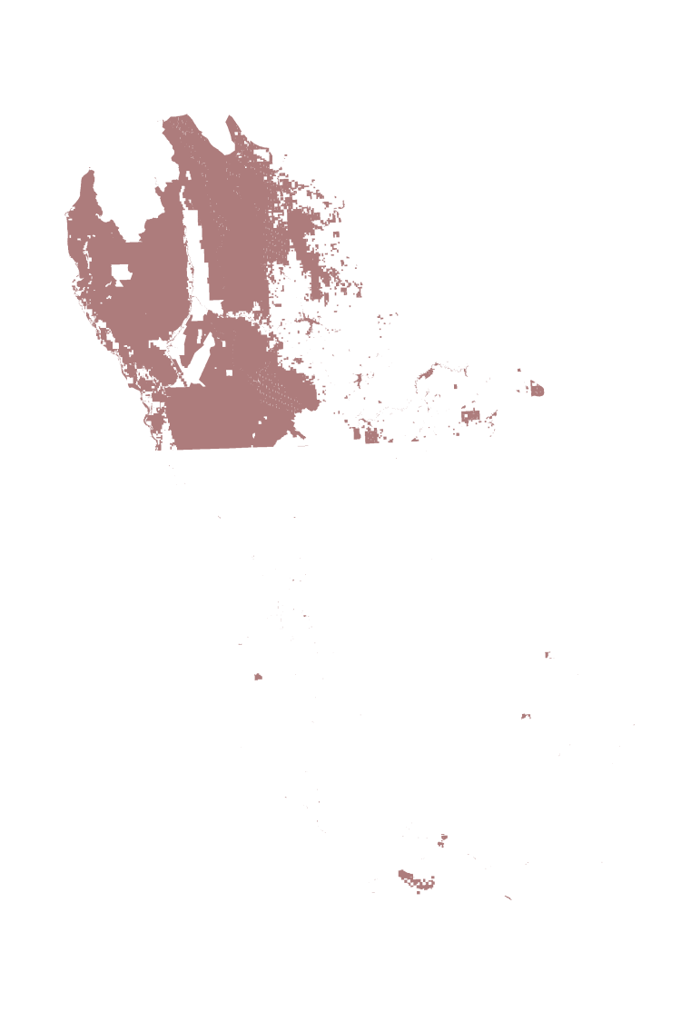


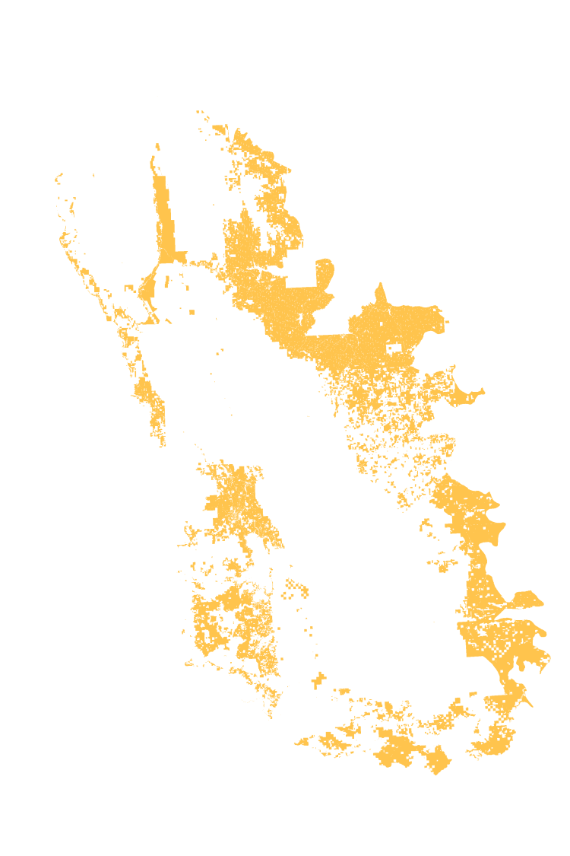
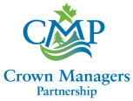
First Nations/Tribal land
National Parks
US Bureau of Land Management
US Fish & Wildlife
US Forest Service
Federal
Provincially Protected Areas
State Trusts
Montana Fish, Wildlife, & Parks
Provincial/State
Private Conservation Land
Plum Creek Timber
Private Land

Slide 10
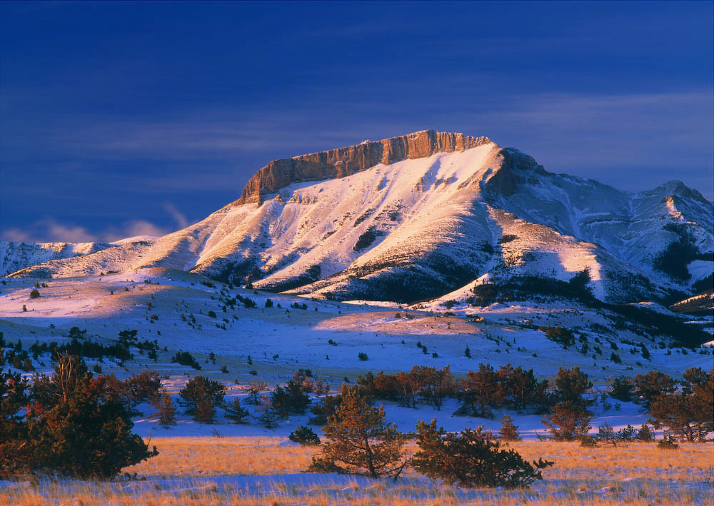
What Constrains?
A broad geographic scope – challenges of scale, representation, equity
Multiple jurisdictions (mandates, laws, policies, cultures)
Limited capacity
Competing factions
Competing goals

Slide 11
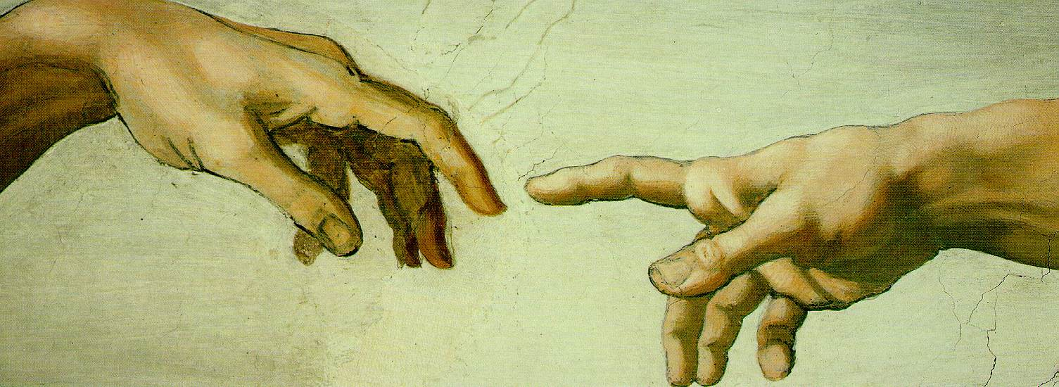
Connecting Social Scale with Ecological Scale
How can we scale up

Slide 12
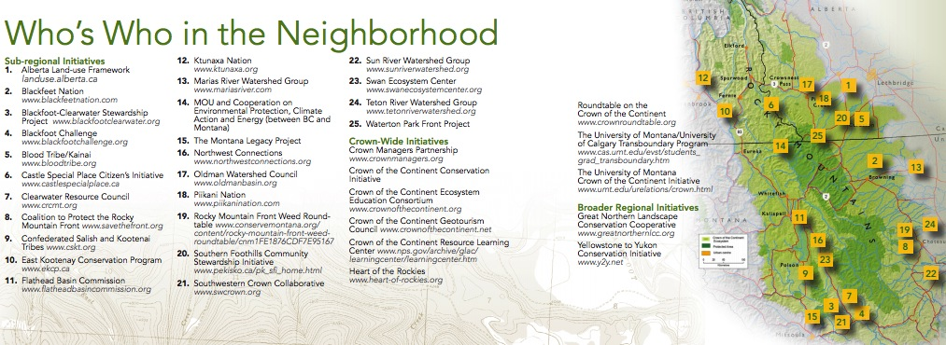
A Regional Neighborhood

Slide 13
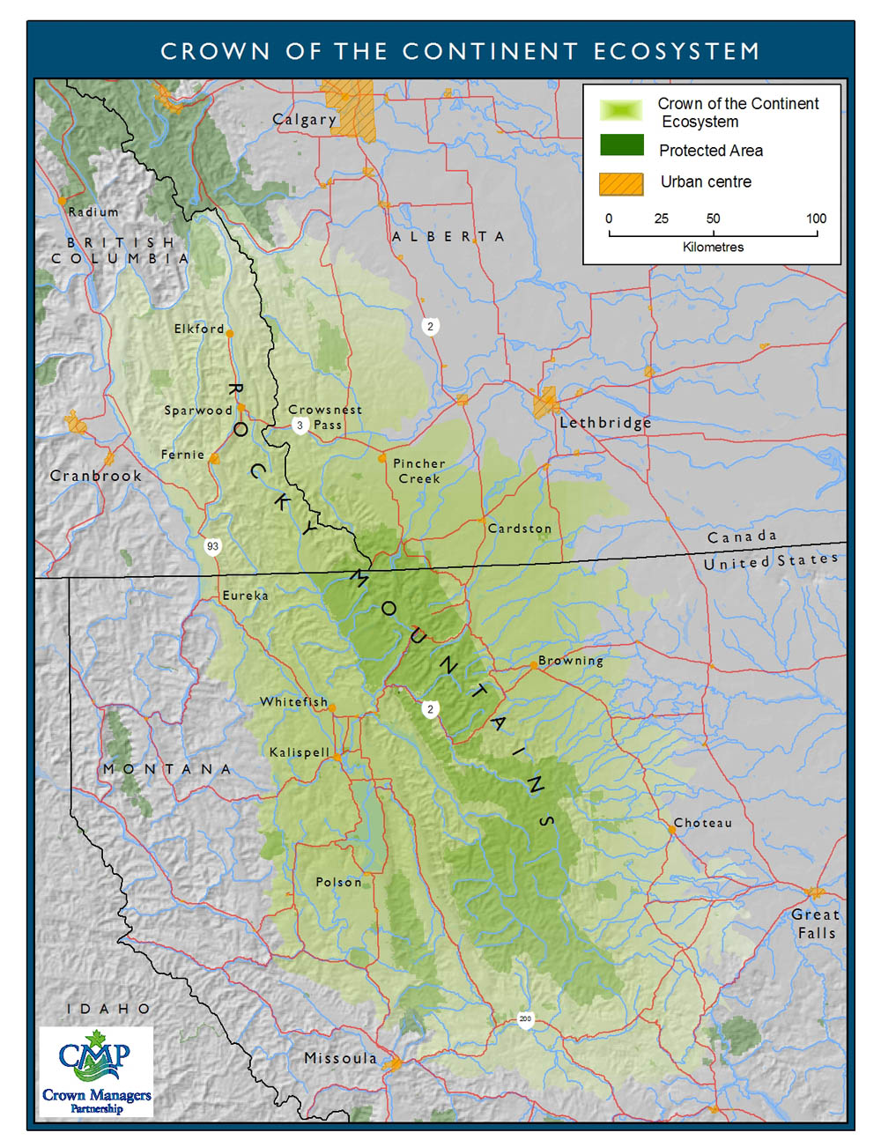
Crown-wide Initiatives
1994
COC Ecosystem Education Consortium
1999
UM/U Calgary Transboundary Program
2001
Crown Managers Partnership
2002
COC Resource Learning Center (GNP)
Heart of the Rockies
2007
COC Geotourism Council
Roundtable on the COC
2009
UM COC Initiative
COC Conservation Initiative

Slide 14
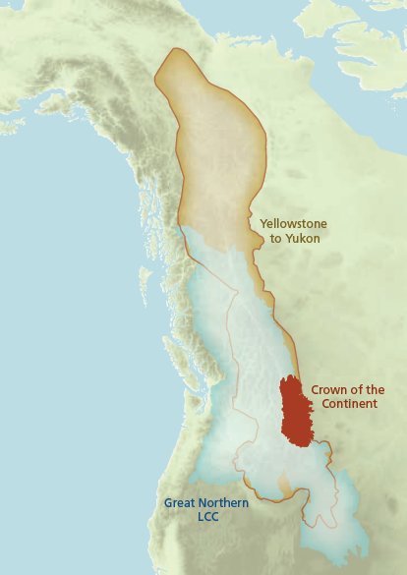

Slide 15
An impressive community of people shaping the future
Place-based Partnerships
Crown-wide Initiatives
Larger Regional Initiatives

Slide 16
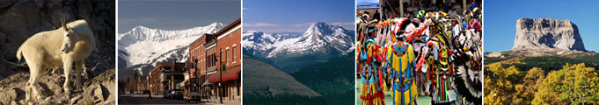
What is the challenge / opportunity?
Growing need and value to work
at all spatial scales and across silos
People are connected to the
landscape, but not to each other

Slide 17
Public Agencies
Landowners
Conservationists
Educators
Tribes & First Nations
Community Leaders
Small Business
Resource Industries
Researchers
What It Is
An annual gathering
An inclusive network
A vehicle to:
Raise awareness
Foster communication
Build identity
Forge a common agenda
Advocate and promote
Sustain people and nature

Slide 18
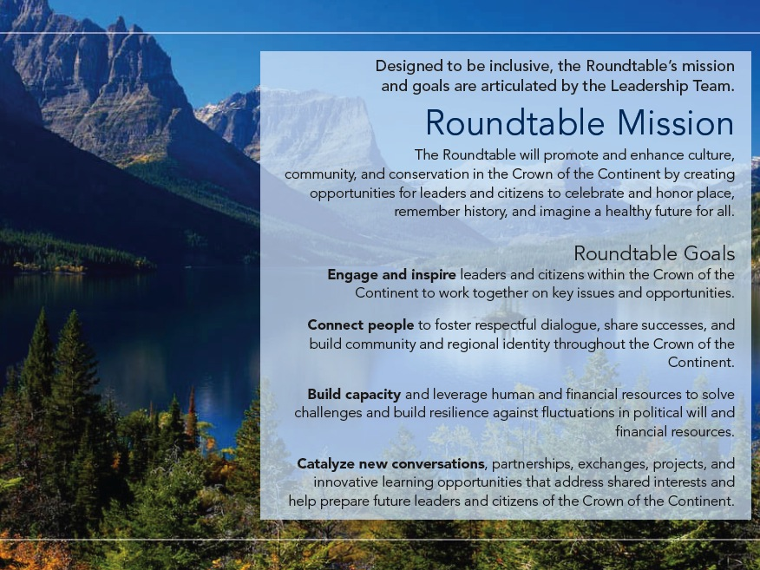
Culture
Community
Conservation

Slide 19
Initiatives
Annual Conference
  To exchange information, build relationships, and explore opportunities to work together
Friends of the Crown
  To build regional identity
Newsletter / Website
  To share information and resources on key issues, successes and challenges
Adaptive Management Initiative
  To sustain and enhance culture, community, and conservation by:
    Building capacity to advance the success of existing partnerships and initiatives
    Support on the ground adaptation projects

Slide 20
It takes time…
2006
2007
2008
2009
2010
2011
2012
2013
Graduate students affiliated with the Center for Natural Resources & Environmental Policy (CNREP) complete a preliminary inventory of formal and informal initiatives in the COTC to clarify who is doing what.
The Crown Mangers’ Partnership (CMP) invites CNREP to prepare a “communications plan” for CMP to improve both internal and external communications.
CNREP and the Lincoln Institute of Land Policy convene a broad-based workshop of about 100 people in Whitefish, Montana to take stock of current and emerging issues and initiatives in the region.
CNREP and the Lincoln Institute convene a small workshop of about 30 “leaders” in Kalispell, Montana to explore the idea of a “roundtable” to connect the various initiatives within the region
CNREP creates a web site for the Roundtable and a set of GIS maps
CNREP completes a “walk-about” to visit with all of the Tribes and First Nations in the region, and convenes a multi-day meeting in Pincher Creek, Alberta with Tribes & First Nations
CNREP and the Lincoln Institute convene another workshop with recognized leaders in the region at Glacier National Park to continue exploring ways to connect people and organizations in the Crown of the Continent
CNREP invites the Center for Large Landscape Conservation (CLLC) to come alongside and co-direct the Roundtable
CNREP and CLLC convene a “government-to-government” dialogue in Polson, Montana to explore opportunities and challenges in the region
CNREP, Lincoln Institute, and CLLC organize and convene the 1st Annual Conference in Waterton, Alberta
CNREP produces a foundational policy report on issues and options facing the region
CNREP, CLLC, and other partners launch “Friends of the Crown”
CNREP, Lincoln Institute, and CLLC organize and convene 2nd Annual Conference in Polson, Montana; the Confederated Salish and Kootenai Tribes (CSKT) co-host the Conference
CNREP and CLLC invite stakeholder to form the “founding” Leadership Team
Leadership team develops and adopts Terms of Reference for governing the Roundtable
CNREP and CLLC prepare a proposal to the Kresge Foundation for core operations support, including the annual conference (grant awarded)
CNREP and CLLC (staff), in consultation with the Leadership Team, prepare a proposal to the Kresge Foundation for an Adaptive Management Initiative (AMI) (grant awarded)
Leadership Team and staff solicit and evaluate proposals for the AMI and eventually award grants to 12 projects
Leadership Team and staff organize and convene the 3rd Annual Conference in Fernie, British Columbia and prepare 2012 Update
Leadership Team and staff prepare and adopt first Strategic Plan
CNREP and CLLC staff provide assistance to implement AMI projects, including contract administration, regular learning sessions, and project-specific support.
CNREP and CLLC (staff), in consultation with the Leadership Team, prepare a follow-up proposal to the Kresge Foundation to continue the Adaptive Management Initiative (AMI) (two-year grant awarded)
Leadership Team and staff organize and convene the 4th Annual Conference in East Glacier, MT
Leadership and staff prepare first Business Plan to guide the Roundtable’s annual projects and operations
2014
New Support Team structure goes into place
Leadership Team, Support Team, and local planning team organize and convene the 5th Annual Conference in Waterton Lakes, AB
16 Adaptive Management Initiative projects funded
New Leadership Team members added, representing Missoula County and the Blackfeet Community College
Tribal Gathering added to start of Annual Conference
Adaptive Management projects move forward
Short film on the Roundtable produced and shared

Slide 21
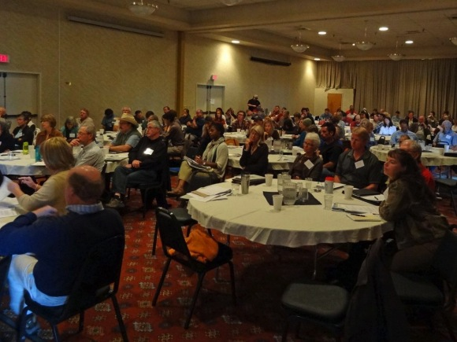
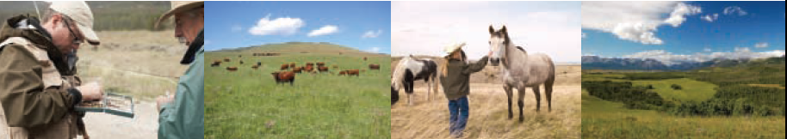
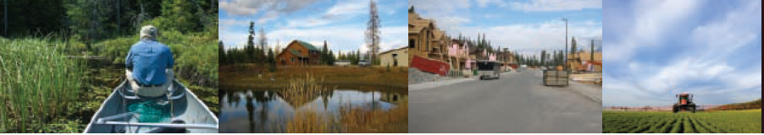

Slide 22
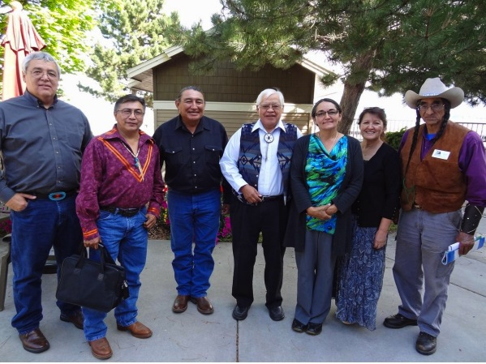

Slide 23
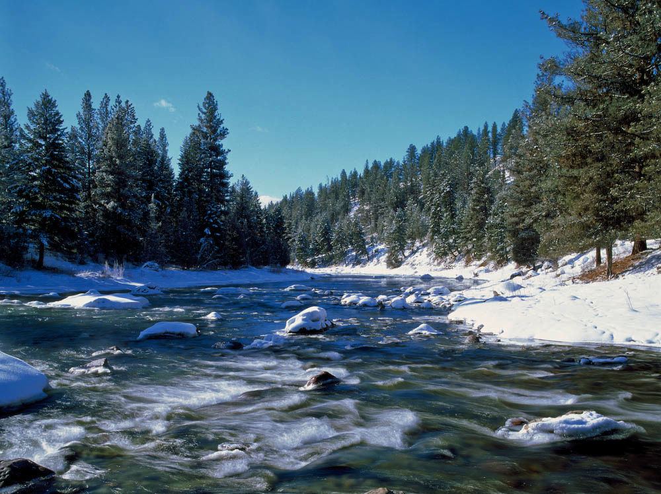
What Sustains?
Building Social Memory
A growing network of people and organizations
Successes at various scales and across jurisdictions
Momentum (learning, building new relationships, making new connections)
Enough capacity to serve as the glue
Consistent leadership
Relevance

Slide 24
16 Projects, five focal themes of the Roundtable
Forestry 37%
Working Lands 22%
Water 26%
Indigenous Perspective 11%
Sustainable Economies 4%
Notes:
Forestry 37%: Mostly planning
Water 26%: Watershed Management, beaver reintroducion,
Indigenous Perspecitves 11%: Working with Tribes, Tribal Workshop, Implementation on CSKT
Working Lands: Mostly weed and invasive spp programs
Sustainable Economies: Geotourism Council

Slide 25
Moving Towards Implementation
Engage with stakeholders, educate public and increase awareness of landscape changes
Implementation actions
Evaluation of the landscape: needs and gaps
Asses available science, vulnerability, general ecological health
Identify goals and design implementation plan
Notes:
It is a long process to get to implementation
One of our problems was finding projects that were ready-to-go
Since there weren’t many, we decided to fund at many levels
Actions may be: Stream bank restoration, drought management, Invasive spp programs,
Education may be considered an implementation action!

Slide 26
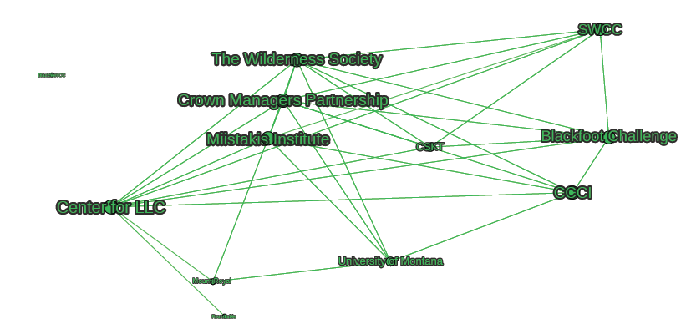
Adaptive Management Organizations
Year 1

Slide 27
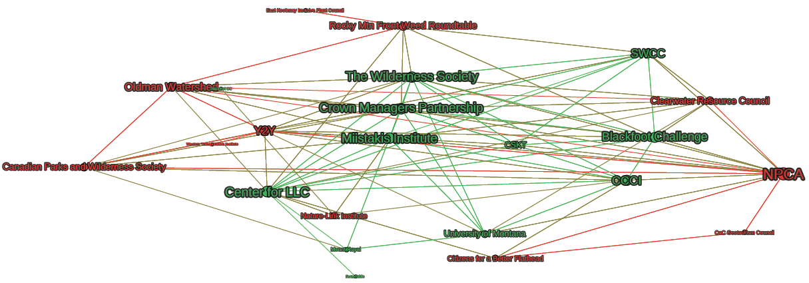
Adaptive Management Organizations
Year 2

Slide 28
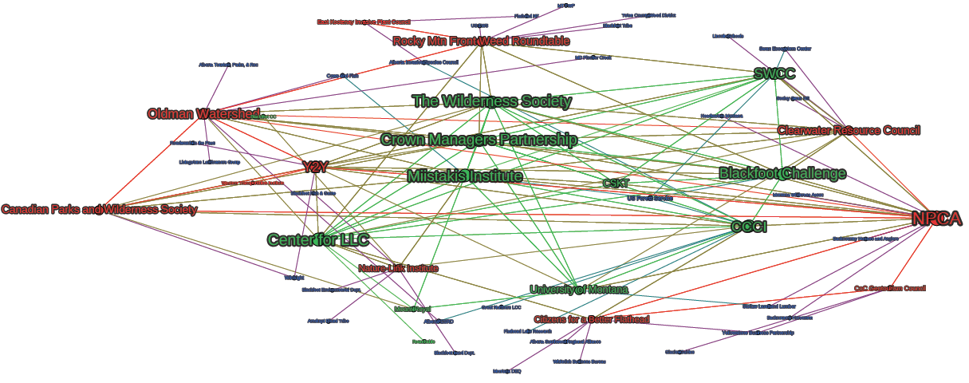
Adaptive Management Organizations
Year 2 plus Project Partners

Slide 29
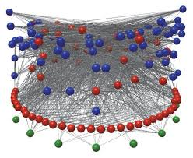
Networked Communication
Networked Science
Networked Governance
Networked Society

Slide 30
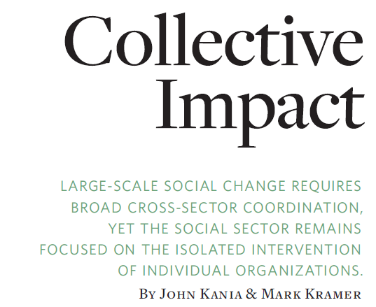



Slide 31
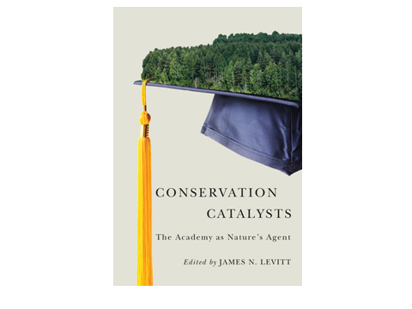


Slide 32
