Slide 1

Transboundary Conservation Governance:
Key Principles & Concepts
Governance of Transboundary Conservation Areas
WPC, Sydney, 17 November 2014
Matthew McKinney and Maja Vasilijević
IUCN WCPA
Transboundary Conservation Specialist Group

Slide 2
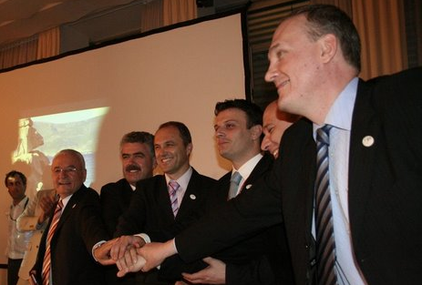
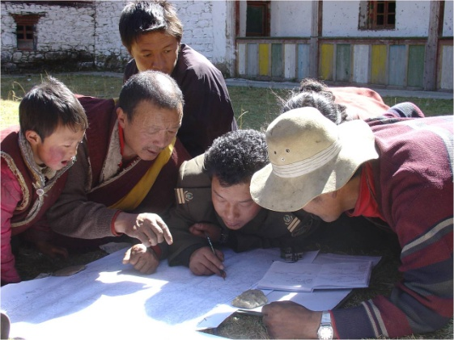
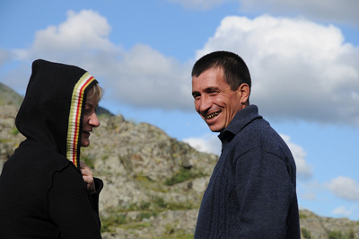
Defining governance
Graham et al. (2003) define governance as
‘the interactions among structures, processes and traditions that determine how power and responsibilities are exercised, how decisions are taken, and how citizens or other stakeholders have their say’
Transboundary Conservation Specialist Group

Slide 3
Governance vs. management
Who decides what the objectives are How to bring together the appropriate people with the best available information to determine what ought to happen How the decisions are taken Who holds power, authority, and responsibility Who is accountable Reconciling differences between and among stakeholders Deciding amongst choices that lead to trade-offs ____________________________________________ What is done in pursuit of given objective The means and actions to achieve objectives Generate, implement, and assess the effectiveness of alternative policies, programmes, and plans
Governance
process
Management
substance
Transboundary Conservation Specialist Group

Slide 4
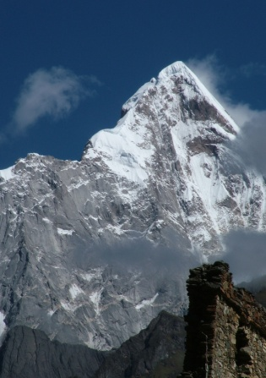
IUCN’s Types of Protected Area Governance
Governance by government
  Multiple levels … national, regional, local
  May delegate responsibilities to NGOs, communities, etc.
Private governance
  Individual landowners
  NGOs
  For profit organizations
Indigenous/local governance
  Indigenous initiatives
  Community-based efforts
Shared governance
  Collaborative
  Joint
Transboundary Conservation Specialist Group

Slide 5
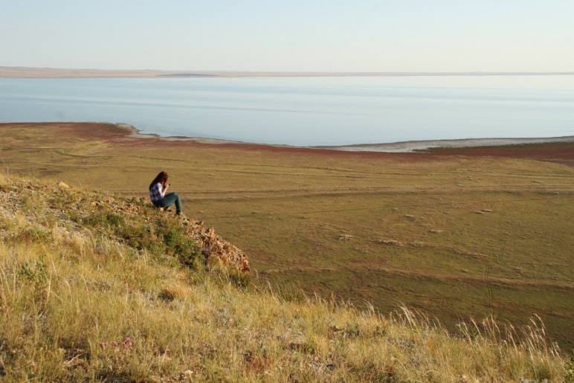
Transboundary governance
A type of shared governance in which
various actors from two or more countries
share power, authority and responsibility in
the decision-making process
It normally involves:
  Multiple actors
  Diverse levels of authority
  Informal and/or formal arrangements
No single model, but key characteristics
Transboundary Conservation Specialist Group

Slide 6
10 defining characteristics of TBC governance
Case studies will illustrate how these characteristics are adapted
1. Leadership
6. Learning
2. Public participation
7. Decision-making
3. Representation
8. Conflict resolution
4. Function and scope
c
9. Adaptive management
5. Authority, legitimacy and accountability
10. Financing
Transboundary Conservation Specialist Group

Slide 7
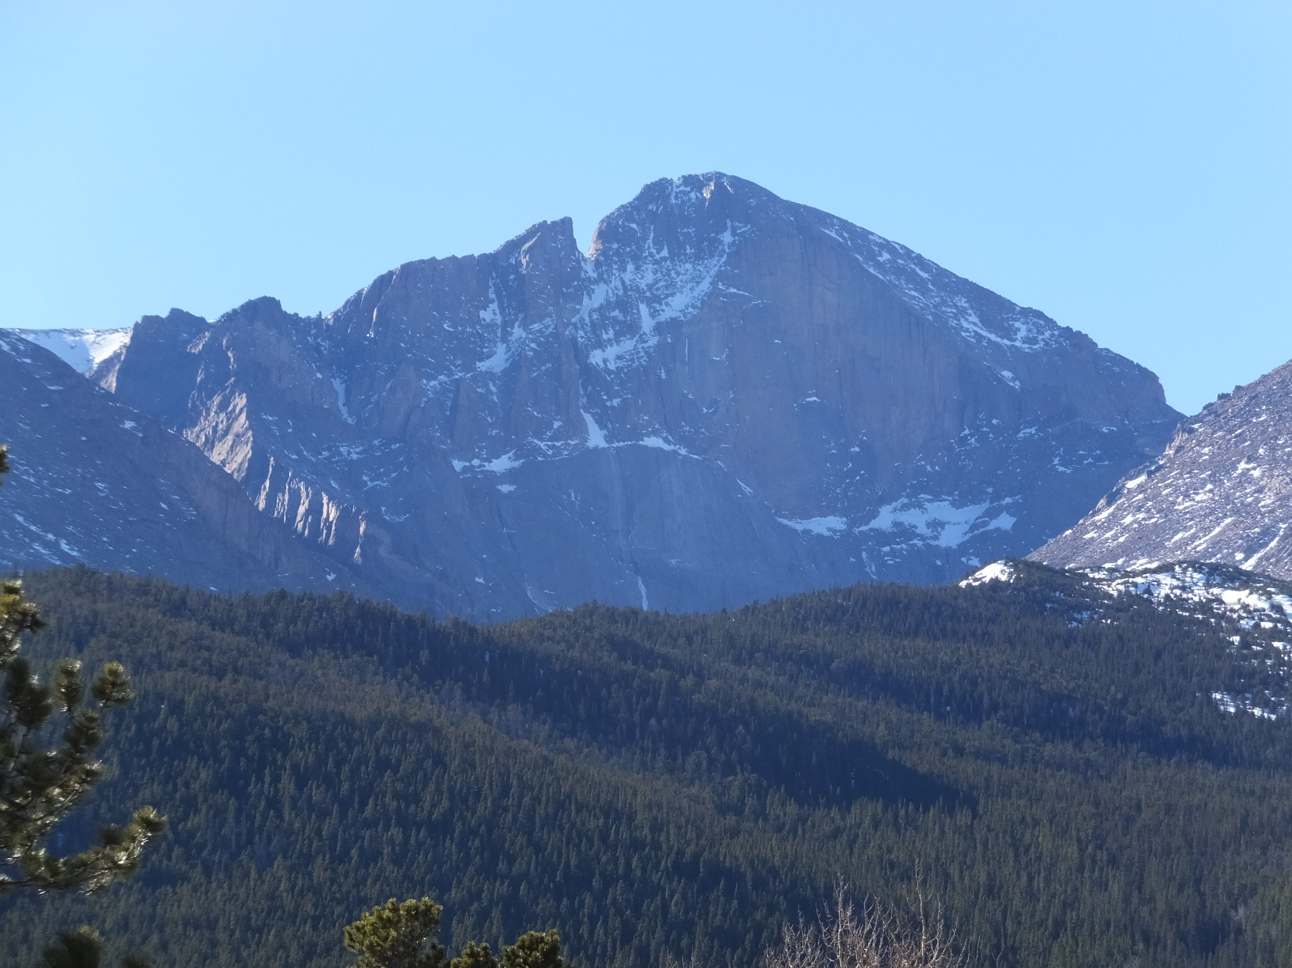
Leadership for TBC
The willingness and ability to share power, mobilize people, synthesize ideas, and assemble resources
The ability to …
  forge alliances with people holding diverse interests, viewpoints, and mandates
  invite people to develop and take ownership of a shared vision and values;
  bridge differences and nourish relationships
The need for different types of leaders to catalyse, enable, and sustain action
Transboundary Conservation Specialist Group

Slide 8
Types of
Leadership
For TBC
Transboundary Conservation Specialist Group

Slide 9

Financing for TBC
In addition to …
  Building civic and political will
  Mobilizing and engaging key actors
  Gathering the best available scientific information
Funding is essential for transboundary conservation
  “Backbone support”
    Planning, managing, and supporting the activities of a TBC initiative
    Facilitative leadership, data collection and reporting, technology and communication support, and handling the necessary logistical and administrative functions
  On-the-ground work
Transboundary Conservation Specialist Group

Slide 10
Sources of Funding
Transboundary Conservation Specialist Group

Slide 11

(Some) Obstacles
Lack of:
  Public awareness & understanding
  A compelling story
  Civic & political will
  Trust among potential partners
  Local capacity and civil society experience
  Capacity to integrate culture, community, and conservation interests
Incompatible missions & mandates, making it difficult to align common goals and aspirations
Competition within the same region for limited resources
Challenge of moving from ad hoc project funding to more sustainable operational funding
Transboundary Conservation Specialist Group

Slide 12
Recommendations to Improve Financing
Create training opportunities
  For example a Transboundary Conservation Finance training
  Peer exchange and network
  Highlight innovative tools, programmes, and partnerships
Compile and disseminate resources
  Information clearinghouse
  Case studies
  “Ask the Expert” webinars
Build and support a Transboundary Conservation Finance Network
  Exchange information
  Build capacity
  Inspire each other
Foster new and innovative ideas & approaches!
  e.g., a “funder’s collaborative” around particular landscapes
Transboundary Conservation Specialist Group

Slide 13
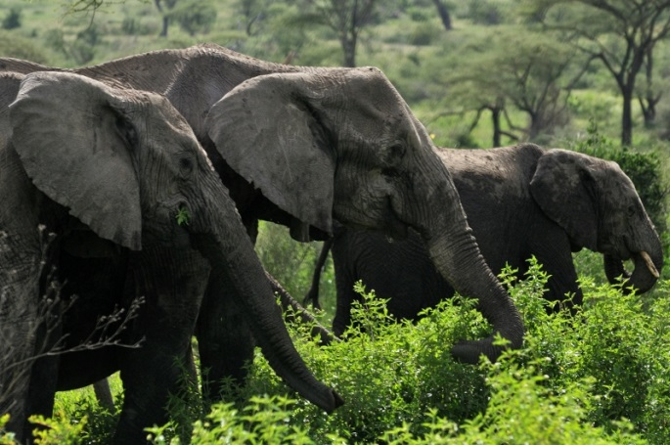
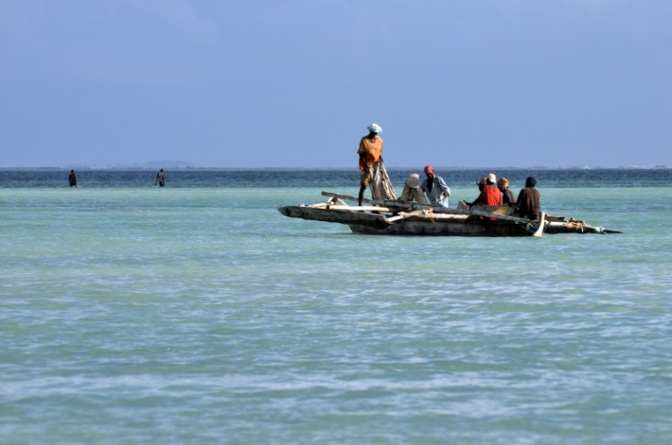
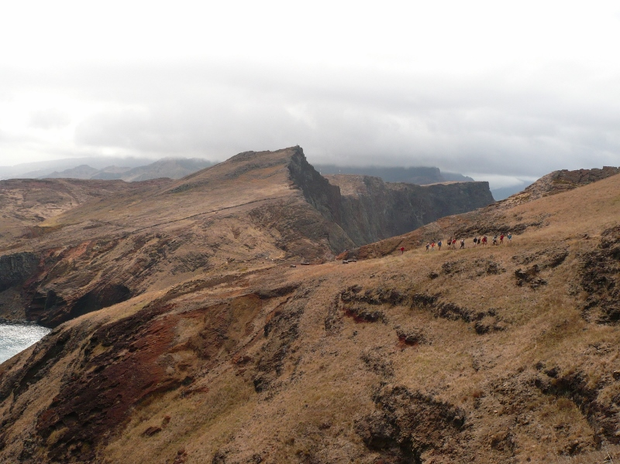
3 trends in TBC governance
Increasingly collaborative - engagement of diverse players & sectors
Increasingly nested - includes distinct but linked systems at two or more levels of social organization
Increasingly adaptive - learn by doing and create an expectation of
learning as we go
Transboundary Conservation Specialist Group

Slide 14
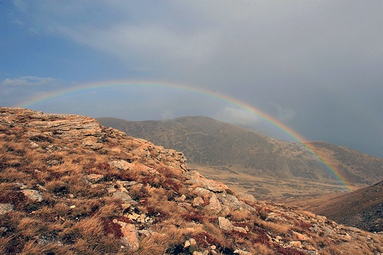

Five Key Take-home Lessons
No single model, but key elements
Let form follow function; create homegrown solutions
Be intentional, yet flexible and adaptive
Promote accountability via open, inclusive, transparent processes
Govern at the scale of the problem
Transboundary Conservation Specialist Group

