Slide 1

Guidelines for the Establishment and Development of SADC TFCAs
IUCN World Parks Congress
Sydney
12 – 19 November 2014
Kevan Zunckel

Slide 2
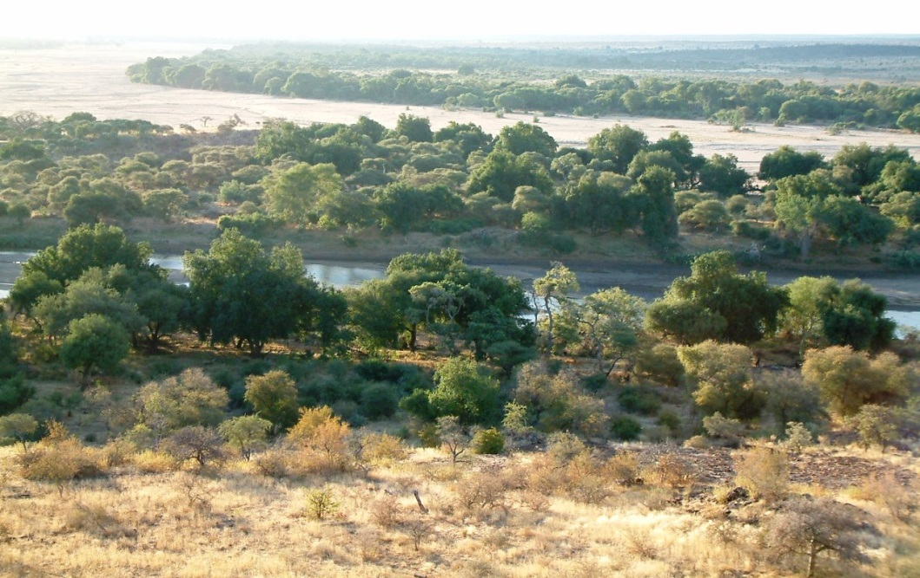
Presentation outline
The SADC TFCA Guidelines
The current status regarding governance of SADC TFCAs
Some observations

Slide 4
SADC TFCA Guideline - process of compilation
Development of a table of contents and presentation to the SADC TFCA Network for critical review – Jo’burg workshop (South Africa).
Revision of ToC and initiation of process for SADC TFCA practitioner engagement – Luanda workshop (Angola)
Guideline drafting process including inputs from practitioners received via email and SADC TFCA Network Portal
Critical review of draft guidelines by practitioners and production of final draft – Maseru workshop (Lesotho)
Translation of final draft into Portuguese and French for final review – still in process

Slide 5
SADC TFCA Guideline – Table of Content
Intro
Part I: Background and contextual information
  Definitions
  Legal and policy framework
  The value of TFCAs
  The status quo
Part II: The initiation process
  Relevant stakeholder and role players
  Assessing the enabling environment
  Assessing feasibility
  Designing the implementation process

Slide 6
SADC TFCA Guideline – Table of Content (cont.)
Part III: Establishment and development process
  Securing buy-in and building legitimacy
  Selecting an appropriate governance model
  Defining the geographic extent
  Developing a framework for joint management
  Refining the joint management framework
  Planning for financial sustainability
  Monitoring and evaluation

Slide 7
SADC TFCA Governance
  Governance instruments – increasing in formality
    Memorandum of agreement – written understanding between parties to cooperate on the achievement of an agreed objective
    Memorandum of understanding - expresses a convergence of will between the parties, indicating an intended common line of action
    Treaty - express written agreement that sovereign states use to legally bind themselves to a multi-national agreement
    Protocol - the etiquette of diplomacy and affairs of state. It may also refer to an international agreement that supplements or amends a treaty

Slide 8
SADC TFCA Governance
  Governance mechanisms (level of complexity proportional to age of TFCA)
  high level multi-national political structure – ministerial committee;
  a high-level multi-national technical structure - joint management board or committee;
  a number of discipline-specific or sectoral multi-national structures - management committees or task groups;
  Secretariats and/or implementation units (often linked to short-term donor-funding)

Slide 10
Some observations
  Pre- and feasibility assessments must be used to guide the selection of a model that is appropriate to specific circumstances
  Whatever model is selected it must evolve towards ensuring:
    Strong collaboration at and between all spheres
    Feedback mechanisms between spheres
    Adaptability and flexibility
    Performance tracking
    Measure, monitor and track equitable flow of benefits
    Open channels of communication
    Long-term access to adequate resources

Slide 11
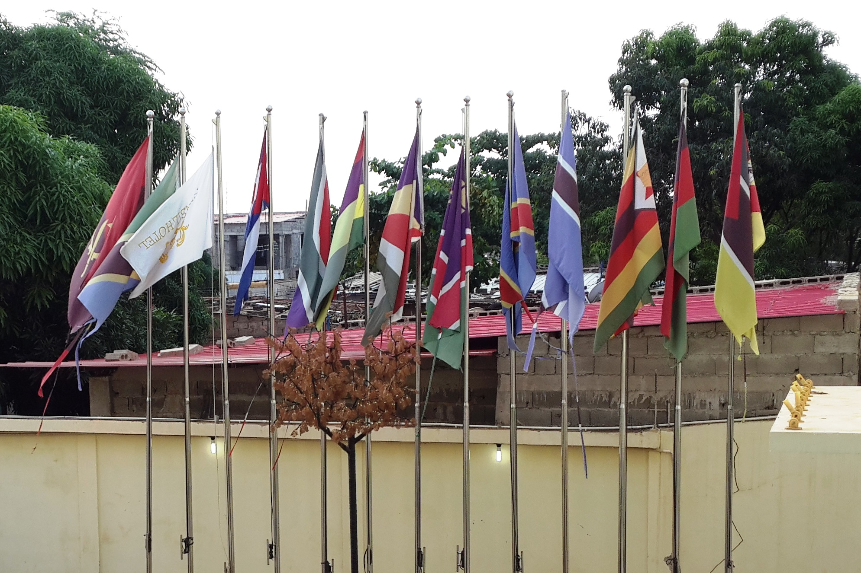
THANK YOU

