Slide 1
Integrated Conservation and Development Transboundary Initiatives in the Hindu Kush Himalayas
Nakul Chettri
Side Event:
Governance of the Transboundary Conservation Areas
17 November 2014, Olympic Park, Sydney

Slide 2
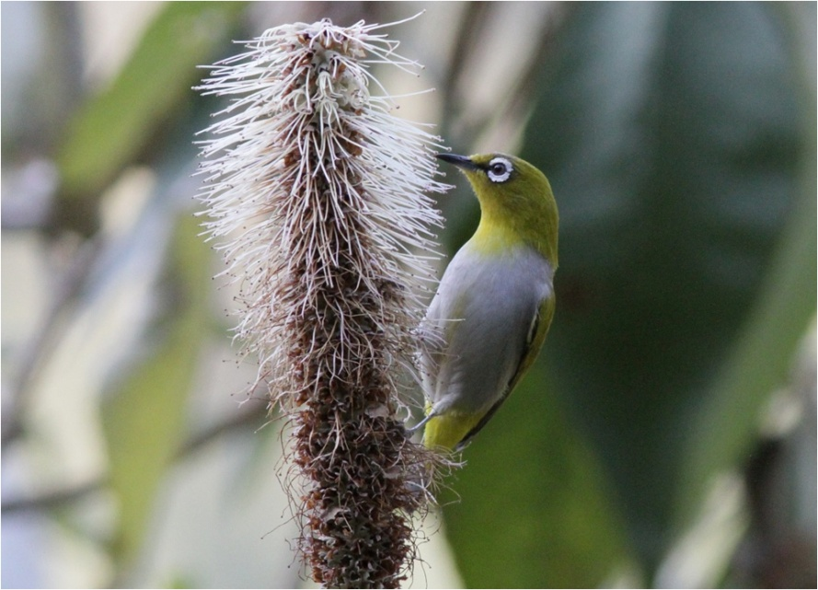
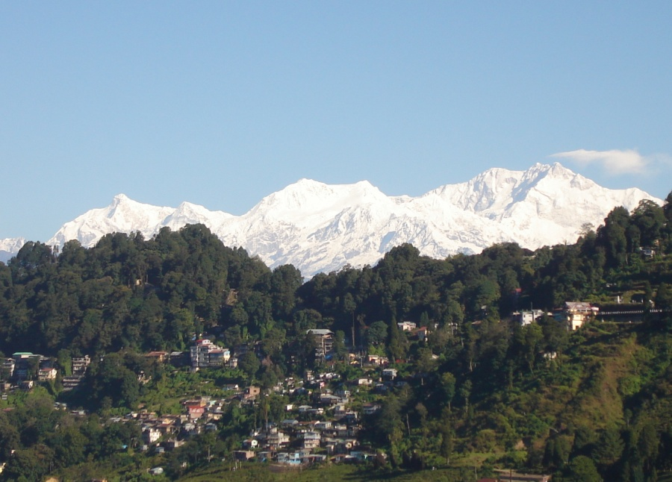
Presentation Outline
Introduction
Rationale and concept
Framework elements and key achievements
Challenges and lessons learnt

Slide 3
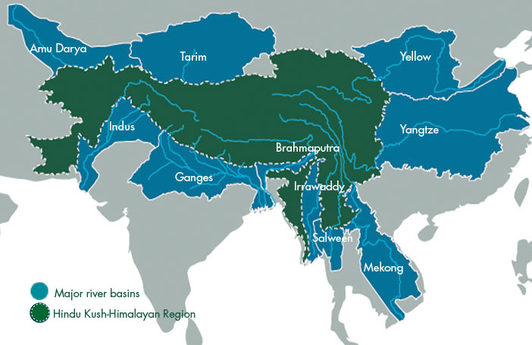
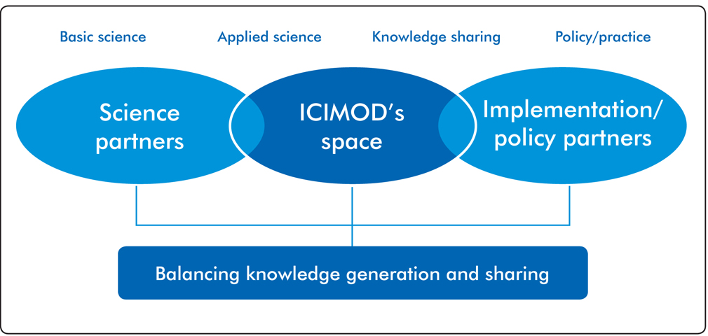
ICIMOD: a regional platform and enabling centre
Inter-governmental non-political international organization
Mountain learning, knowledge and enabling centre
Promote regional cooperation
Build capacities
Link research with policy and practice

Slide 4
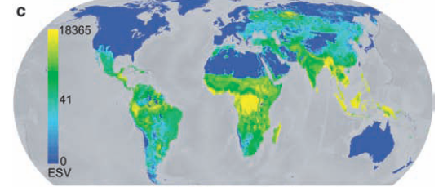
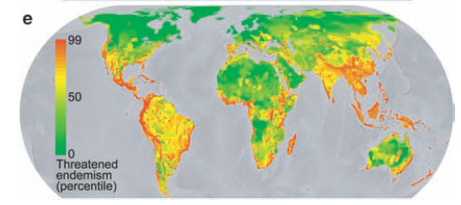
Transboundary Landscapes: the rationale
Higher ecosystem services values
House 4 biodiversity hotspots, 488 PAs, 331 IBAs
Dependency of one third of humanity
Culturally rich with 1000 living languages
Vulnerable to varied drivers of changes including climate change
Turner et al 2012

Slide 5
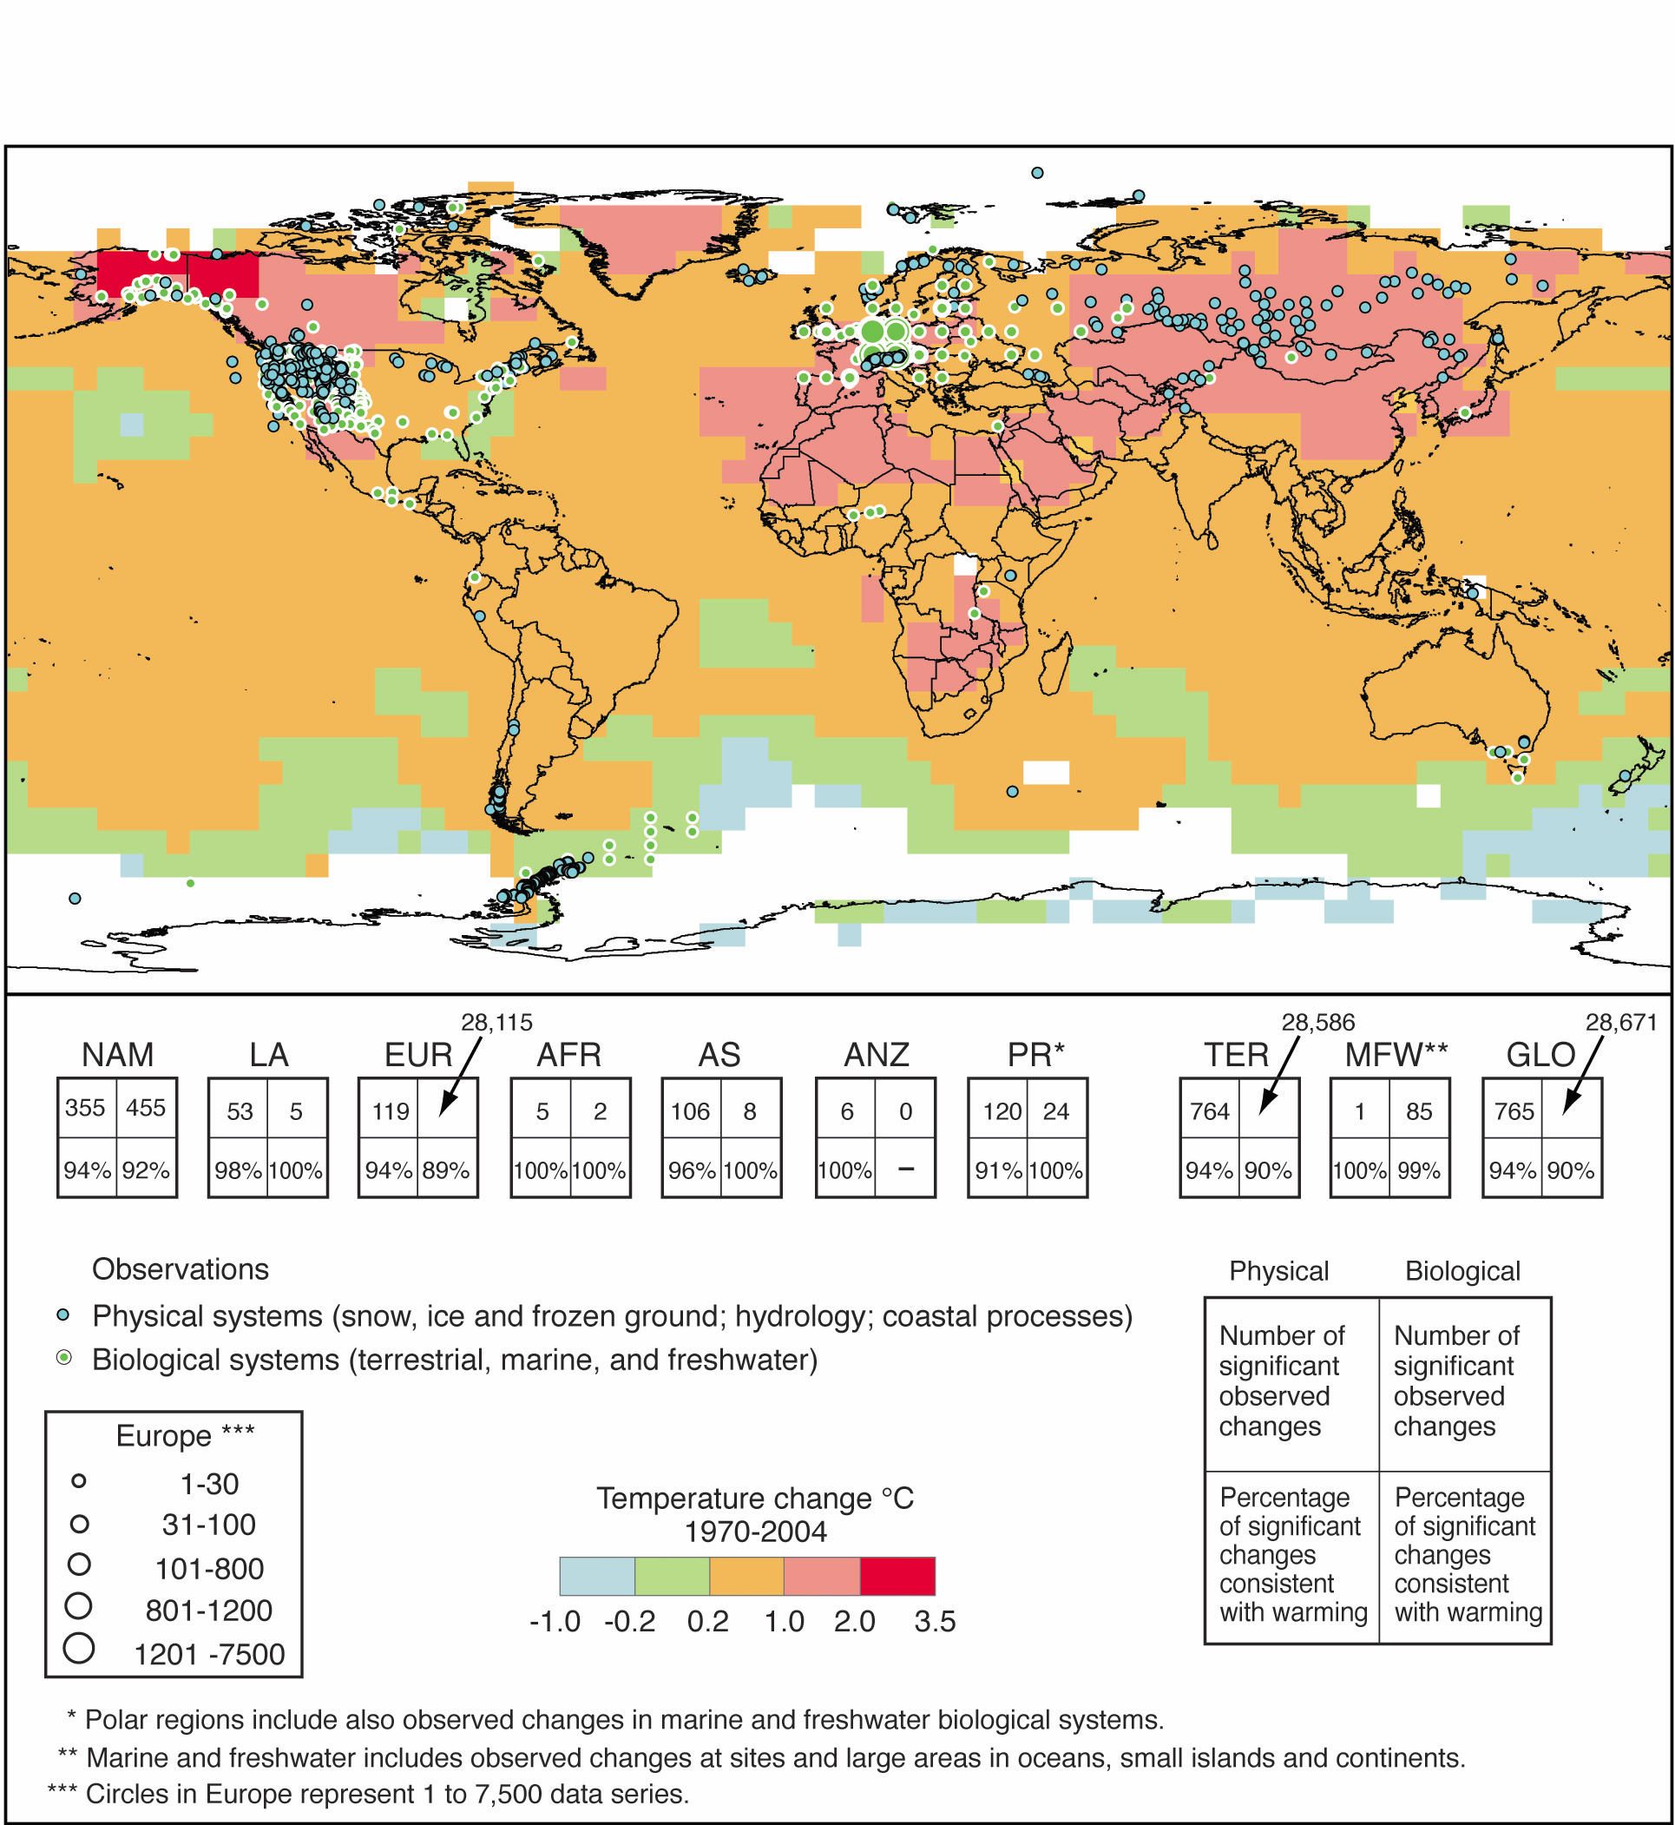
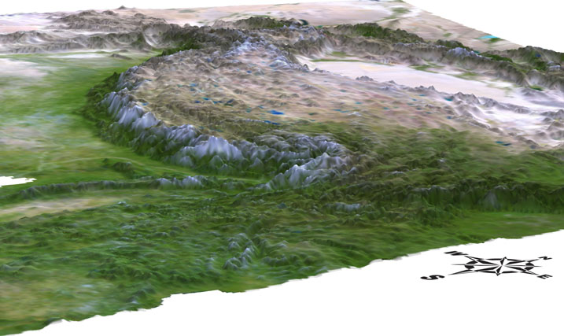
Transboundary Landscapes: the rationale
Himalayan region as a data deficit area
Most ecosystems are transboundary in nature
Environmental changes are prominent and visible
Differences on governance capacity, conservation priority
Weak collaboration

Slide 6
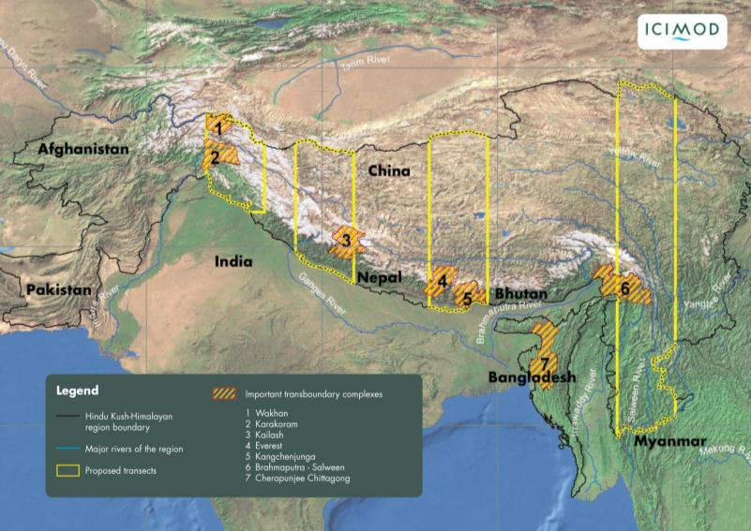
Transboundary Landscapes: the concept
Consistent and comparable data
Adequate research on biophysical and social aspects
Proper representation coverage - arid to wettest areas, altitudinal, longitudinal and latitudinal

Slide 7
Goal
Transboundary landscapes are better conserved and managed for sustaining ecosystem goods and services to improve livelihoods and enhance ecological integrity, economic development, and socio-cultural resilience to environmental changes.

Slide 8
Participatory planning with long term vision
Sustainability and exit strategy
Programme Implementation; Policies & Institutions development
Years
Programme Implementation Plans
Formulation of Regional Cooperation Framework
Feasibility Assessments
Preparatory Phase
Start-up Phase
Phase I
Phase II

Slide 9
Focus Components
Component 1- Innovative livelihoods and adaptation to change
Component 2- Ecosystem management
Component 3- Access and benefit sharing
Component 4- Long term conservation and monitoring
Component 5- Regional cooperation, enabling policy and knowledge management
Gender
Governance

Slide 10
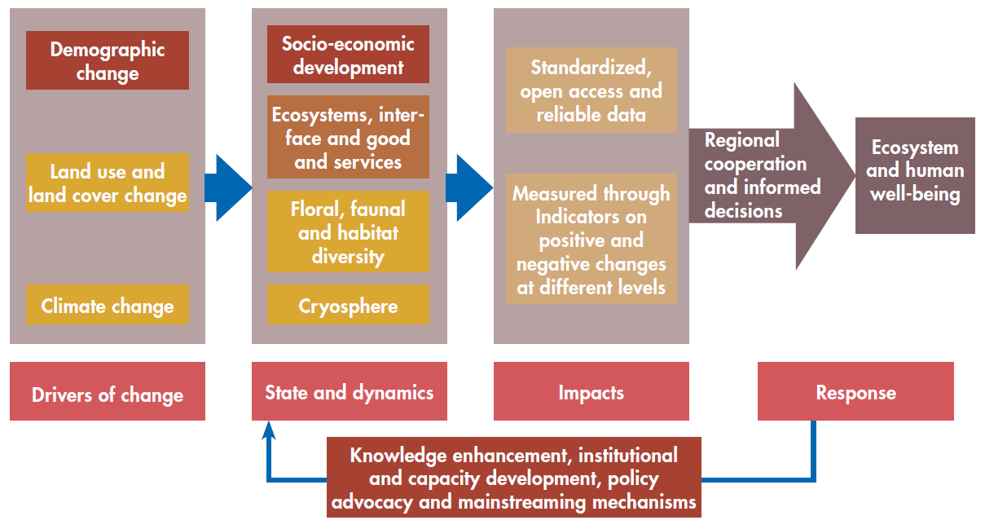
Integrated approach through DSIR monitoring Framework

Slide 11
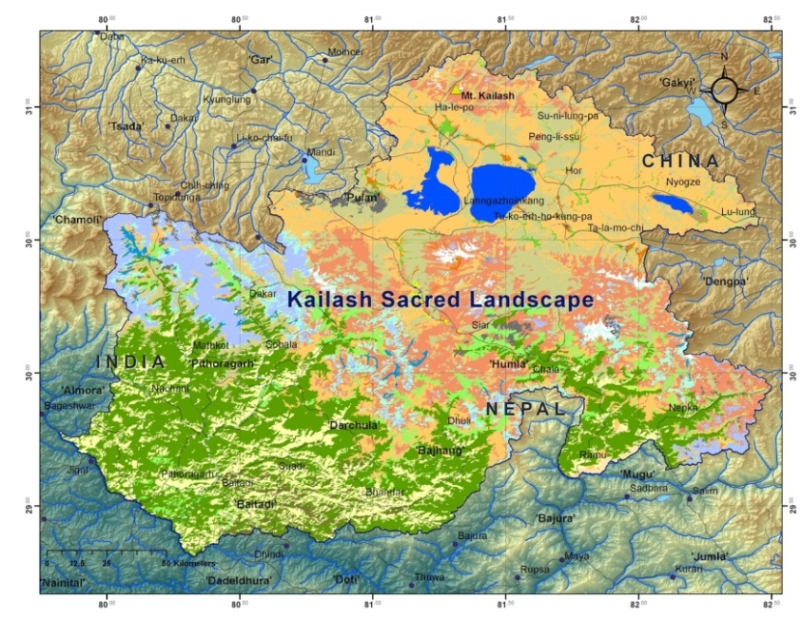
Kailash Sacred Landscape
(China, India and Nepal)
Uniqueness:
Semi arid region to temperate region, sacred areas with Mt Kailash and Mansorover lakes, origin of four major rivers
Programme Implementation; Policies & Institutions development
Years
Programme Implementation Plans
Formulation of Regional Cooperation Framework
Feasibility Assessments
Preparatory Phase
Start-up Phase
Phase I
Phase II

Slide 12
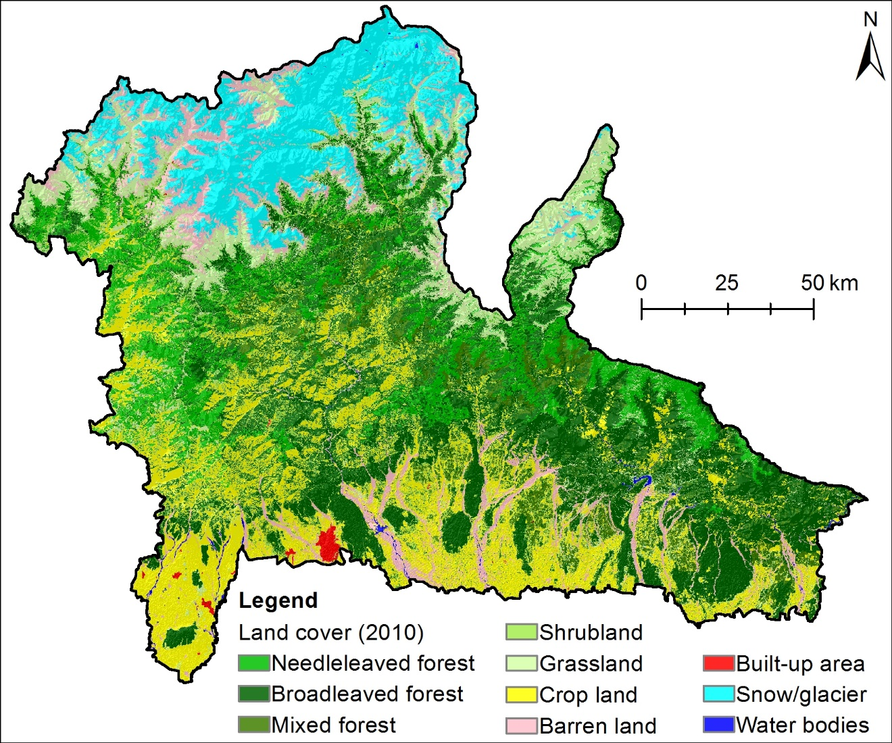
Kangchenjunga Landscape
(Bhutan, India and Nepal)
Uniqueness:
Wet region, having high potentials for developing conservation corridors as connectivity for climate change adaptation, Mt Kangchenjunga the third highest mountain ecosystem, connecting ecological regions from subtropical to alpine areas
Years
Programme Implementation Plans
Formulation of Regional Cooperation Framework
Feasibility Assessments
Preparatory Phase
Start-up Phase
Phase I
Phase II

Slide 13
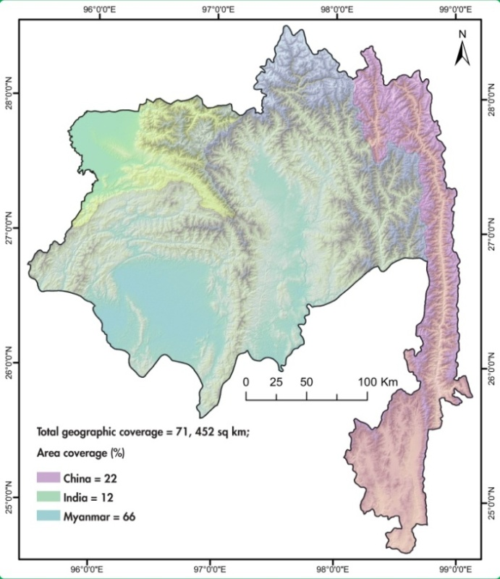
Brahmaputra-Salween Landscape
India, Myanmar and China
Uniqueness:
Convergence of three Biodiversity Hotspots – Himalayas, Indo-Burma and Mountains of Southwest China, one of the highest diversity of flora and fauna, more than 200 species of Rhododendrons, Landscape that connects Himalayas with Mekong region
Years
Formulation of Regional Cooperation Framework
Feasibility Assessments
Preparatory Phase
Start-up Phase
Phase I
Phase II

Slide 14
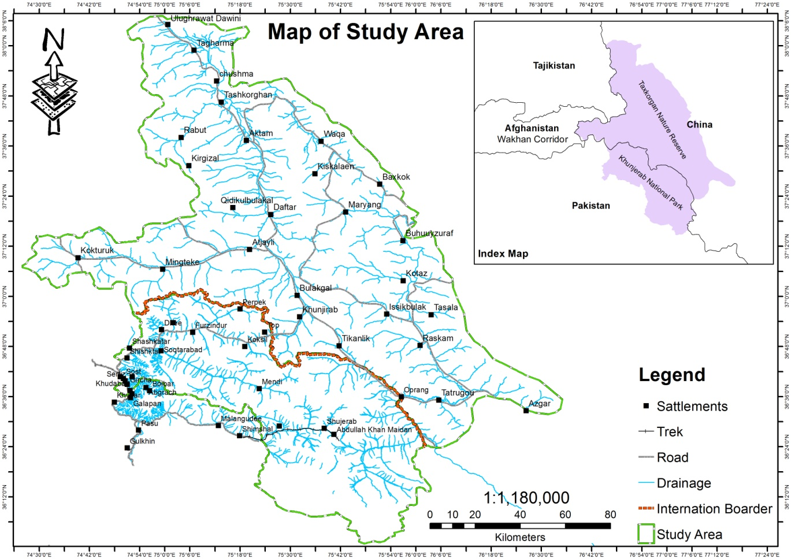
Karakoram-Pamir Landscape
(China and Pakistan)
Uniqueness:
Arid region, habitat for Marco-Polo Sheep and parts of Silk road that connects to Brahmaputra-Salween
Years
Formulation of Regional Cooperation Framework
Feasibility Assessments
Preparatory Phase
Start-up Phase
Phase I
Phase II

Slide 15
Wakhan Landscape
(Afghanistan, China, Pakistan, Kazakistan )
Uniqueness:
Arid region, habitat for Marco-Polo Sheep and parts of Silk road that and also links to Central Asian Mountains
Years
Feasibility Assessments
Preparatory Phase
Start-up Phase
Phase I
Phase II

Slide 16
Key achievements
Conceptual acceptance for three landscapes (Kangchenjunga, Karakoram-Pamir and Brahmaputra- Salween)
Reconciling conservation and development agendas
Endorsements of Regional Cooperation Framework (Kailash)
Understanding governance and transboundary issues at various levels
Integrated Ecosystem Management Framework
Long Term Environmental and Socio-ecological Monitoring Framework

Slide 17
Challenges and lessons learnt
Bottom up approach is inadequate for Transboundary process
Participatory process - integrative but complex and slow
Trade off between conservation and development (e.g. human wildlife conflict)
Local people are positive about conservation provided they benefits during the management interventions or do no harm.
Political will (governance) necessary for regional cooperation and long term sustainability of the initiative

Slide 18









Thank you
Acknowledgements

