Slide 1

WCPA Best Practice Protected Area Guidelines on transboundary conservation: Key concepts
Presenting IUCN WCPA BPG on transboundary conservation
WPC, Sydney, 18 November 2014
Matthew McKinney and Kevan Zunckel
IUCN WCPA
Transboundary Conservation Specialist Group

Slide 2
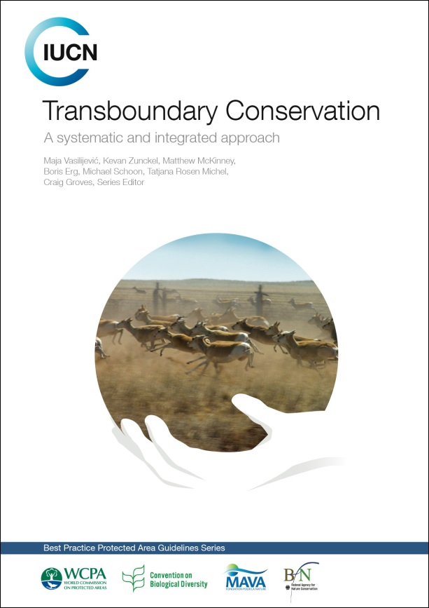
New BPG content
Revised definitions
Updated guidelines on TB initiatives establishment
Guidelines on management of TB initiatives
In-depth understanding of TB governance
Offer good practice examples (36 cases)
Practical advice for implementation in the field
X No TB database revision
Transboundary Conservation Specialist Group

Slide 3
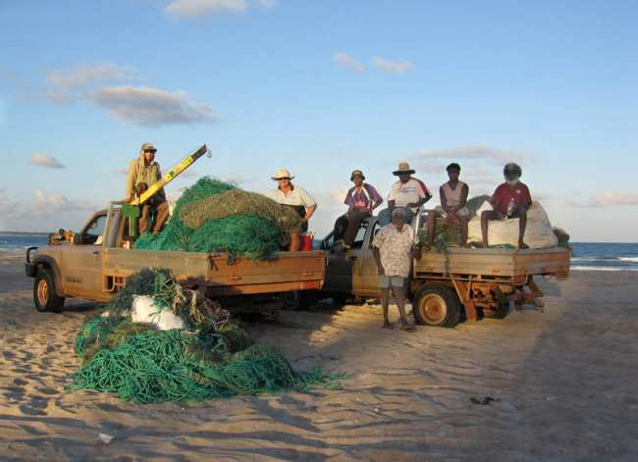
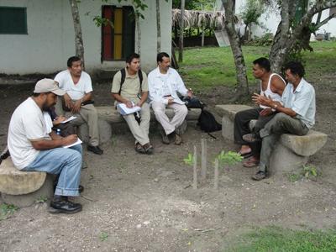
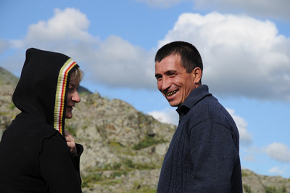
Audience
Senior administrators/system directors/planners
Chief park wardens/superintendents/PA managers
Rangers/field staff
Wider PA community/capacity development professionals
Transboundary Conservation Specialist Group

Slide 4
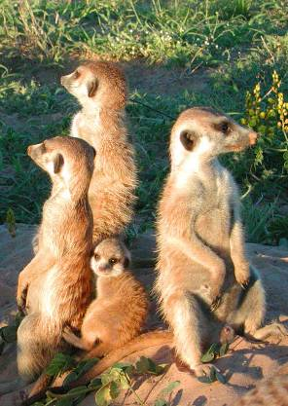
Typology of Transboundary Conservation Areas
Type 1:
Transboundary Protected Area
Type 2:
Transboundary Conservation Landscape and/or Seascape
Type 3:
Transboundary Migration Conservation Area
Special designation:
Park for Peace
Transboundary Conservation Specialist Group

Slide 5
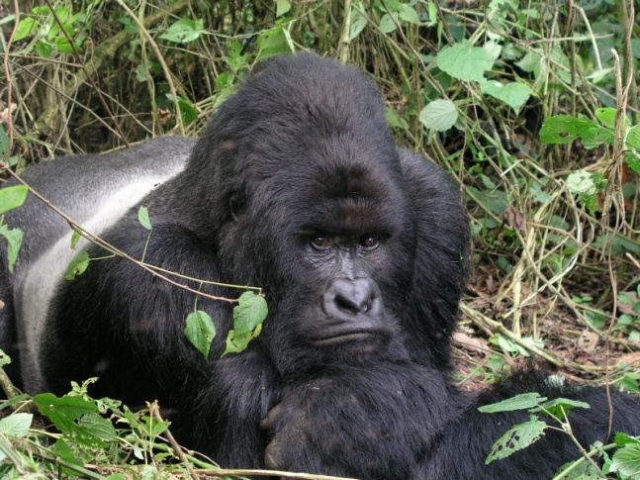
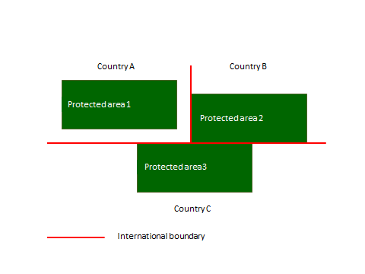
Definitions of TBCA types
A Transboundary Protected Area is a clearly defined geographical space that is comprised of protected areas* that are ecologically connected across one or more international boundaries and is under some form of cooperation.
*Dudley, 2008
Transboundary Conservation Specialist Group

Slide 6
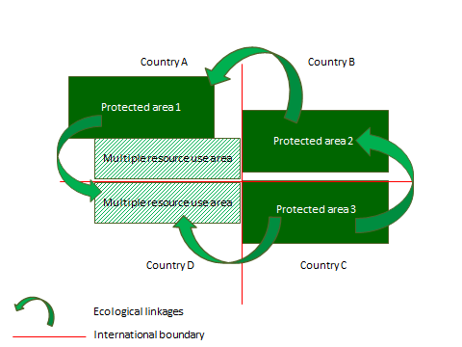
Definitions of TBCA types
A Transboundary Conservation Landscape and/or Seascape is an ecologically connected area that sustains ecological processes and crosses one or more international boundaries, and which includes protected areas as well as multiple resource use areas, and is under some form of cooperation.
Transboundary Conservation Specialist Group

Slide 7
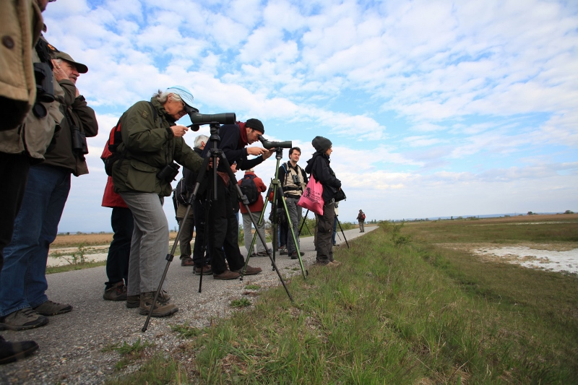
Definitions of TBCA types
Transboundary Migration
Conservation Areas are
wildlife habitats that are necessary
to sustain populations of
migratory species and
are under some form of cooperation.
Transboundary Conservation Specialist Group

Slide 8
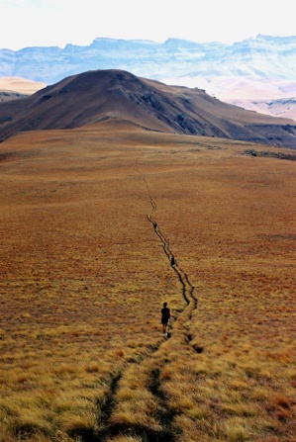
Definitions of TBCA types
A Park for Peace is a special designation that may be applied to any of the three types of Transboundary Conservation Areas and is dedicated to the promotion, celebration, and/or commemoration of peace and cooperation.
Transboundary Conservation Specialist Group

Slide 9
Models of cooperation in TBC
Model of cooperation | Example
Communication or Information sharing | Occasional or regular communication on actions, problems, opportunities or other relevant issues Sharing of information
Consultation | Seeking opinion, feedback or advice from each other Cooperative process with the aim to harmonize management
Coordinated action | Jointly coordinated management actions implemented within the sovereign areas of each party, that contribute to the conservation goals of the entire transboundary ecosystem, e.g. monitoring of species and ecological processes occurs as regular activity on the territory of each party, but the results contribute to conservation of species or ecosystems in the whole shared ecosystem This is a form of cooperative management
Joint implementation of decisions | Jointly coordinated and implemented management actions across the sovereignty boundaries, e.g. joint law enforcement patrols, joint fundraising and project implementation, the production of marketing material that profiles the TBCA as a single entity, etc. This is a form of cooperative management
Transboundary Conservation Specialist Group

Slide 10
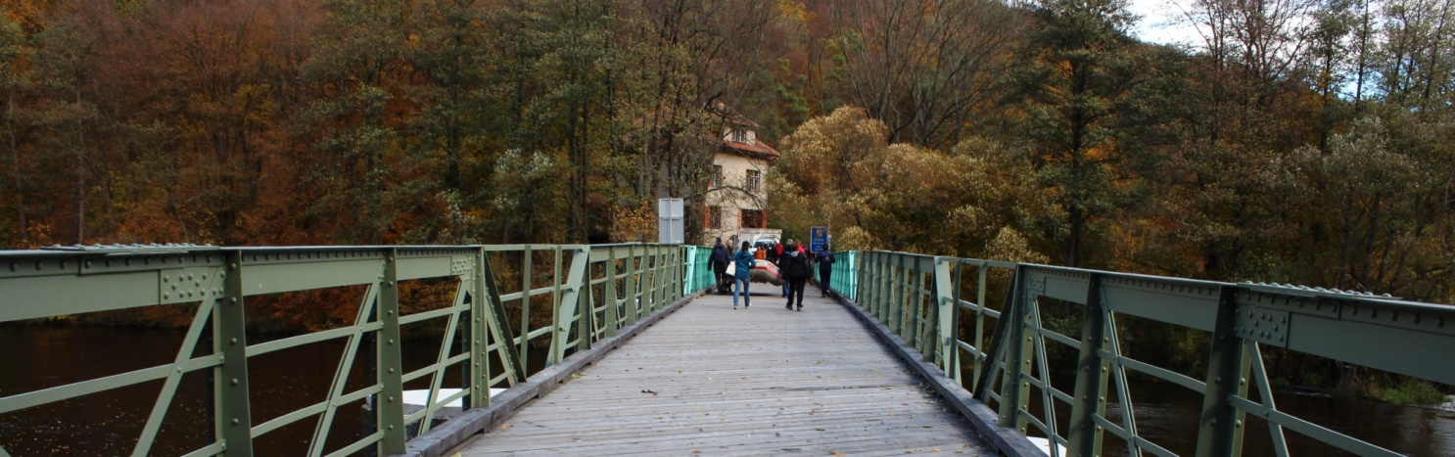
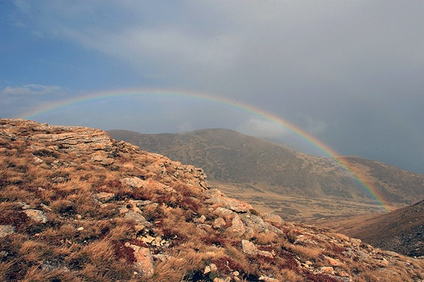
Making the case for transboundary
conservation
Ecological
Socio-economic
Cultural
Enhanced efficiency of day-to-day management of common issues
Harmonisation of legal and policy frameworks
Enhanced political relations and stability
Transboundary Conservation Specialist Group

Slide 11
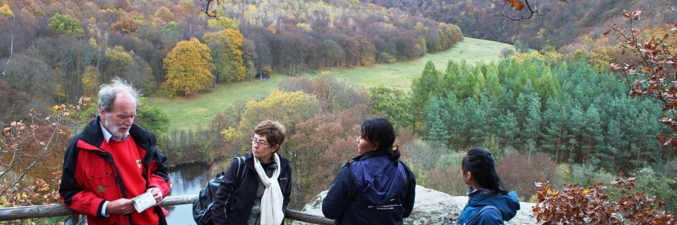
Transboundary governance
TBC reflects variations of shared governance involving multiple actors ranging from informal to formal arrangements
Unique circumstances will/need to dictate the model of governance that is appropriate
There are specific requirements that ensure good transboundary governance
Transboundary Conservation Specialist Group

Slide 12
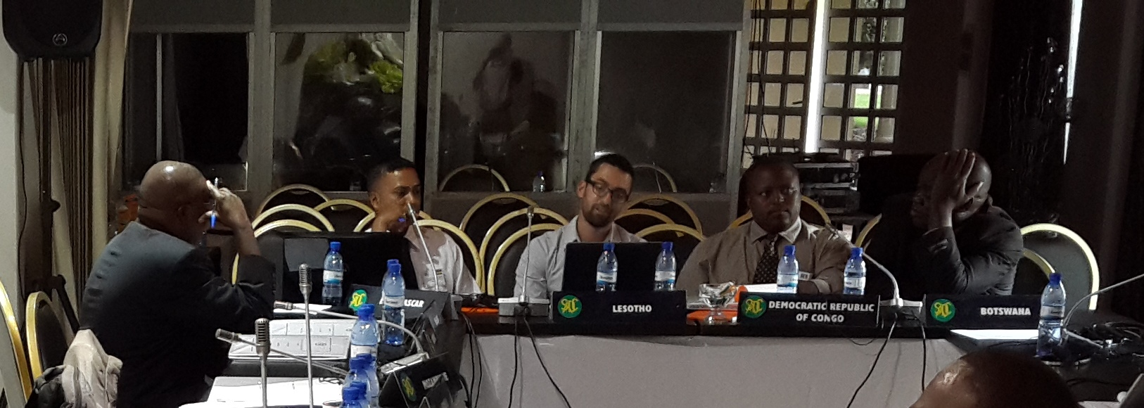
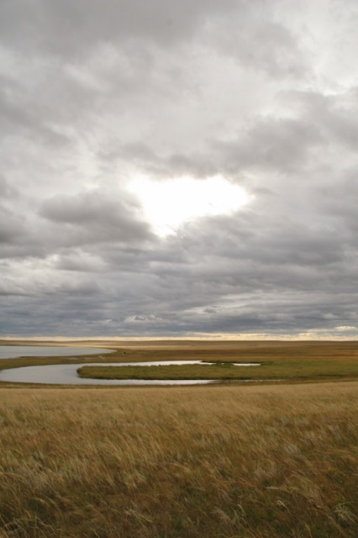
Planning and designing the TBC process
Assessing or scoping the enabling environment
Assessing feasibility
Designing the right process for implementation
Transboundary Conservation Specialist Group

Slide 13
The establishment and management of TBC initiatives
Securing political buy-in and building legitimacy
Positioning the initiative within the right legal and policy framework
Developing a shared understanding, common vision, and framework for cooperative management
Refining the cooperative management framework
Securing financial sustainability
Transboundary Conservation Specialist Group

Slide 14
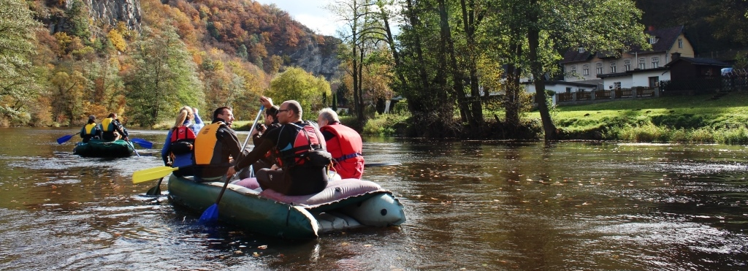
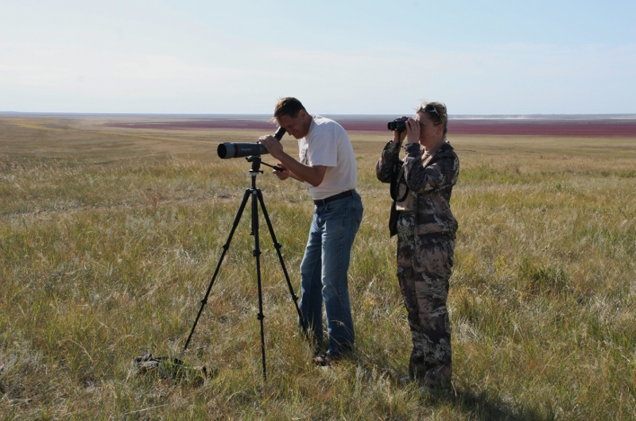
Monitoring and evaluation
Overview of the principles and processes associated with M&E in conservation
Assessment of management effectiveness of protected areas
Tools to measure/assess TBC performance
Transboundary Conservation Specialist Group

